Slide 1

ATAP’s AT3 Center Presents:
Aging PAL Session 4
April 8, 2026

Slide 2
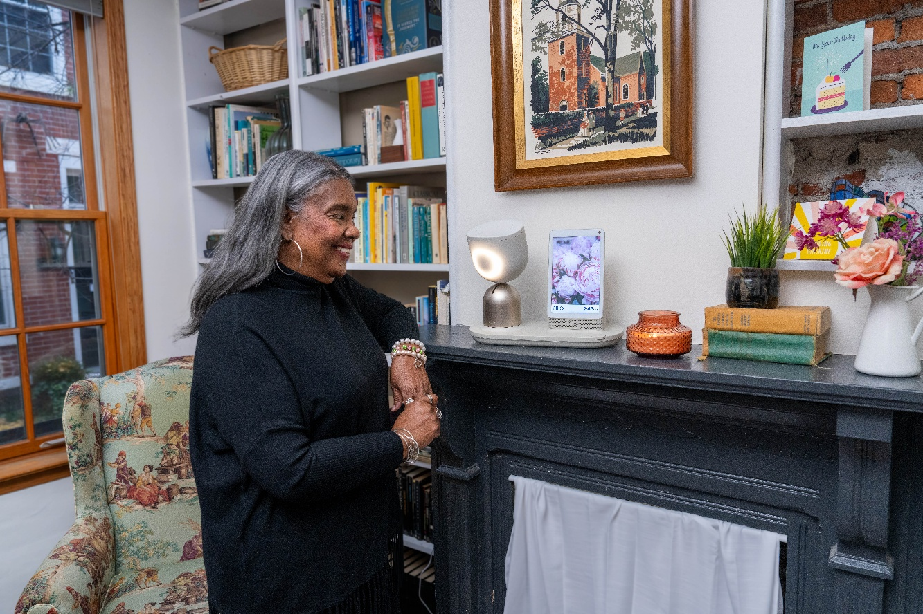
Assistive Technology in 2026
Nearly 40 Years of AT Evolution
Now AT is an ecosystem that supports functional capability across the lifespan
Yet misunderstandings persist
The reality: AT serves anyone navigating changes in vision, hearing, memory, mobility, fatigue, speech, or behavioral health (and more!), regardless of age and whether they identify as "disabled.“
The 21st Century AT Act (2022) anchors AT in lifespan access and cross-disability reach, defining both the technology and its beneficiary population in functional terms.

Slide 3
Legal Definition of AT
ASSISTIVE TECHNOLOGY—The term ‘assistive technology’ means technology designed to be utilized in an assistive technology device or assistive technology service.
  ASSISTIVE TECHNOLOGY DEVICE—means any item, piece of equipment, or product system, whether acquired commercially, modified, or customized, that is used to increase, maintain, or improve functional capabilities of individuals with disabilities.
  ASSISTIVE TECHNOLOGY SERVICE (abbreviated)—means "any service that directly assists an individual with a disability in the selection, acquisition, or use of an assistive technology device," encompassing evaluation, acquisition, customization, coordination with therapies and education plans, instruction for the individual and their support network, training for professionals and employers, and, critically, "expanding the availability of access to technology, including electronic and information technology, to individuals with disabilities" (clause G).

Slide 4
AT is…
defined by
what it does
in improving, maintaining, or increasing the functional capabilities of the person
VS
what the device is

Slide 5

The Assistive Technology Umbrella-1
The Legal definition of AT is inherently broad enough to include all of this technology AND MORE, including technology that has not been invented yet!!
Speech Communication such as dedicated speech generating devices, mainstream tech with apps, low tech picture boards, accessibility features and other access devices, etc.
Vision-magnifiers, mobile devices with apps, software, talking devices, large print keyboards, etc.
Hearing-amplified telephones, alerting systems, video communication with ASL, personal hearing systems, etc.
Home Modifications-ramps, grab bars, walk-in showers, etc.
Environmental Controls-smart home devices (i.e. smart speakers, sensors, smart plugs, cameras, thermostats, door openers, TV controls, smart deadbolts, remote shades, etc.), built-in accessibility features, and other access devices, etc.
Communications Technology-telehealth, remote monitoring, care companions, social isolation, built-in accessibility features, mounts and access devices for mobile phones for communication, as well as the connectivity to run the devices, and more.

Slide 6

The Assistive Technology Umbrella-2
The Legal definition of AT is inherently broad enough to include all of this technology AND MORE, including technology that has not been invented yet!!
Learning, Cognitive, Developmental, Behavior Health Technology-wandering tech (i.e. GPS, alarms systems (analog/smart)), mobile devices and apps (i.e. scan & read),wearables, software, educational tools, memory devices and reminder systems (i.e. medication management systems-analog/smart), robotic pets, etc.
Daily Living Technology-PERS and fall detection systems, medication management systems (analog/smart),smart devices for living (i.e. wearables, toothbrushes), tech for eating, toileting, dressing, robotics, etc.
Vehicle Modifications & Transportation Tech-ramps, driving controls, seat assist, etc.
Recreation, Sports and Leisure Tech-adapted gaming tech, gardening tools, etc.
Mobility, Seating, and Positioning- wheelchairs, exoskeletons, access controls, Durable Medical Equipment, etc.
Computers and Related-includes mainstream tech such as computers, tablets and other mobile devices, software, all access methods (i.e. mouth joystick, eye-gaze, onscreen keyboards),
and More!!!
NOTE: Assistive technology wears many hats; a single device often fits into several different categories depending on how it's used.

Slide 7
Who is Assistive Technology For?
People with Disabilities
Older adults and those Aging into Disability
  "Underrepresented population" to include "older individuals" and "youth with disabilities aging into adulthood.“
  To "increase access to and acquisition of assistive technology addressing the needs of aging individuals and aging caregivers in the community.“
  Requires State AT programs to collaborate with the State agency under the Older Americans Act
Temporary, Intermittent, and Progressive Conditions
People Who Do Not Yet Identify as Disabled
Support Networks
  AT services include instruction for family members, guardians, and advocates, and for professionals, employers, and others substantially involved in the major life functions of individuals with disabilities .

Slide 8
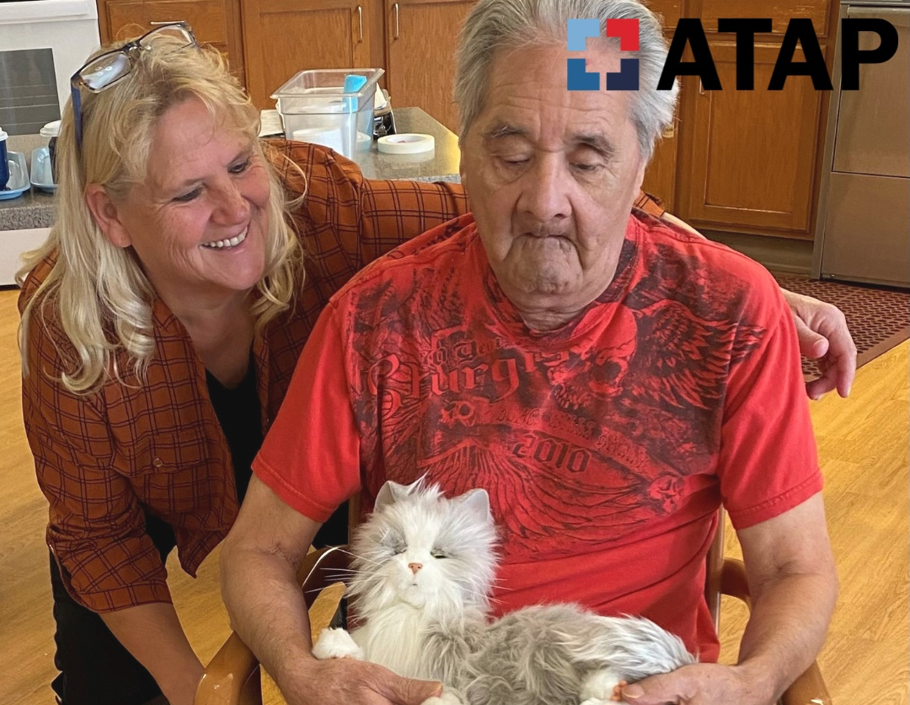
What Can We Achieve Together?
Every person on the planet will either need assistive technology for themselves or they will know someone who needs it. The trick is to build AT awareness, so everyone knows about it before they need it, and NO ONE goes without!
This requires a collective effort from all of us who are already familiar with these
life-changing solutions!
From North Dakota Assistive

Slide 9
Discover your local AT Act Program.
Every state. Every territory. Every person.

