Slide 1
Teeth for a Life-Time: AT for Oral Health October 7, 2025
Ellen Sugrue Hyman
Attorney at Law
and
Health Care
Advocate

Slide 2
What do people need to maintain their teeth for a lifetime?
Daily oral health care
Brushing and flossing
Fluoride
Preventative care
Early detection of decay/minimally invasive care
Restorative care

Slide 3
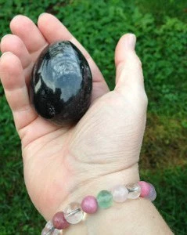
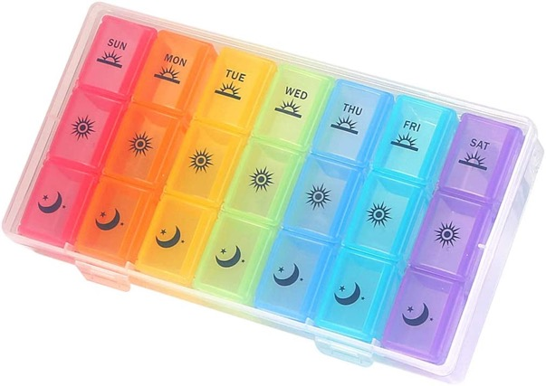
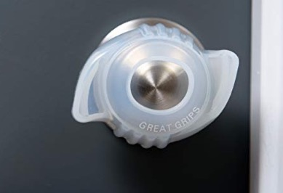
What is AT?
Assistive Technology (AT) is any item, piece of equipment, software, or app that is used to help people with disabilities, including older adults, do what they want to do.
Technology can make things easier for everyone. For people with disabilities, AT opens up possibilities.

Slide 4

Michigan Assistive Technology Program
Access to AT information and services in Michigan
Federally funded through the AT Act with money that flows through MRS
By people with disabilities, for people with disabilities
Demonstrations, loans of devices, trainings, and more
Lending library of more than 1800
Devices across all disabilities and ages
Request a demo or loan of devices
800-578-0280
MI-AT.org choose the Assistive Technology tab if there is that option

Slide 5

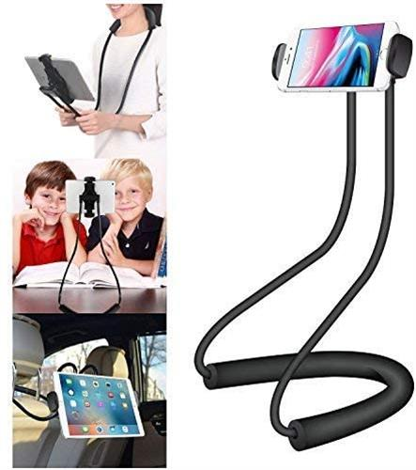
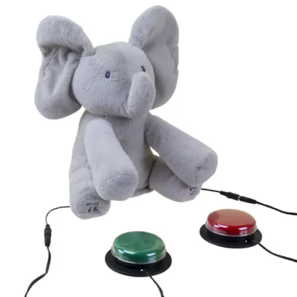
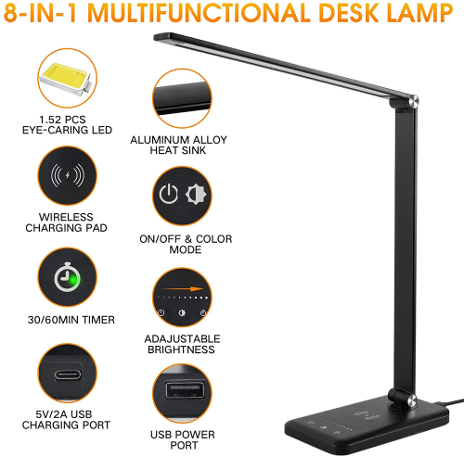
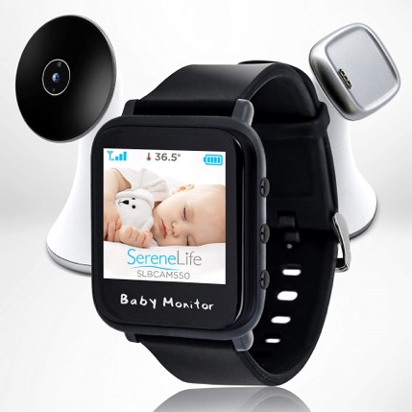
MATP Lending Library
More than 1,800 devices

Slide 6
Resources
Michigan AT Loan Fund
MI-UCP.org
800-827-4843
To Learn more or test out the items presented request a demonstration:
AT@MI-AT.org
800-578-0280
MI-AT.org

Slide 7
Resources for AT Learning
MATP—email/newsletter list, social media, TechTuesday Trainings
ExploreAT.net
JAN (Job Accommodation Network)
Unified Listing (ul.gpii.net)
Assistive Technology Industry Association https://www.atia.org/
Notes:
Explore AT.net is a resource from the AT3Center with links and information by disability type (hearing, speech, vision, learning) and also AT use area (daily living, recreation, environmental adaptation, vehicle modification) there are links to techTip videos, and suggestions of AT types along with case studies.
JAN lists AT and accommodation options by disability type, work function type, or type of limitations
Unified Listing brings together 14 different databases from Europe, US, and Australia to list devices and using the powersearch, you can search for devices by limitations and product type and select for operating system if that is relevant. Their limitation types include hearing, planning, seeing, reading, understanding, holding, input, and other and have subsets for each.

Slide 8
From Childhood to Old Age—Poor Oral Health
Older Adults
10 percent of adults 18 to 64 have lots 6 or more teeth
Nearly 13 percent of seniors over 64 have lost all of their teeth
Nearly half (47%) of adults suffer from some form of periodontal disease
Children
50 percent of elementary children have tooth decay
90 percent of young adults have tooth decay
Tooth Decay is the most common chronic childhood disease
https://www.americashealthrankings.org/explore/measures/teeth_extractions_sr/MI
https://www.michigan.gov/mdhhs/keep-mi-healthy/communicablediseases/epidemiology/chronicepi/bfrs

Slide 9
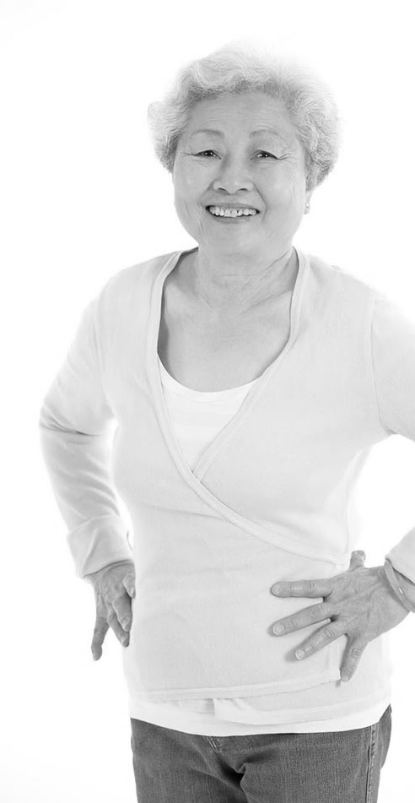
What are the impacts of poor oral health?
Difficulty eating healthy food
Pain/discomfort
Abscess/infection
Heart disease
Diabetes
Oral cancer
(https://www.washingtonpost.com/health/2024/02/17/throat-neck-bleeding-medical-mysteries/)

Slide 10
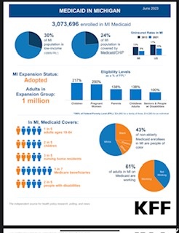
Dental Insurance in Michigan
Quick facts MI Census (2020): 10,077,331 US Dental Insurance Coverage: 50 % (Private) 30% (Medicaid) 20 % (No Insurance)
No Dental Insurance in Medicare That translates to over 2 million uninsured Michiganders This is a treatment vs. prevention model of care for 20 percent of Michiganders
https://files.kff.org/attachment/fact-sheet-medicaid-state-MI
Notes:
What insurance covers dental care for seniors
Medicare—No
Medicare Advantage/Medigap—Maybe
Medicaid—Yes (In Michigan)
Rate increases
Service array expansion (what is covered)
About a quarter of people in Michigan have no insurance

Slide 11
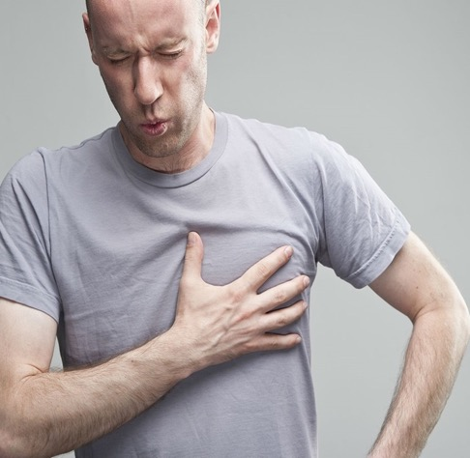
Heart Disease and Oral Health
Heart disease is the leading cause of death in MI
Every year, more than 25,000 Michiganders die of Heart Disease
29% of adult Michiganders have High Blood Pressure (a precursor to Heart Disease)
In US, Heart Disease costs $214 billion in medical care every year and results in $138 billion in lost productivity
There is a correlation between gum disease and oral health

Slide 12
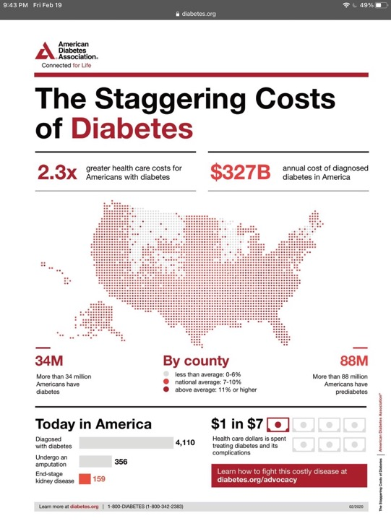
Diabetes and Oral Health
Almost 11% of Michiganders have diabetes (1 million people)
Over 15 % of Black or Latinx Michiganders have diabetes
$327 Billion Annual Cost of Diagnosed Diabetes in US
$237 Billion in Medical Costs
$90 Billion Lost Productivity
Strong correlation between oral health and diabetes management

Slide 13
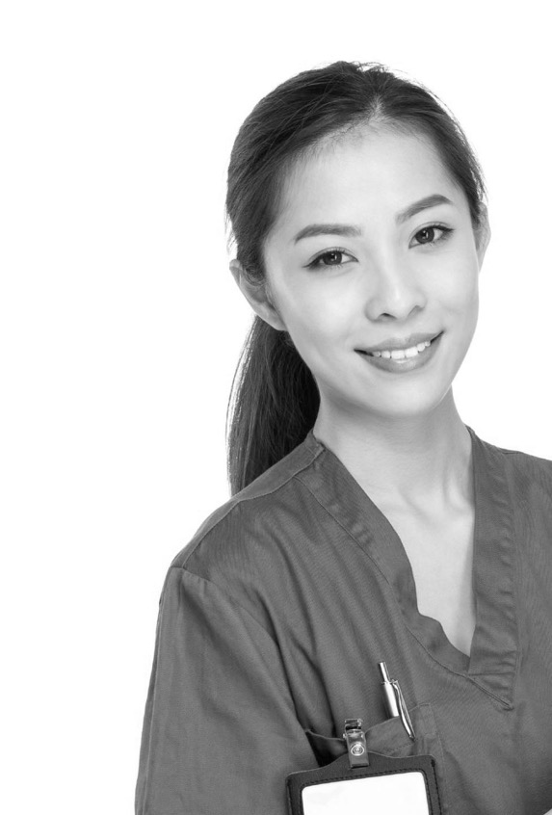
How Dental Providers Can Impact Overall Health?
Dental professionals can:
Provide dental exams, cleanings and treatment that eliminate bacteria in the mouth
Measure blood pressure
Perform an oral cancer screening
Identify and provide advice on known risk factors, such as smoking and diet
Coordinate care with and referring to primary care and specialty care
Educate patients on proper daily oral health care
Diagnose and treat gum disease

Slide 14
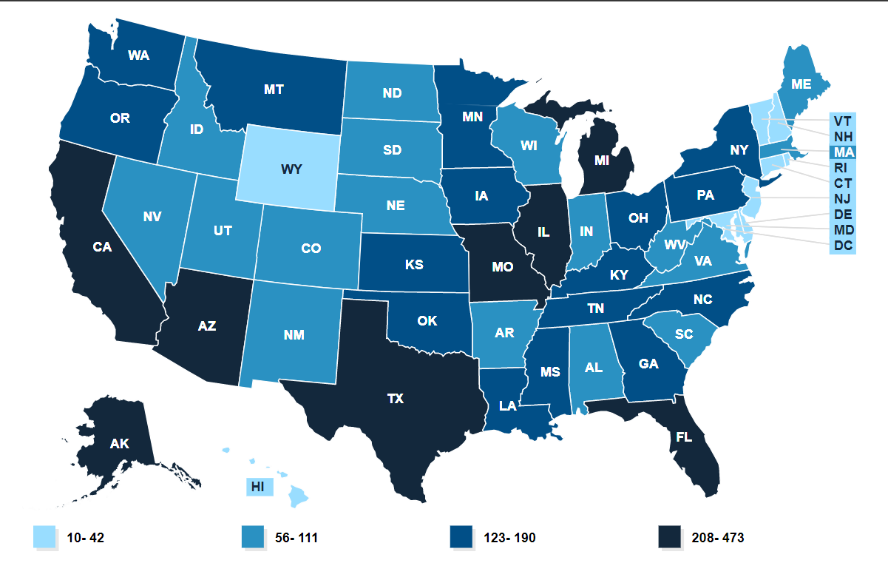
Dental Health Provider Shortage Areas
Michigan has the 6th most dental HPSA locations in the U.S
1.5 million Michigan residents living in dental HPSA
1 dental provider can serve 5,000 people
Michigan needs 286 additional providers in shortage areas
People with disabilities have the hardest time finding a dental provider.
https://data.hrsa.gov/topics/health-workforce/shortage-areas
Notes:
HPSA: 5,000 people or more to every one dentist
MI has the 6th most dental HPSAs in the country
Importantly, our state dentist to population ratio is 31st from the bottom. This means that we don’t have a dire shortage of dentists in Michigan, just a dire number communities where they are not practicing.
77 of our 83 counties contain a HPSA
According to the Kaiser Family Foundation, only 26% of Michigan’s oral health needs are being met and we would need 286 providers added to HPSA areas to remove all of them.
We are also seeing a lot of burnout causing a serious shortage of dental hygienists and dental assistants in the field, and it is particularly urgent in public health.
According to the CDC, Oral health across the U.S. has improved overall since the 1960s, but oral health disparities have actually worsened for some racial/ethnic and socioeconomic groups. We’re going in a direction that is the opposite of oral health equity, and the dental field really needs to take a hard look at why 74% of our population is not well-served by the care we’re providing.
26% of needs being met- need 286 additional providers
in shortage areas
Burnout among dentists, hygienists, and assistants
U.S. oral health has improved overall, but disparities are worse

Slide 15

New Medicaid Preventative Dental Benefits
Topical Application of Fluoride
Topical application of fluoride (fluoride foam/gel, varnish) is covered for ages 6-21 twice per year
Not Available for Adults 22+ yet
Sealants
Sealant expansion coverage is for ALL beneficiaries for the prevention of pit and fissure caries. Coverage includes:
first and second primary molars,
first and second permanent molars
first and second permanent premolars
Notes:
Prior to April 1:
Sealants were covered on first and second permanent molars (2, 3, 14, 15, 18, 19, 30, 31) for beneficiaries under 21.

Slide 16
Restorative Care Services Added to Medicaid
Root Canal Treatment
Root canal treatment is a benefit for ALL beneficiaries
Crowns
Laboratory processed cast restorations (crowns) and associated procedures are covered for ALL beneficiaries
Coverage is limited to full metal crowns on first and second permanent molars
Porcelain and porcelain fused to metal crowns are limited to permanent first and second premolars, canines and incisors
Prior to this service expansion, the only option for individuals with Medicaid coverage was extraction
Notes:
PA is not required.
Prior to April 1:
Limited crown coverage was a covered benefit for beneficiaries under age 21.
Restorative root canal treatment was not previously covered for adults 21 and over.

Slide 17
Barriers to Care for People with Disabilities
Restorative care does not last forever
Lack of dental insurance/cost
Find a dental provider
Limited ability to do oral health care themselves
For some people, difficulty communicating dental pain

Slide 18
Oral Health Care
The most important oral health care is the daily care done at home
Tips for daily care
Brushing
Flossing
Mouthwash
There are lots of AT options to help with daily care

Slide 19
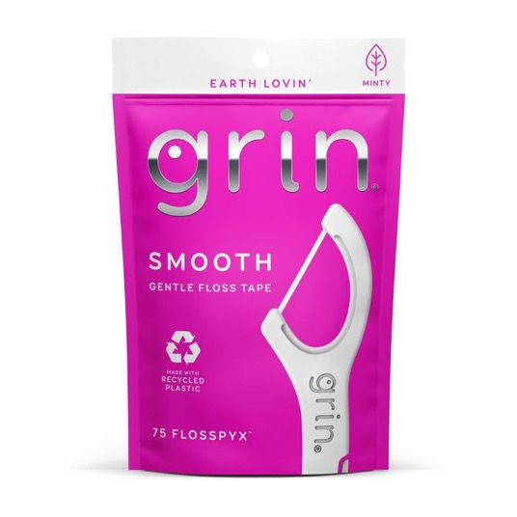
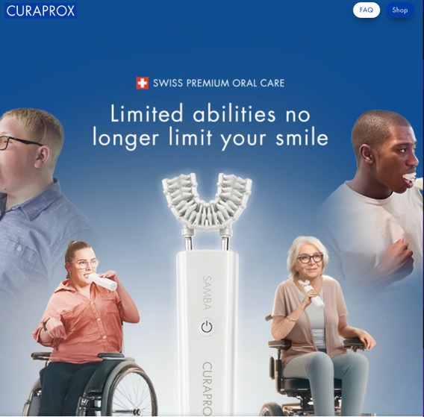
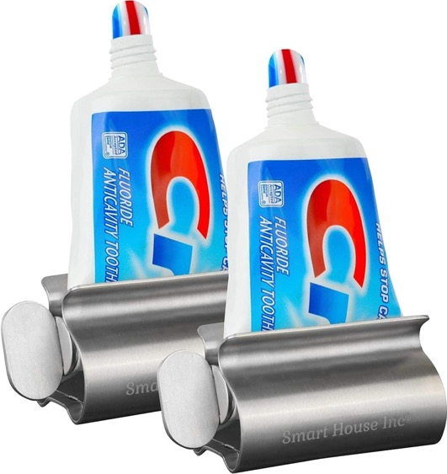
Oral Health Care AT
Lots of Options for Assistive Technology
Any electric toothbrush brush will do a better job than a manual toothbrush
Important to find an option for flossing

Slide 20

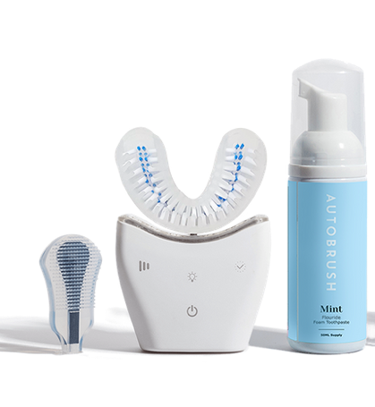
Automatic Toothbrushes
Curaprox Samba
Https://www.youtube.com/watch?v=DaGeYWmoeiQ
Autobrush

Slide 21

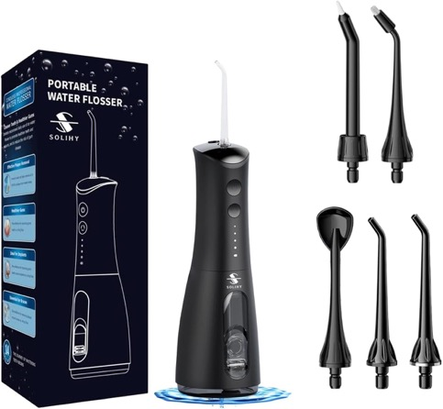
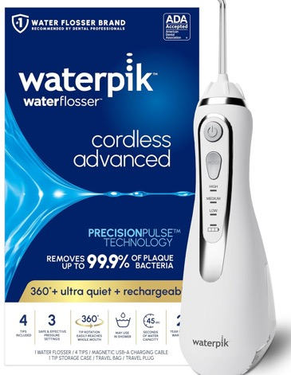
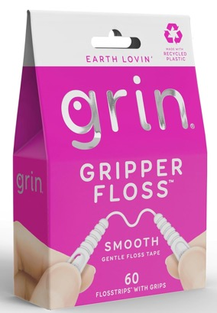
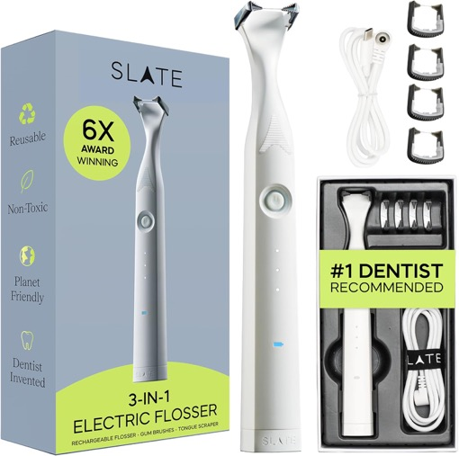
Water Flossers and Flosser Pics

Slide 22
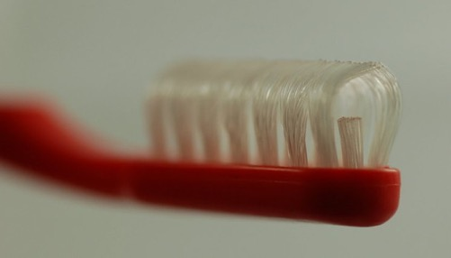
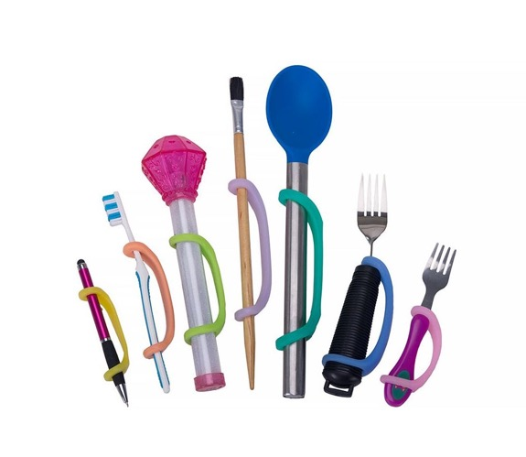
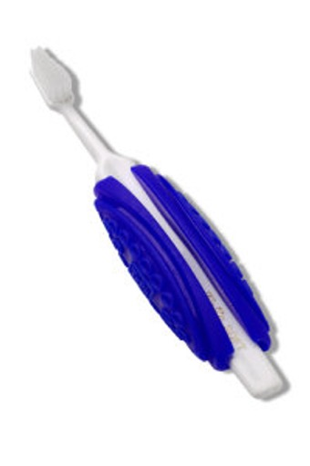
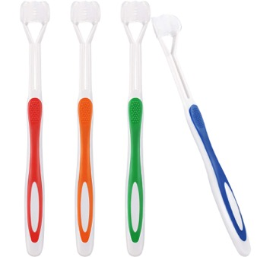
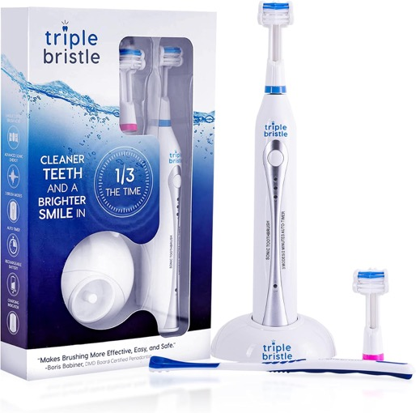
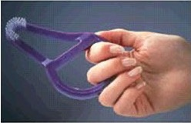
Toothbrushes & Grips

Slide 23
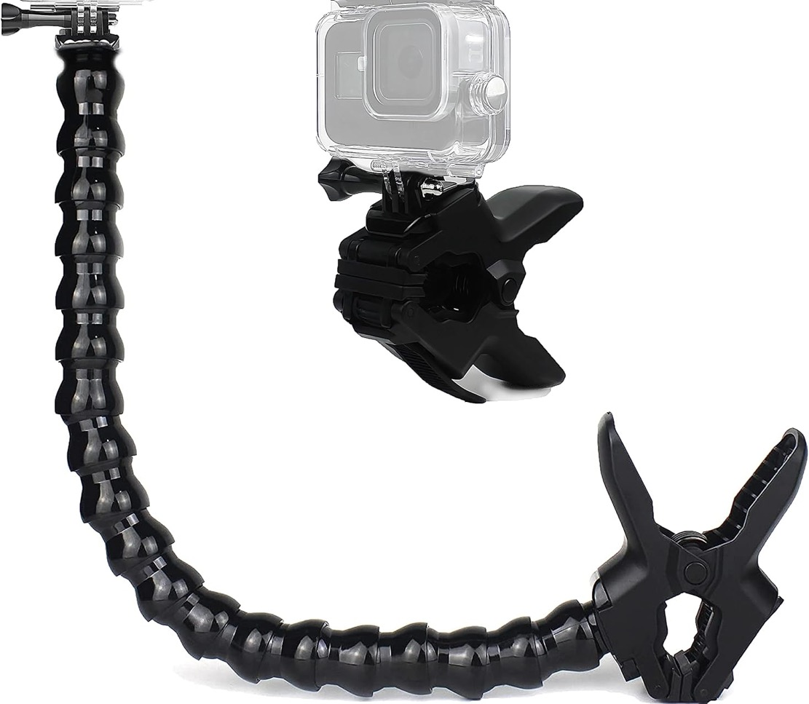
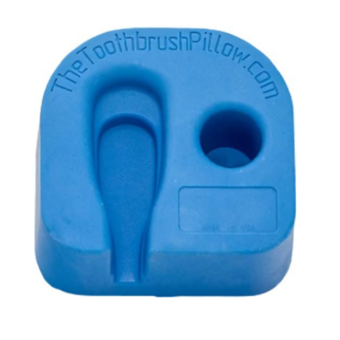
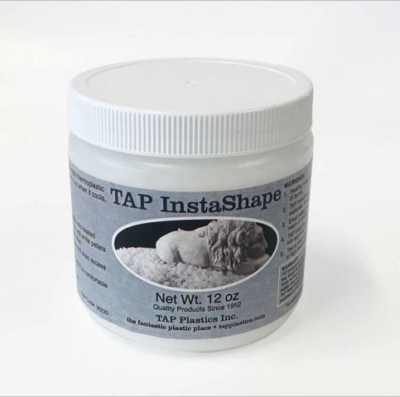
Holders

Slide 24

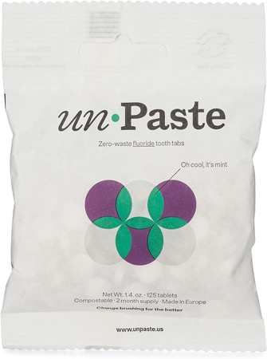

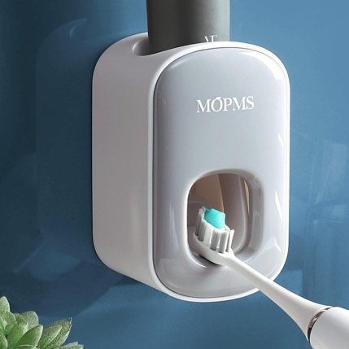
Toothpaste and dispensers

Slide 25
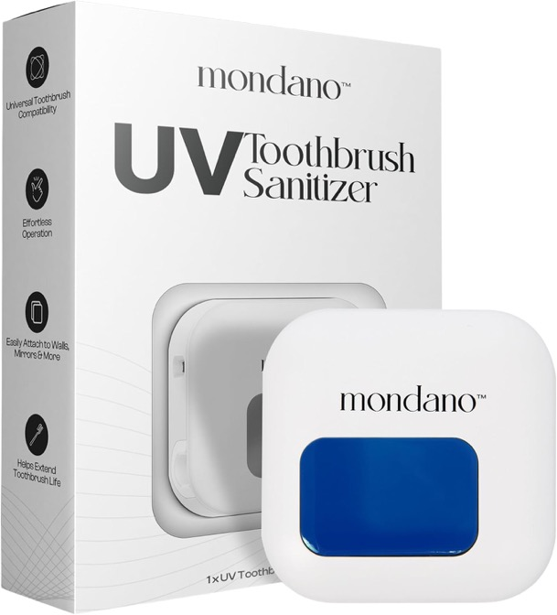
Toothbrush Cleaners
There is are devices to clean and sanitize your toothbrush.
Mondano

Slide 26
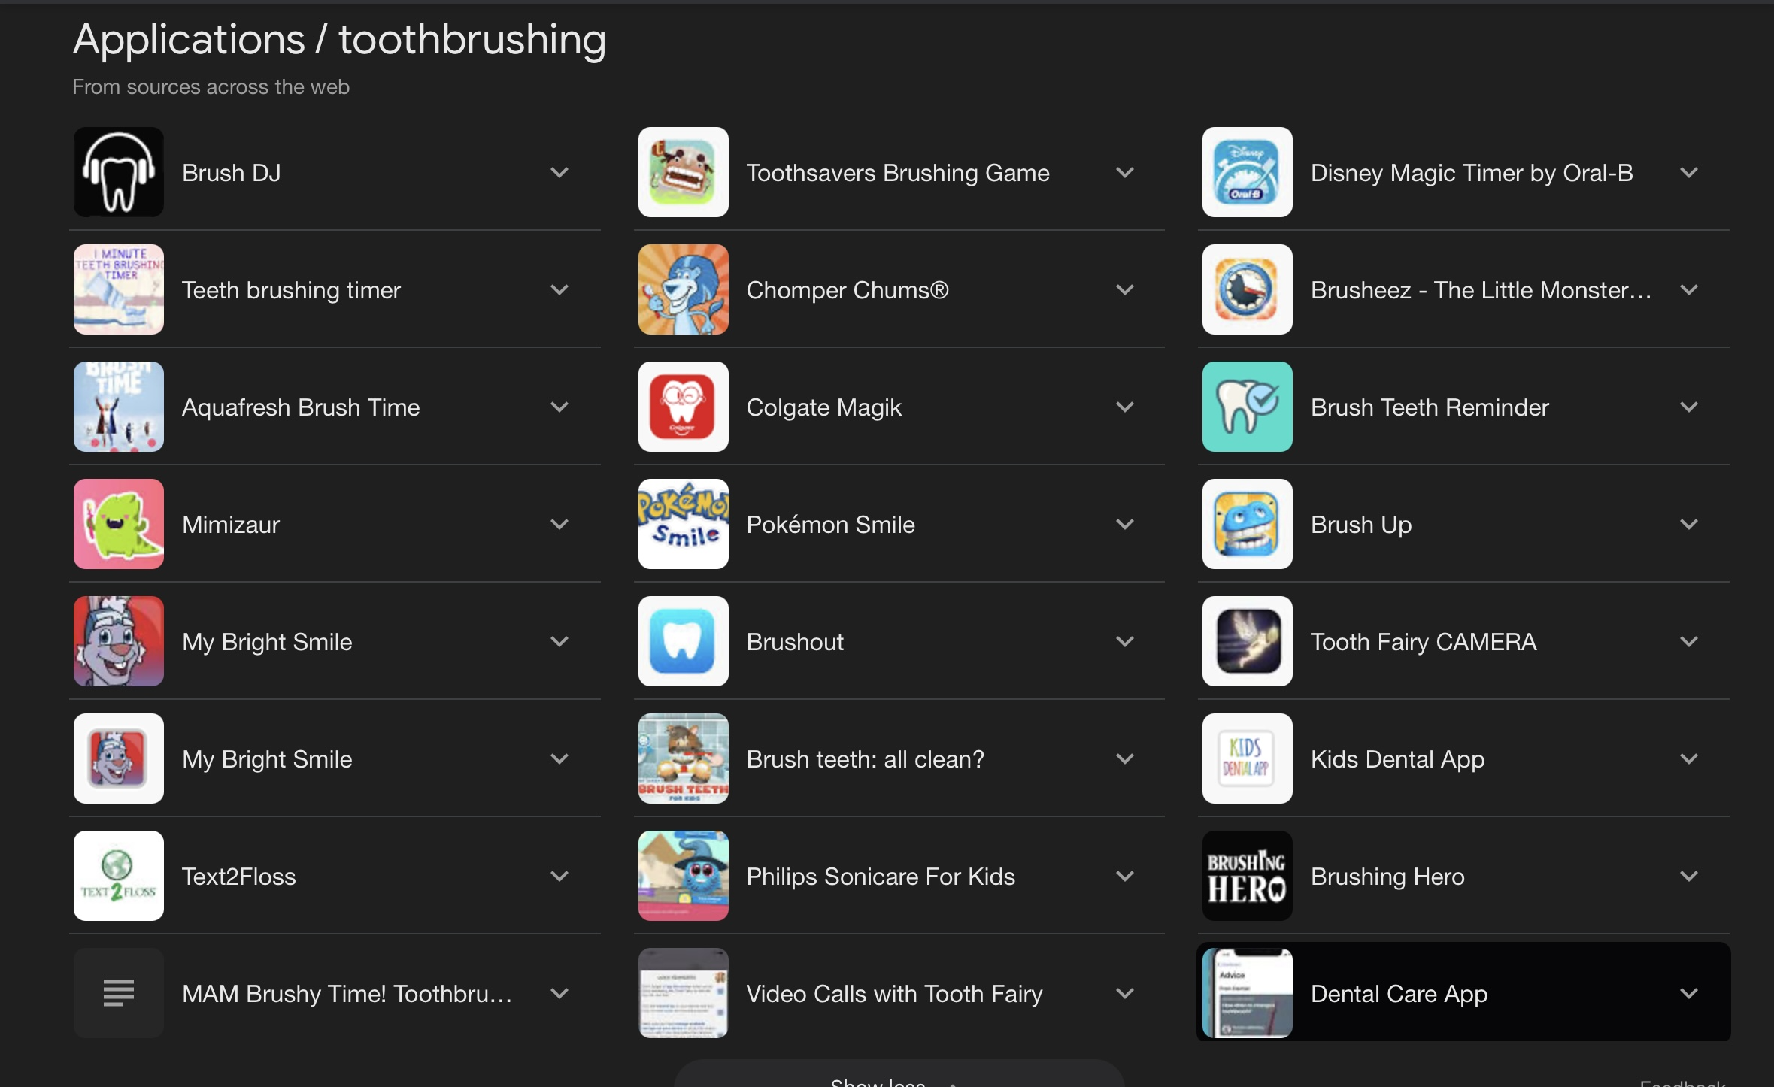
Apps for Phones and Tablets

Slide 27
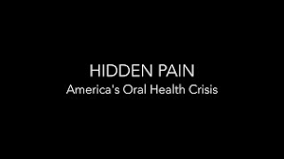
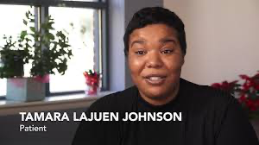
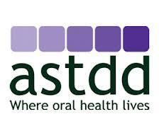
Questions and Resources
Hidden Pain movie:
MDHHS Oral Health Section
ASTDD Oral Health Portal
ASTDD Healthy Aging Resources

Slide 28

Questions
Ellen Sugrue Hyman
ellensh@comcast.net

