Slide 1

Increasing Access to AT through Digital Fabrication
Erin Higgins
erinh2@umbc.edu
erinlhiggins.github.io
Notes:
Hi everyone. Thanks for the intro and for having me to campus, I’m here today talk about my accessibility research which is focused on increasing access to AT through digital fabrication.

Slide 2


Background
2017: University of Pittsburgh - B. Eng Computer Engineering
2021: University of Pittsburgh - Master’s Rehabilitation Science
Currently: University of Maryland, Baltimore County - PhD Human-Centered Computing
Notes:
Quick background before I get into it, so I did my undergrad at Pitt in computer engineering where I did research into the reliability of emerging memory frame works. I worked as a software engineer for a little bit. Then did my master’s in rehab science at Pitt where I did a lot of different research into prosthetics, some brain computer interface stuff, tech transfer of NIDILRR grants, lots of stuff, and then I finally found HCI where I could kind of combine a lot of these interests.

Slide 3
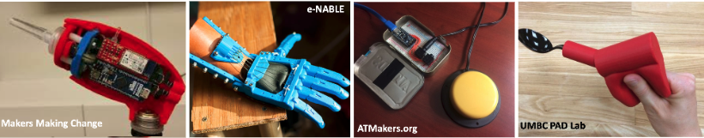
Introduction
There is a long history of utilizing digital fabrication tools to create custom DIY-AT¹
While research has shown it is successful, there are many barriers regarding accessible design tools and effective communication between experts²
Manoff, 2019; Buehler, 2015; McDonald, 2016; Higgins, 2022; Hamidi, 2015, 2019; Hook, 2014; Hofmann 2019, 2021; Lakshmi, 2019; Savage, 2022
Lakshmi, 2019; Savage, 2022; Hofmann, 2021; Mankoff, 2019, Higgins, 2022; Hurst, 2013; Buehler, 2015
Notes:
So just a little bit of background, there is a long history of utilizing digital fabrication tools to create custom DIY-AT. I have some pictures here of various maker organizations that create digitally fabricated AT for inWhile research has shown that it is useful and successful, there are many barriers regarding accessible design tools and effective communication between experts within ecosystems of DIY-AT making. So I was interested in that and have done a few studies looking into these collaborations and how we can support DIY-AT at scale.

Slide 4




Government
“An Ecosystem of Support: A U.S. State Government-supported DIY-AT Program for Residents with Disabilities” ASSETS 2024.
University
“Towards a Social Justice Aligned Makerspace: Co-designing Custom AT within a University Ecosystem” ASSETS 2023.
Community
“Creating 3D Printed Assistive Technology Through Design Shortcuts: Leveraging Digital Fabrication Services to Incorporate 3D Printing into the Physical Therapy Classroom” ASSETS 2022.
Notes:
So over the past 3 years, I’ve kind of taken three different levels of a look at this problem.

Slide 5
Community
“Creating 3D Printed Assistive Technology Through Design Shortcuts: Leveraging Digital Fabrication Services to Incorporate 3D Printing into the Physical Therapy Classroom” ASSETS 2022.
Notes:
So we first looked into creating 3d printed AT through design shortcuts by leveraging digital fabrication services and incorporating 3d printing in to the physical therapy classroom - this was a collaboration with some collegues at NYU, the university of marlyand baltimore (where our PTs are) and our lab. And this was focused at the community level and focused on functionality and from the medical context.

Slide 6
Educational Series Design
Phase 1: Building foundational skills with simulated end users
  Introduction to 3D printers and example ideas
  Imaginary case designs
  Order forms to communicate with makers
Phase 2: Designing with real end users
  Volunteers who developed ideas with the students
  Sketches, clay, and measurements were used to model
Notes:
So this paper was all about introducing digital fabrication as an option to PT students. Our educational design series included two phases. Phase One was used to build foundational skills with simulated end users. The initial class sessions (sessions 1-4) were embedded into a PT course. During the first class, PT students were introduced to 3D printing concepts and an exercise to get them thinking about what is possible to create through 3D printing. We then moved on to designing for imaginary users, where they developed their DIY-AT ideas based off of scenarios created for them by their professor. Finally, they used order forms to communicate with the makers what should be printed. The order forms included spaces for sketches as well as measurements, and they were also able to use clay for modeling.
Phase Two was conducted in the following semester with the same group of students. This time they developed DIY-AT for real end users who were volunteers. It was a similar process to Phase One, but the end user was the one who came up with a design idea working together with the PT student. Communication with the end users was entirety synchronous and in person. Communication with the makers was entirely asynchronous and through forms and email.

Slide 7
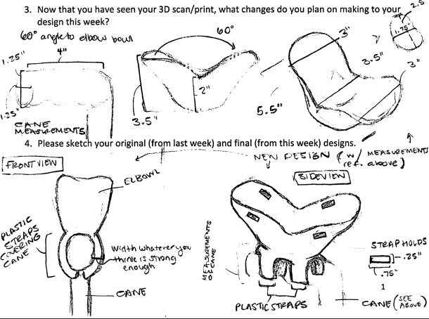
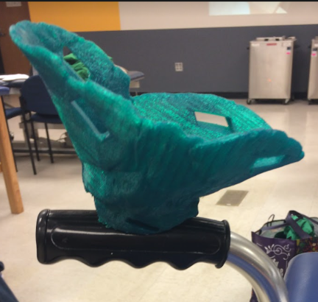
Findings – Device Outcomes
  17 “successfully” printed items
    5 simulated, 12 real end users
Notes:
So this process was shown to be able to successfully print 3D products, and 17 products were printed. As shown on this slide, the sketching skills of the PT students were incredibly helpful in creating the end product. This slide shows an image of a PT student sketch of an elbow bowl from multiple angles, including detailed measurements. The sketch itself is very detailed as well and illustrates the different angles of the object well. It then shows the end product of that sketch, which is a green elbow bowl sitting on top of a handle that looks very similar to the device in the sketch. This device would allow the user to rest their elbow in it in order to use a cane instead of the traditional handle due to limited wrist flexibility.

Slide 8
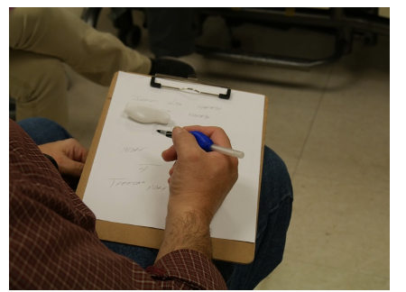
Findings – Stakeholder Collaboration
  Working with real end users was more impactful and helped PT students understand what was reasonable for digital fabrication
  Communication breakdowns with makers occurred when the makers didn’t understand the measurements provided or the PT students didn’t understand material selection
Notes:
The findings pointed towards the importance of collaboration. PT students stated that working with real end users was much more impactful and helped them to understand what was reasonable for digital fabrication. The study began to uncover what modeling tools were best - sketching, clay modeling, or a combination of the two - and what some of the pitfalls and advantages were to each modeling type in different situations.
An example of a successful print is shown on the right hand side of this slide. This was a custom Pen grip created with clay modeling and then scanned for printing that helped the end user to feel less fatigued with writing. In the image, they are shown using the Pen Grip to write on a clipboard. The size and scope of this end product as well as the use of clay for modeling it were very appropriate for digital fabrication and the end user was very satisfied with their product.
There were communication breakdowns, however, between makers and PT students when sketches or measurements were not precise enough, there was a misunderstanding of the material, or the wrong modeling method was chosen.

Slide 9
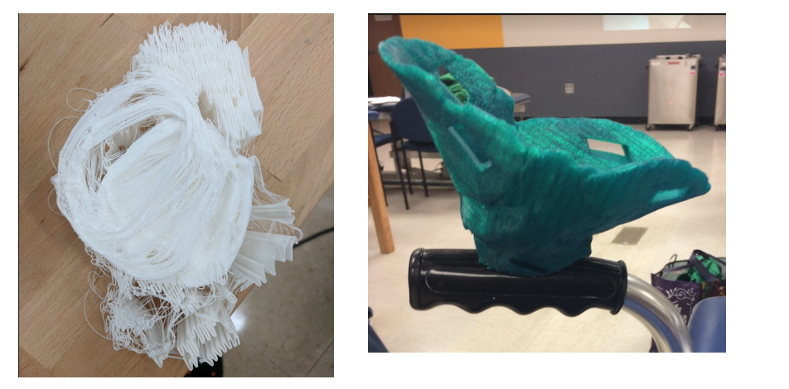
Findings – Tensions between the design process and clinical structures
Iteration required created tension with the clinical process and availability of end users
Products that were small with limited liability concerns were the most successful
Most students and end users would pay market rate for the products and wait a long time for them to be completed:
“It could change our patients’ lives. She said within minutes that the stretch felt ‘so good’. That is invaluable”
Notes:
One of the biggest tensions identified was between the design process and clinical structures. Iteration is required to develop products, but it's difficult to get users back for repeat visits. Products that were small and had limited liability issues, like the Pen Grip, were the most successful prints. As shown on this slide, in the images, material misunderstandings could lead to failed prints that would require iteration.
In the left hand side of the image, we see a pile of what looks like string. This was actually the PT students wanting to use cheetah filament printing for a more flexible end product, which failed. As shown in the right image, they eventually ended up with a successfully printed elbow bowl as described previously.
This iteration, while expected in engineering, was frustrating for the PT students. Most stakeholders, however, saw the value of the process, stating that they would pay whatever cost and wait any length of time if they could get a highly customized item, with one student stating, "It could change our patients lives. She said within minutes that the stretch felt so good. That is invaluable."

Slide 10
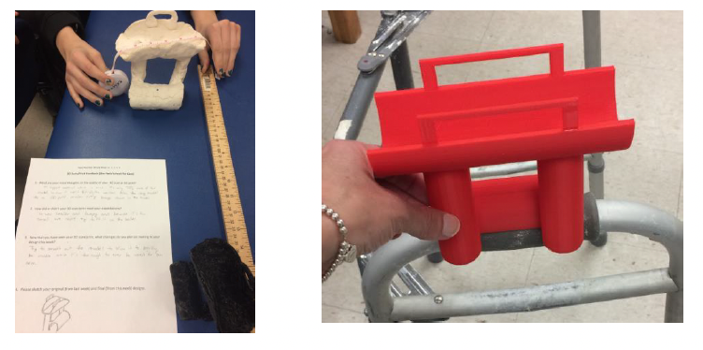
Findings - Iteration leads to multiple communication tools
Difficult to deal with failures and iteration in the medical context
Molded clay would deform and not scan well but it could be used to generate more precise measurements to send makers
Developed a better understanding of appropriate use cases, and materials
Notes:
Iterations, thought it could be frustrating, sometimes helped the PTs to learn! On this slide there are two images on the right hand side, in the first image, we can see in the foreground, a form with a sketch of a device on it. The device is a forearm holder that a user can place their arm in that can be attached to a walker for easier pushing. In that image, you can also see in the background a clay mold of that sketch. This clay mold, because of the heaviness of the item, easily deformed. This made it impossible to scan and print. However, as seen in the image, they were able to use it to get precise measurements that were sent to the makers which allowed them to print in the second image which is the forearm device on top of a walker. Going through this process, while it could be a burden, helped the PT students to better understand appropriate use cases for this sort of fabrication and best materials for printing and communicating.

Slide 11
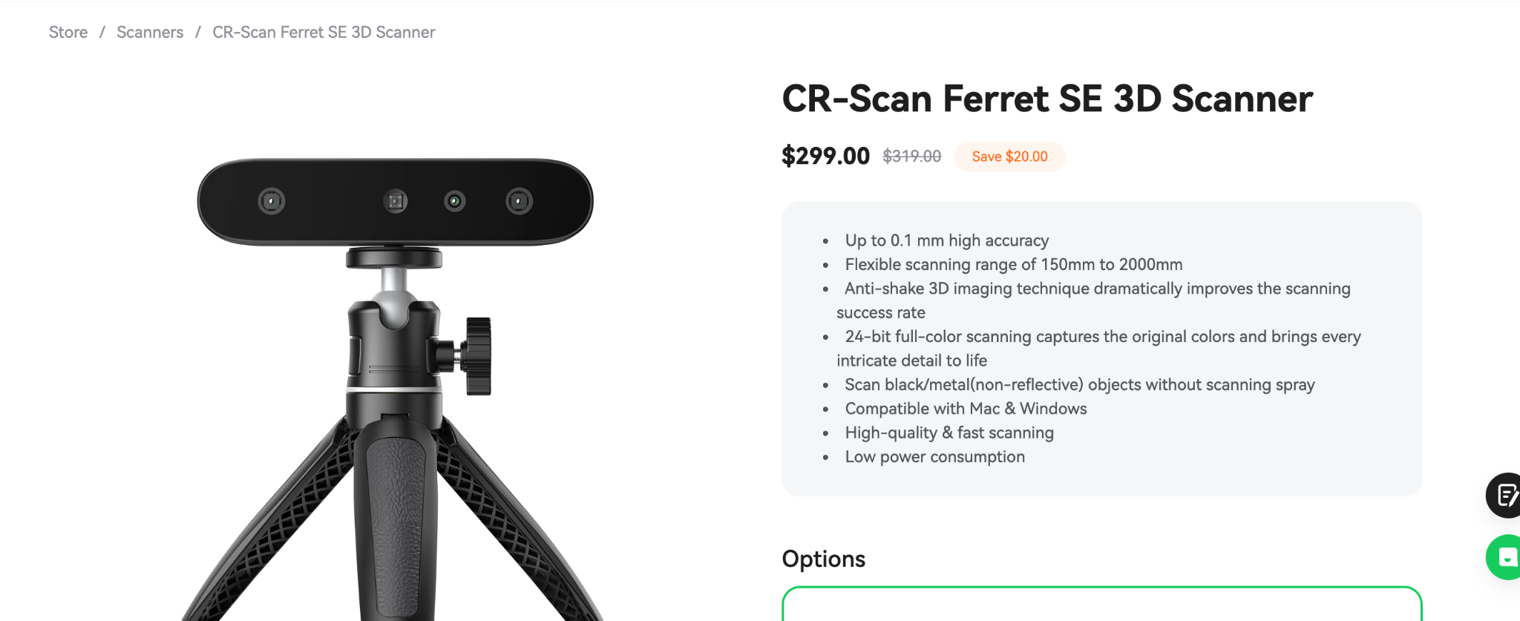
Scanner Set Up

Slide 12
Discussion
Successful, but hard to sustain
University settings intriguing - multiple experts in one space
Notes:
So, in this study, we found that this was a successful method for creating custom AT. We concluded that all stakeholders need to be involved to ensure safe and appropriate product selection, while ensuring that the end user's voice is not lost.
However, there were communication breakdowns between all stakeholders. To eliminate this, there is a need to develop interdisciplinary shared language between makers and PT to ensure a more efficient and effective design process. And academic training programs can be leveraged to connect makers and clinical students or end users, setting them up for collaboration. Our work in particular connected PT students at the University of Maryland, Baltimore with youth makers who provide fabrication services a few neighborhoods over in the same city. Connections like these can provide each stakeholder with a chance to learn about each other’s discipline to foster better collaboration in the future.
And finally, we started to uncover what PTs needed to know to adequately communicate with makers. Many of their skills were very helpful in terms of communicating - such as sketching and molding to patients. This study offers some situations in which drawing and measurements were more appropriate and others were modeling worked best. In either case, face-to-face and continuous communication would be ideal to facilitate collaboration. A better understanding of materials from the PTs and a better understanding of traditional medical use cases from makers might make this process even easier. These connections, however, eliminates the need for any group to become an expert in the others discipline and while outsourcing fabrication to makers adds an overhead of communication, it removes the burden of learning CAD from already busy PTs.

Slide 13
Community
“Creating 3D Printed Assistive Technology Through Design Shortcuts: Leveraging Digital Fabrication Services to Incorporate 3D Printing into the Physical Therapy Classroom” ASSETS 2022.
Notes:
So we learned a lot from that study. But there was a big focus on functionality. During that study, I became really interested in these ecosystems that support DIY-AT, who is involved in making them work, and importantly, who is left out.

Slide 14
University
“Towards a Social Justice Aligned Makerspace: Co-designing Custom AT within a University Ecosystem” ASSETS 2023.
Community
“Creating 3D Printed Assistive Technology Through Design Shortcuts: Leveraging Digital Fabrication Services to Incorporate 3D Printing into the Physical Therapy Classroom” ASSETS 2022.
Notes:
Which led me to a study about creating DIY-AT within our university ecosystem

Slide 15
Introduction
University settings have multiple experts in one location as well as the privilege of makerspace tools which make them an interesting site of possibility for creating DIY-AT through interdisciplinary collaboration
They are also sites of many social justice movements, especially around disability advocacy which can be incorporated into these design spaces¹
Shinohara, 2011; Bennett, 2019; Harrington, 2019; Kimball, 2016; Hamraie, 2016; Evans, 2017
Notes:
University settings have multiple experts in one location as well as the privilege of makerspace tools which make them an interesting site of possibility for creating DIY-AT through interdisciplinary collaboration within this ecosystem. Universities are also sites of many social justice movements, especially around disability advocacy which can be incorporated in these design spaces. I bring up the social justice aspect because we starting developing DIY-AT for our campus community after the disability advocacy group on campus had seen our previous work and expressed interest in making their own DIY-AT after I gave a presentation to their organization. This collaboration kind of naturally led us to a more social justice oriented making experience.

Slide 16
Methods
Co-design of custom DIY-AT
  Session 1: Initial interview and co-design session
  Session 2: Follow up interview after final device was printed
Communication through: in-person conversations, emails, photos, exemplar devices, clay, drawing
Notes:
So for this study, we conducted a basic qualitative research study in which we co-designed AT with students on our campus. The participants did an initial interview where we encouraged discussion of social justice movements. We then would conduct a co-design session where they came up with an idea for an AT device that we could design and print. They then came in for a second session to receive their printed device and offer feedback. We collaborated through in-person conversations, emails, photos, exemplar devices, clay models, and sketch drawing. And we would iterate with them even after the study was concluded and continue to create DIY-AT in our lab.

Slide 17
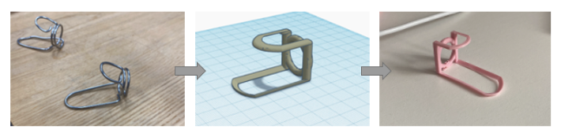
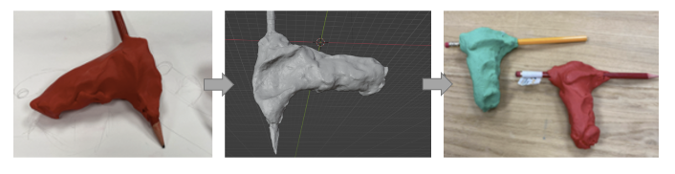
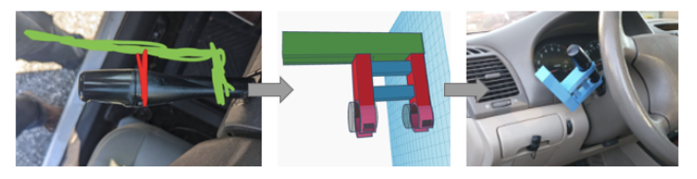
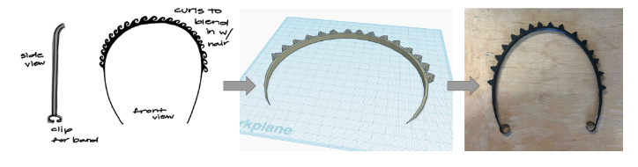
Devices and Participants
P1 - President of the DAU; custom finger splint
P2 - In the DAU; pencil grip created with polycam for use as an art student
P3 - Not in DAU; turn signal extender for driving
P4 - Audiologist; bone conduction headband that matches her natural hair
Notes:
So here are the first four devices that we created through our campus program. P1 is the president of the disability advocacy union on campus and created a custom finger splint; P2 is in the DAU and created a custom pencil grip for use as an art student that would not be covered by the university or insurance; P3 was not in the DAU and created a turn signal extender for use while driving; P4 is an audiologist who created a bone conduction headband to match her natural hair.

Slide 18
Scanner Set Up
Polycam

Slide 19
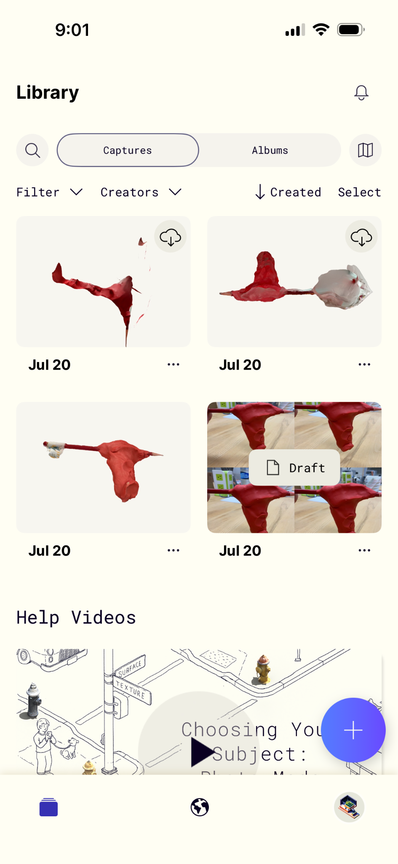
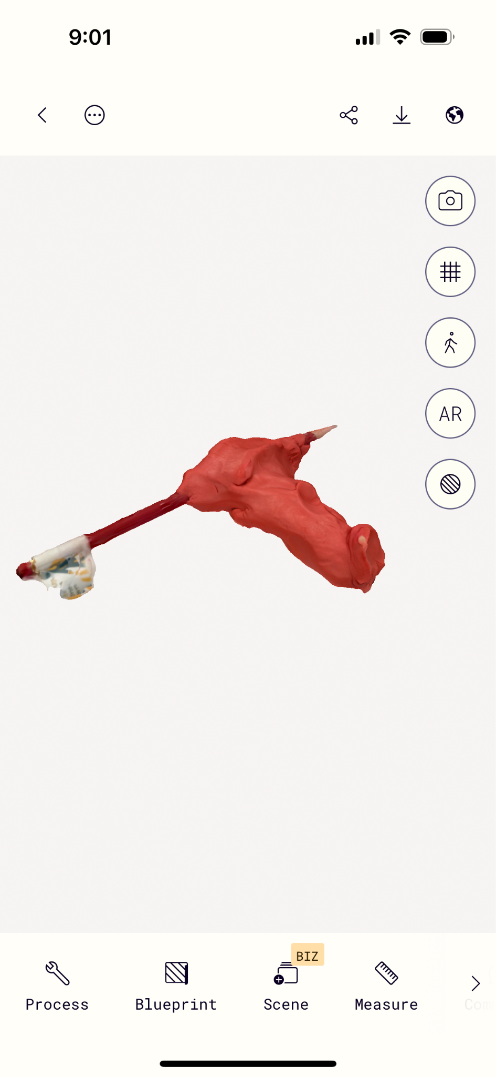
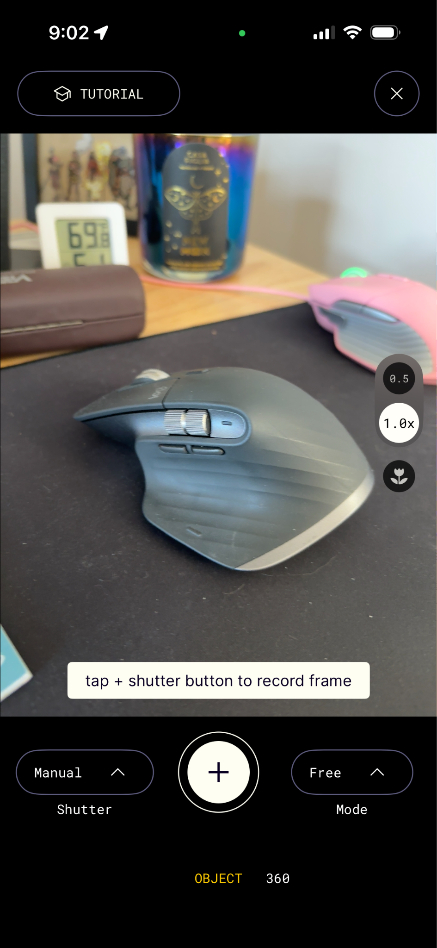

Slide 20
Barriers to students creating DIY-AT
Lack of knowledge around resources at the university
No relationship to a medical professional
“…it’s not as clear cut as just them being interested because someone can say, ‘Well, yeah that would be cool, but I have zero clue medically what I would need.” - P1
Notes:
Though all of them were able to create AT, through our interviews with these participants, we gained many valuable insights into the barriers to participating in this process. Some topics that were brought up were around their lack of knowledge around the people and technical resources on campus to assist with this practice. Another interesting point was that our makerspace using the words “DIY-AT” was intimidating to some of the members of their organization and that the language we used needed to be more well considered. Finally, all of them brought up the fact that they have a good working relationship with a medical professional. P1 stated about more people creating AT in this way, “it’s not as clear cut as just them being interest because someone can say, ‘Well, yeah that would be cool, but I have zero clue medically what I would need”.

Slide 21
Empowerment and inclusion as motivators
Economic benefits
  Personal or shared resources
Sense of empowerment
Supporting inclusion through design
“Nothing is the flesh tone. With me being an African American, myself, what can I do? ‘Does it have to be pink?’ That’s what they [her patients] say. ‘Why does it have to be pink, I’m not that color. Can they do my color?’ and I’m like ‘They can’t do your color.’” - P4
Notes:
They also offered some unique reasoning around why they would choose to participate in this sort of work. First, the economic benefit. AT is very expensive and often not covered by insurance, which our participants brought up repeatedly. The lower cost of the printers compared to the cost of the devices inspired P1 and P2 to consider creating more DIY-AT for their communities for the economic benefits. P1 wanted to learn the skills herself and P2 was more interested in leveraging the university resources. P3 discussed the sense of empowerment he felt through solving his own problem with design. P4 brought up how she sees the potential of supporting inclusion through design. She said when she talks to her black patients she considers her own race, P4 stated “nothing is the flesh tone. With me being an African American myself, what can I do? ‘Does it have to be pink” that’s what my patients say. ‘Why does it have to be pink, I’m not that color. Can they od my color?’ and I’m like ‘They can’t do your color’

Slide 22
Barriers to receiving appropriate accommodations
Confusing and biased towards students with visible disabilities and medical documentation
Mismatch between documentation and received accommodations
  Under or over correcting
Notes:
Our encouragement to align their conversations with their social justice activities led to important conversations around the accommodation process in the university. They stated that the system is confusing and biased towards students with visible disabilities and medical documentation. In addition to that, they also brought up the mismatch between documentation and received accommodation with either over or under fitting to their needs.

Slide 23
“I was told on my intake that I could not have a calculator because ADD [attention deficit disorder] is not a mathematical disability…And again, I’m one of the lucky ones, I got pretty much everything else I needed…” - P2
“At my previous college, they gave quite an incredible amount of accommodations,...when I take tests and stuff, I could have double time if I wanted. And I didn't really know where that came from,...I haven't actually gone through the accommodations process here…I don't know…I don't always like the idea of having an accommodation.” - P3
Notes:
This could mean under or over fitting as shown here with these two quotes. In the first quote, P2 expresses, “I was told on my intake that I could not have a calculator because ADD is not a mathematical disability…and again, I’m one of the lucky ones, I got pretty much everything else I needed” this quote showing how even with diagnosis sometimes the internal systems at a university will not accommodate. P3, on the other hand stated, “at my previous college, they gave quite an incredible amount of accommodations…when I take tests, I could have double time if I wanted. And I didn’t really know where that came from, I haven’t actually gone through the comoodatations process here…I don’t know…I don’t always like the idea of having an accommodation”. P3 is showing the other side where the university system again had a mismatch with needs and accommodation but in this case over correction which made him feel embarrassed.

Slide 24
Supporting the co-creation of DIY-AT at university makerspaces
Multiple ways for participants to create and communicate initial designs
Make university resources visible and communicate about it in a more clear manner
Using DIY-AT making as an opportunity for setting up interdisciplinary collaborations
Opportunity for students with disabilities to gain technical expertise and self-determination
Notes:
So the creation of DIY-AT is actually well suited for university makerspaces. And to facilitate this, makerspaces should have multiple ways for device recipients to communicate their designs - so we had clay, drawings, just talking, email - it’s also important to make this information obvious to students so they know where to find these resources. It’s a great opportunity for interdisciplinary collabor

Slide 25
University makerspaces as sites of antiracist and inclusive DIY-AT making
Strategies of explicitly communicating that we were interested in all aspects of social justice and encouraged sharing brought perspectives beyond functional AT
  Led to students using the creation of DIY-AT as an opportunity to discuss systematic dimensions of oppression at the university and beyond
  For example, P2 created a device to assist her in her coursework that wasn’t provided by the university
  P4 created a device that matched the color and texture of her natural hair that a manufacturer would never have made
Notes:
Overall, we found that university makerspaces can function as sites of antiracist and inclusive DIY-AT making. The strategy of explicitly communicating that we were interested in all aspects of social justice and encouraged sharing brought perspectives beyond functional AT. It led to student using the creation of DIY-AT as an opportunity to discuss systematic dimension of oppression at the university and beyond. For example, P2 created a device to assist her in her coursework that wasn’t provided by the university. P4 created a device that matched the color and texture of her natural hair that a manufacturer would not make.

Slide 26
University makerspaces as sites of antiracist and inclusive DIY-AT making
Co-design as a means of bringing together like-minded people to generate discussion and increase awareness and solidarity - which may bring about change
  Creative devices created can serve as exemplars that encapsulate critical perspectives on the existing status quo
Activism is demanded of students with disabilities on campus and DIY-AT can provide tangible artifacts to critique the inequitable power structures at play
Notes:
Through these examples, we can start to see how co-designing can be a means to bring together like-minded people to generate discussion and increase awareness and solidarity which might bring about change - creative devices can serve as exemplar that encapsulate critical perspectives on the existing status quo. Activism is demanded of students with disabilities on campus and DIY-AT can provide tangible artifacts to critique the inequitable power structures at play.

Slide 27
University makerspaces as sites of antiracist and inclusive DIY-AT making
Both accessibility and making are rooted in creativity and empowerment. They subvert the traditional systems put in place around the acquisition of technology. The intersectional elements of accessibility and making provide an inherent connection that can be leveraged, as shown with our study, to create technology that is in itself critical of the systems that have previously prevented the acquisition of these needed ATs.
Notes:
Both accessibility and making are rooted in creativity and empowerment. They subvert the traditional systems put in place around the acquisition of technology. The intersectional elements of accessibility and making provide an inherent connection that can be leveraged, as shown with our study, to create technology that is in itself critical of the systems that have previously prevented the acquisition of these needed ATs.

Slide 28
Identified next steps
Continue working towards the creation of an antiracist, feminist makerspace within our community ecosystem
Replication in different contexts to understand transfer
Work towards aligning the social justice, grassroots nature of this work with formal infrastructure and support
Notes:
Finally, we would like to implement the lessons we learned and try to include perspectives from the university accessibility services to see how our grassroots, social justice work could align with formal infrastructure and support.

Slide 29
University
“Towards a Social Justice Aligned Makerspace: Co-designing Custom AT within a University Ecosystem” ASSETS 2023.
Community
“Creating 3D Printed Assistive Technology Through Design Shortcuts: Leveraging Digital Fabrication Services to Incorporate 3D Printing into the Physical Therapy Classroom” ASSETS 2022.
Notes:
So we learned a lot about a small ecosystem at this point, but then we were interested in seeing how this scaled

Slide 30
Government
“An Ecosystem of Support: A U.S. State Government-supported DIY-AT Program for Residents with Disabilities” ASSETS 2024.
University
“Towards a Social Justice Aligned Makerspace: Co-designing Custom AT within a University Ecosystem” ASSETS 2023.
Community
“Creating 3D Printed Assistive Technology Through Design Shortcuts: Leveraging Digital Fabrication Services to Incorporate 3D Printing into the Physical Therapy Classroom” ASSETS 2022.
Notes:
In the final study in this series, we looked at a governmental level support ecosystem for DIY-AT program.

Slide 31
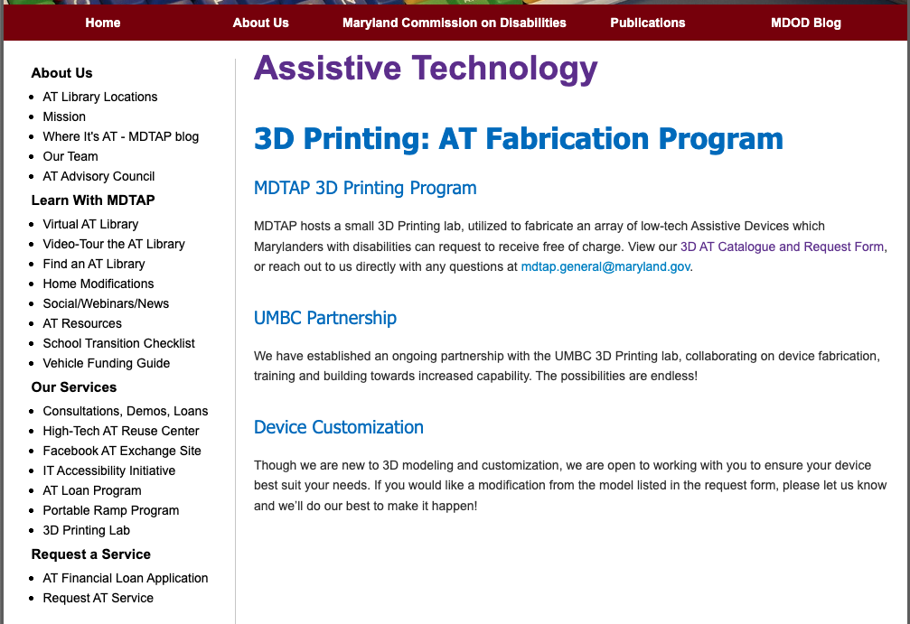
Program Overview
Initiated August 2023
Inspired by the existing 3D printed AT program in Pennsylvania
Our research lab met while our lab director was serving on a state assistive technology advisory board
We provide support in the form of training, editing design files, taking on projects that are outside of their scope, fixing printers, and providing additional support when a large number of requests come in at one time
Notes:
So to understand how DIY-AT could work at this scale, we conducted an action research study where we assisted in the creation of a maryland state program to provide free 3D printed AT. The program started in August 2023 and was inspired by a similar program in the neighboring state of PA. Our research lab was contacted because we have a history of working with the Maryland state department of disabilities. This relationship began when our lab director was serving on the state AT advisory board. We did a few smaller projects with them before they approached us to provide support in the form of training, editing design files, taking on complicated design projects, fixing 3D printers, and providing additional printing services when there were too many requests at once.

Slide 32
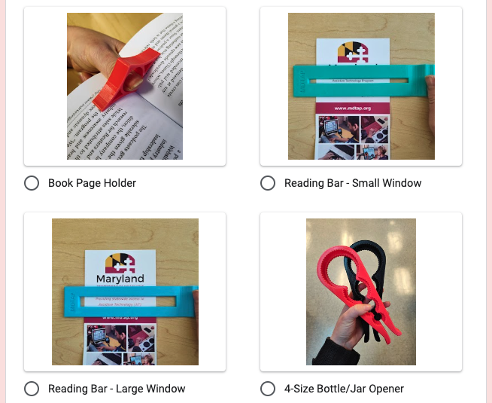
Order Form
Here is a screenshot of the form where individuals can request devices
They provide their email, which device they want, which color, and where to ship the device
Shipping cost and printing materials are subsidized by the state department and are ‘negligible’ according to our partners
Individuals can also send an email requesting a custom device that will be handed off to the research team for further development
Notes:
Here is a screenshot of the form that people use to request devices. They provide their email, color preferences, and shipping information and the state department prints and ships the device. The shipping and material costs are subsidized by the state department and we were told the cost is ‘negligible’. Individuals can also request a larger or more complicated device that would be outsourced to our team.

Slide 33
Motivations for Participating in the Program
Restrictive and difficult insurance policies
Low quality and expensive devices online
Interest in seeing what would happen
“[The key holder] is such a small, simple thing, but it really is for him life changing because now he can open the door without having to reach for his mom to guide his hand. That’s one more thing he can do on his own. It’s so important”
Notes:
Many individuals discussed why they participated and how. Most individuals discovered the program on social media. They had a variety of reasons for participating, but the restrictive and difficult insurance policies were the primary motivating factor. They also mentioned that what they could find online was low quality and expensive so it was not a viable workaround. Other reasons involved having a temporary disability from something like a stroke and not being able to receive devices. And some were simply interested in seeing if the program would work. All of them agreed that the devices that they received, though simple, were very impactful. One participant stated, “[The key holder] is such a small, simple thing, but it really is for him life changing because now he can open the door without having to reach for his mom to guide his hand. That’s one more thing he can do on his own. It’s so important”

Slide 34
Relationship to Creating and Customizing 3D Printed AT
Consider themselves “pretty crafty”
Have access to 3D printers at home (P4, 5, and 9), at school (P2, 4, 6, and 11), or through a community space (P7 and 10)
Lack of knowledge of what to make
“It’s not necessarily a tech issue that scares me off, it’s more I don’t know what to make…What would I make and why? I would say actually receiving this in the mail I was like, ‘Oh, that’s interesting. So this is just a little [toothpaste squeezer] which is super helpful, but it’s just a little thing that you could presumably make yourself”
Notes:
We also discussed how this program helped them to rethink their relationship to making and digital fabrication. Many of the participants we spoke to considered themselves to be pretty craft and all of them stated that they had access to a 3D printer. Their hesitation in making their own items was a lack of understanding about what to make. One participant stated, “It’s not necessarily a tech issue that scares me off, it’s more I don’t know what to make…What would I make and why? I would say actually receiving this in the mail I was like, ‘Oh, that’s interesting. So this is adjust a little [toothpaste squeezer] which is super helpful, but it’s just a little thing that you could presumably make yourself”

Slide 35
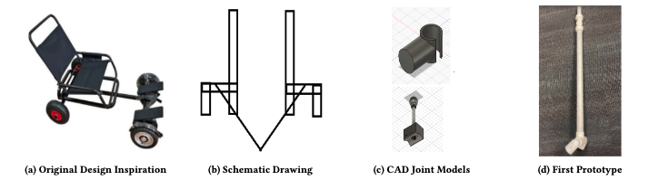
Participating in and Growing a DIY-AT Ecosystem of Support
Spreading the word about the program
The program supporting people in unique ways
  Researcher assisted co-design
Notes:
All of the individuals saw the value of participating in this ecosystem. Many chose to spread the program through word of mouth after participating. They also saw that they were being supported in unique ways like some who just wanted to receive the devices, some who wanted to learn to print themselves who now had a repository of things to start with and some who had fully unique devices printed for them. For example in the image here we show the design process for a hoverboard attachment for a wheelchair. This individual worked more deeply with the individuals in the ecosystem to create something entirely different for themselves. All of the participants had suggestions for growth in order to support even more and unique people within the ecosystem.

Slide 36
Participation Supporting Reflection on Disability and AT Use
Not viewing themselves as ‘disabled’ or not having a documented disability
Feeling like they have to ‘deserve’ the AT
“I don’t consider myself traditionally disabled…I just have problems in my wrist from carpal tunnel syndrome, so I would say my functioning isn’t affected to that degree. But the [3D printed bag carrier] was the only thing I felt like…I want to say deserved.”
Notes:
Findally, participation encouraged reflection on disability and AT use. Individuals that we spoke to stressed that they did not feel like their had a disability or that they did not deserve the product that they were receive. This many people carefully consider their choice so that they felt deserving of what their received. It also made many participants reflect on what they considered AT, not just high tech, but these low tech, yet impactful devices. One participant explained their feelings around participating in the program by explaining, “It’s not necessarily a tech issue that scares me off, it’s more I don’t know what to make…What would I make and why? I would say actually receiving this in the mail I was like, ‘Oh, that’s interesting. So this is adjust a little [toothpaste squeezer] which is super helpful, but it’s just a little thing that you could presumably make yourself”

Slide 37
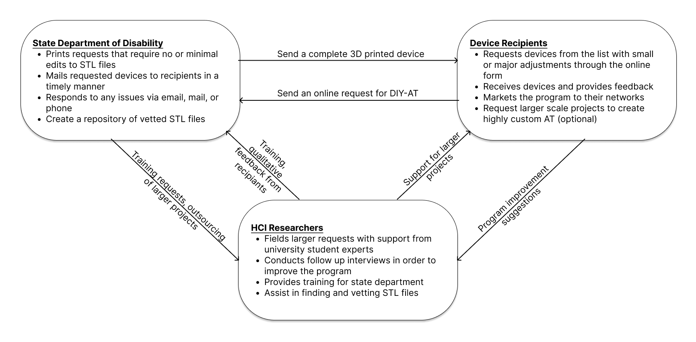
Multiple Roles within an Ecosystem of DIY-AT Support
Notes:
Overall, we found that there are multiple interdependent roles that are needed to support a free DIY-AT state level program. There are three roles within our ecosystem: the state department, hci researchers, and device recipients. They are all equally important and reliant on each other. Researchers field large requests, provide training, assist with STL files, and importantly receive and share feedback. The state department leverages their resources to field requests, print devices, and ship them out while responding to feedback and requesting training and support. Finally, the device recipients set the process in motion with their requests, sustain and grow the program, provide feedback, and participate in larger more unique project definitions.

Slide 38
Expanding and Transcending the Understandings and Definitions of AT and Disability
Insurance is incredibly restrictive in the US
Programs such as this one can circumvent some of the restrictive practices and policies - especially when aligned with like-minded government partners
Flexible design allowed participants to receive AT without being required to identify themselves as disabled
As HCI researchers, we could reflect on how academic institutions and makerspaces can support democratization of AT with a commitment to non-extractive practices
Notes:
This created ecosystem also allowed for individuals to reflect on their own definitions of AT and disability. Insurance in the US is incredibly restrictive. Programs such as this one can circumvent some of the restrictive practices and policies when aligned with like-minded government partners. The flexible design of the program allowed people to participate without being required to identify themselves as disabled. From a researcher perspective, it also allowed us to reflect on how academic institutions and makerspaces can support democratization of AT with a commitment to non-extractive practices.

Slide 39
Implications for the Design of Future Government-supported DIY-AT Programs
Avoid restricting access by diagnosis or disability status
Curate and refine a DIY-AT catalogue
Negotiate and assign clear roles for partners and collaborators
Continuously evaluate and document program outcomes
Notes:
In summary, here are some important guidelines for creating these types of programs. First, avoid restricting access by diagnosis or disability status, second curate and refine a DIY-AT catalogue, third, negotiate and assign clear roles for partners and collaborators, and finally, continuously evaluate and document program outcomes.

Slide 40







Q&A
Email: erinh2@umbc.edu
Notes:
Thank you for listening to my talk. I have here all of the great people I’ve worked with for all of this. And I’m happy to have a discussion with everyone!

