Slide 1



ATAP & AT3 Center’s Aging Peer Action Learning Cohort-Session Five
Assistive Technology – Know It Before You Need It
Wednesday, May 13, 2026
3:00 - 4:30 pm ET
at3center.net
ataporg.org

Slide 2

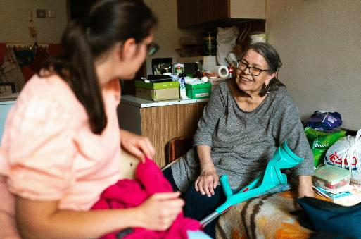

Reminders
To see captions, click on the CC button on the
control panel.
Please enter questions/comments in the Q&A window. Comments will be addressed at logical stopping points or at the conclusion of the webinar.
Please complete post-webinar survey that will immediately follow the webinar; we would like to know if the information provided was helpful.

Slide 3

Today’s Schedule
  Intro
  Overview, Goals & Objectives
  Aging PAL Panel Speakers & Q&A
  Closing reflection, Questions & Takeaways
  Announcements and next sessions

Slide 4

Aging PAL Overview
& Objectives
OBJECTIVES
Increase awareness of AT options for older adults and caregivers.
Identify strategies to reach older adults.
Strengthen collaboration between AT Programs and Aging Networks

Slide 5

Today’s Presenters
JEANNIE KRULL
Director – AT3 Center, ATAP
ANDREA ROUTH-Facilitator
Former Aging Service Director in Missouri and Founder of the Leading Impact LLC
SARA TRIBE CLARK
Director - Director – Eldercare Locator - USAging
MARTY EXLINE
Technical Assistance/Training Lead - AT3 Center, ATAP
MIKE CHAUSSEE
Executive Director – North Dakota Assistive
BARCLAY SHEPARD
Director – Virginia Assistive Technology System

Slide 6

US Aging

Slide 7
Assistive Technology:
Know It Before You Need It
Integrating AT into Aging Services Before Crisis Hits
Sara Tribe Clark
Director, Eldercare Locator
May 13, 2026

Slide 8
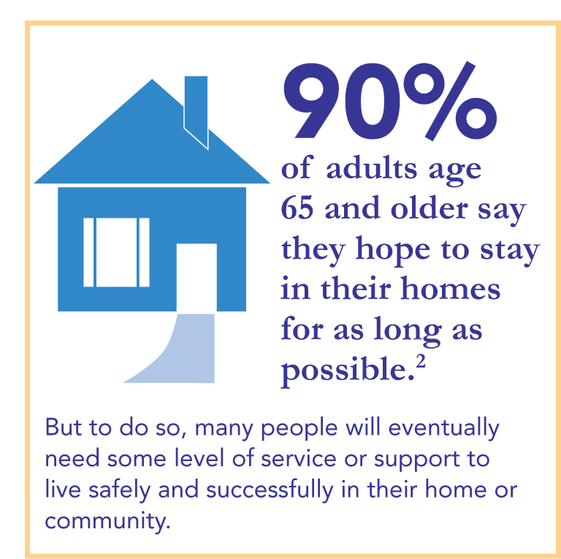
Statistic for older adults wanting to stay in their homes.

Slide 9
The National Aging Network
Mission = To develop a comprehensive and coordinated system of home and community-based long-term services and supports (LTSS) that is responsive to the needs and preferences of older adults and caregivers
Meet people where they are, provide alternatives to nursing home care
Access point for information on all things LTSS

Slide 10
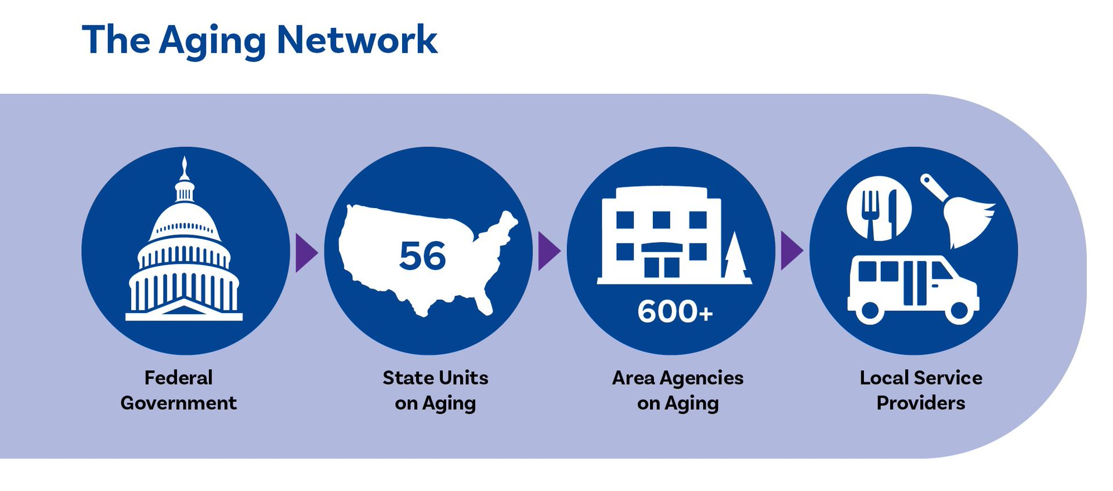
The Aging Network
TRIBES = Title VI Aging Programs

Slide 11
88 Percent of AAAs Serve Consumers Under Age 60
88% of AAAs serve individuals under 60
75% serve caregivers of all ages
71% serve individuals under 60 with a disability or chronic/serious illness
50% serve consumers with dementia of all ages
44% serve children or older relative caregivers raising them
34% serve veterans under 60

Slide 12




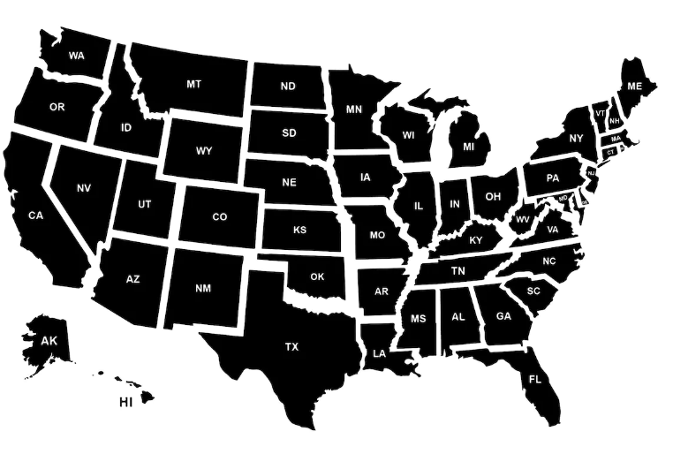
Caller from Anywhere, USA…
Local, state and national resources
Notes:
Older adults, people with disabilities, caregivers and professionals can contact either the Eldercare Locator from anywhere in the United States to find state, local and national resources to help them.
This can be done by calling, texting, online chat, email or looking the resources up on our website.

Slide 13
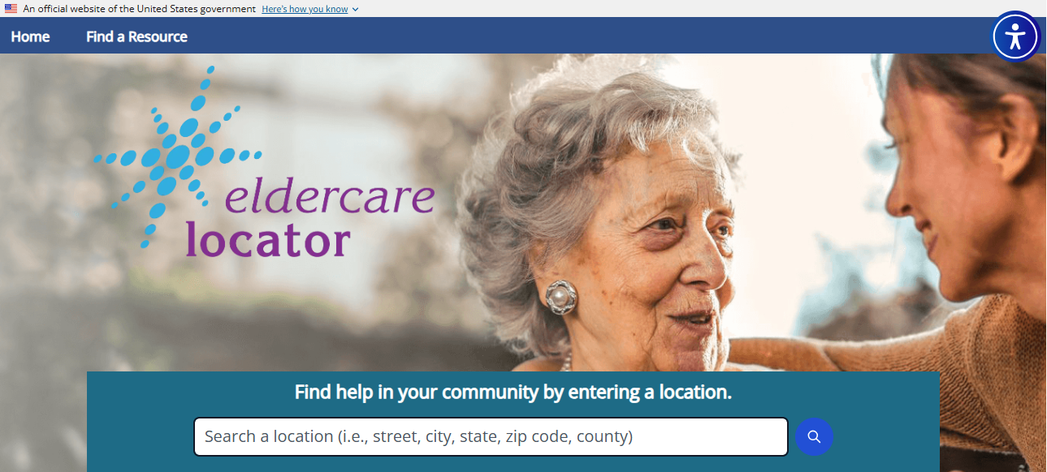
Eldercare.acl.gov
Notes:
Not everyone wants or needs to call or live chat with an Eldercare Locator specialists. Our call center is designed to assist members of the public who are seeking resources and/or need a starting point.
By going to our website (eldercare.acl.gov) people can access our comprehensive database on their own, and get connected to their local aging and disability resources – this is often the preferred method for professionals seeking quick contact information outside the area they normally cover.
This slide shows our home page including a white bar at the top for entering either your zip code OR city/state.
Test it out with your own zip code if you have never used it.
Hopefully, you recognize the information that comes up – Let us know if information you find in the EL database appears to be incorrect or incomplete, or if you hear back from a caller that they were not able to get through.
Email: eldb@usaging.org

Slide 14




Find on the Eldercare Locator Website
Information and Referral/Assistance
Aging and Disability Resource Center
Area Agency on Aging
Title VI American Indian, Alaskan
Native and Native Hawaiian Program
State Unit on Aging
Elder Abuse Prevention
Health Insurance Counseling
Legal Service Program
Long Term Care Ombudsman
Notes:
Once you have pulled up the contact information for your area, you will see some or all 9 possible Federally funded, ACL-supported resources available in our database for every community in the country.

Slide 15
What are people calling about?
Transportation
Housing Options
In-Home Services
Elder Abuse
Legal Services
Long-Term Care
Caregiver Resources
Nutritional Services
Health Insurance
Medical Services
Assistive Tech
Social Security
Home Modification
Crisis Services

Slide 16

Contact Information
  Voice & Video Phone/Text: 800-677-1116
  Email: eldercarelocator@usaging.org
  Live Chat (website): eldercare.acl.gov
  ASL Direct Video: 888-677-1199
Hours of operation
Monday – Friday 8:00 am – 9:00 pm ET

Slide 17
AT Devices and Services
AT Devices and Services – How do older adults and caregivers find out?
Word of Mouth: The Strongest Referral Engine
“Someone Told Me About You…”
Satisfied users become ambassadors.

Slide 18
Most People Don’t Search for AT…
They Hear About It.
• Word of mouth
• Healthcare providers
• Aging networks (AAAs/ADRCs)
• Community partners
• Events & outreach
• Websites & social media

Slide 19
Aging Networks: A Critical Gateway
Area Agencies on Aging, ADRCs and other Aging Entities Matter
Some AT Programs approach 50% referrals from ADRCs or AAAs for AT devices and services for older adults.
Some report strong rural impact via AAA partnership
Annual presentations to ADRCs
Many AT programs engaged in targeted AAA trainings
Two-way referrals increase impact

Slide 20
Healthcare Providers as Referral Multipliers
Healthcare providers often see need first.
PT, OT, ST, Case Managers, Nurses, Social Workers.
AT Programs often see a jump in referrals after targeted presentations.

Slide 21
Digital Tools Support — But Relationships Drive Action
South Carolina: 12% via website/listserv
Michigan: Website overhaul increased traffic
North Carolina: Social media expanding reach

Slide 22
Creative Outreach:
Missouri: 3D‑printed tools spark conversations
Alabama: Mobile lending library (rural outreach)
AT Expos, Health Fairs
State fairs & public events
Library partnerships

Slide 23
Breakout Room Questions
What are some approaches or practical strategies for building awareness? These can be ones mentioned earlier, something you’ve tried before or completely new approaches that you’re interested in.
Who might you partner with or collaborate with to increase awareness and/or help fund your efforts?
How could you get local media or press interested in partnering with you build awareness?

Slide 24
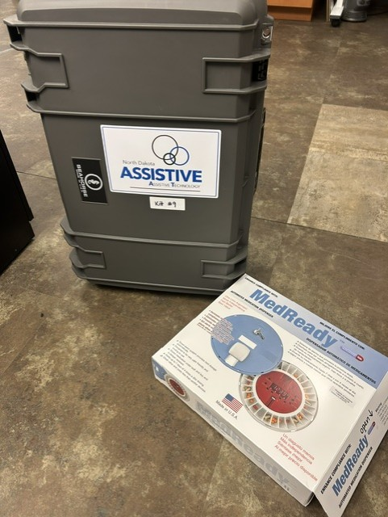
Discover What’s Possible
Rural Services Initiative – Ambassador Kits

Slide 25
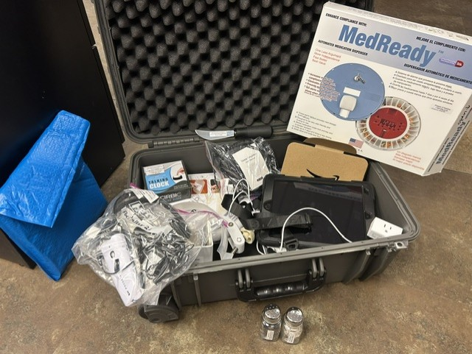

Ambassador Kits
Ambassador Kit Contents
Locked Medication Dispenser
Hearing Amplifier
Voice Amplifier
iPad
Bathtub Rail
Dycem Placemat
Weighted and Large-handled Silverware
Plate Guard
Talking Alarm Clock
Wander Alert Door Kit
Echo Show
Smart Plugs
Plug Lock
Total Cost: $1200 with the case

Slide 26
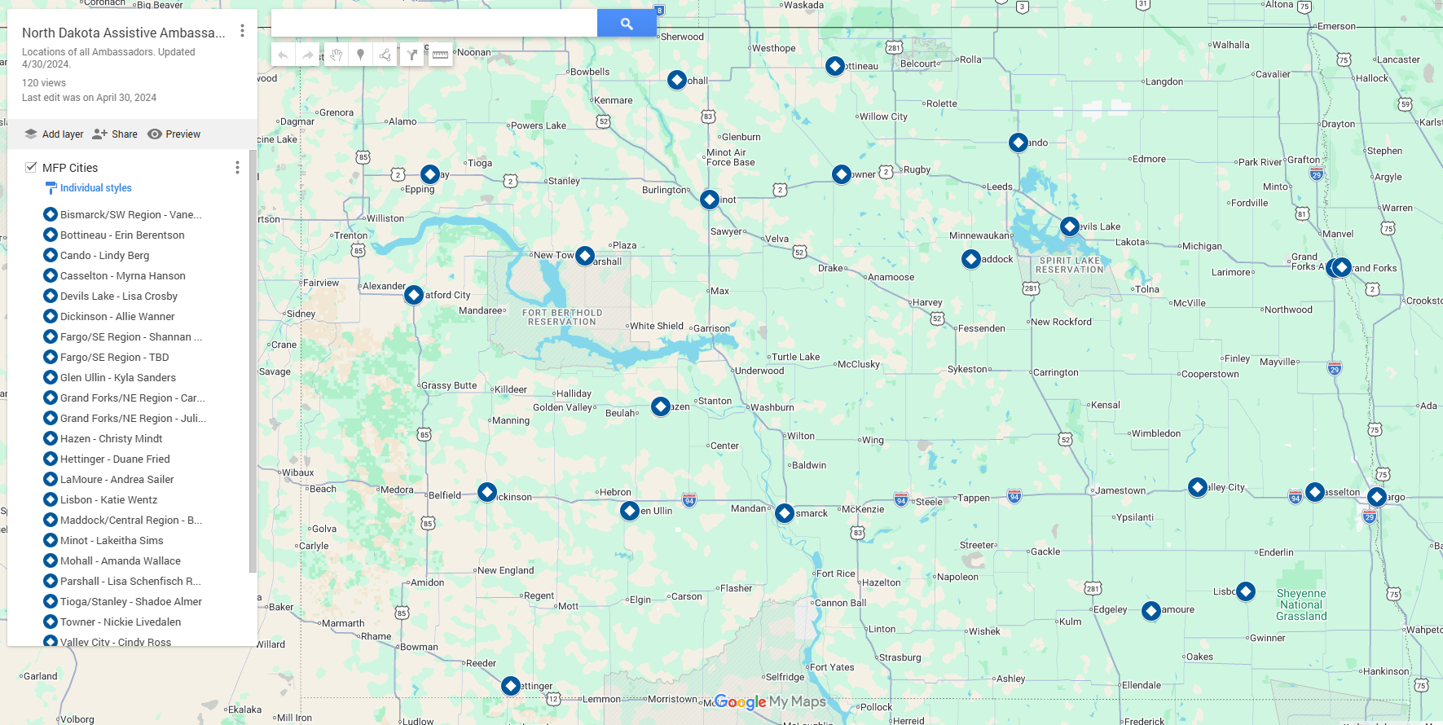
Locations of Ambassadors and Kits

Slide 27
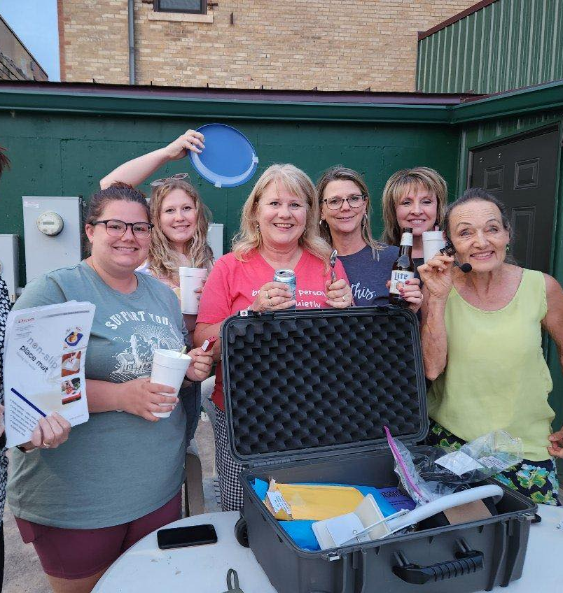

Ambassador Program
Makeup of Ambassadors
University Extension Agents
Alzheimer’s Association
Aging in Community Projects
Brain Injury Network
Hospital Discharge/Social Workers
Rural Home Health Agencies
Rural Telecom Provider
Aging Services Case Managers

Slide 28
AdaptAbility
Occupational Therapist led
Other health services may be included
Assistive Technology provided
Setup and troubleshooting included
Home Modifications provided up to $20,000
Goal: 40 participants, then ask for continued funding

Slide 29
AdaptAbility 2
Goal:
40 participants, then ask for continued funding
Target Group:
North Dakota residents 60+ or ages 18-59 with physical/functional limitations (not on a waiver).
Home has to be livable.
Mods can’t be worth more than 20% of the
home’s value.

Slide 30
Home for the Holidays Campaign
An annual Eldercare Locator marketing campaign to raise awareness about an important issue affecting older adults and caregivers.
It’s also an opportunity:
  to increase visibility of the Eldercare Locator, ensuring consumers have information on a critical topic
  to highlight Aging Network programs locally, with consumers and the media.

Slide 31
Past Home for the Holidays Topics
Find on Eldercare Locator’s Outreach Campaign Page
  Protect Your Wallet: A Guide to Avoiding Financial Scams
  Season of Wellness: Vaccination Guide
  Ready to Volunteer… Now what?
  COVID & Social Isolation
  Modify your Home for Healthy Aging
  Long-Distance Caregiving
  Living Well with Dementia in the Community
  Before you Give Up the Keys: Driving Safety
  Brain Health
Notes:
While the ACL site is still under construction, the best place to find all past brochures is on USAging’s Eldercare Locator Outreach Campaign Page: https://www.usaging.org/content.asp?contentid=1258

Slide 32

2025 Campaign
AAA Nutrition Services:
AAAs offer a variety of programs that promote healthy eating, reduce food insecurity and support caregivers.
Meal Access:
  Home-delivered meals, congregate meals, grocery delivery
Nutrition Support:
  Counseling, education, risk screening, SNAP assistance
Community Programs:
  Farmers market program, cooking programs, chronic disease programs
Caregiver and Other Support:
  Caregiver training, food pantry guidance
Notes:
Eat Well. Live Well. Age Well: A Guide to Health Home-Delivered and Community-Based Meals for Older Adults

Slide 33
Common Questions
Q: How can older adults find meal or nutrition services?
  A: Contact the Eldercare Locator to connect with your local AAA for available programs. (Contact information is below.)
Q: What does it cost?
  A: Meals may be covered by Older Americans Act funds; recipients can contribute voluntarily.
Q: Who is eligible?
  A: Adults age 60+ with unmet needs (mobility, limited kitchen access, etc.).
  For a downloadable PDF and more information, visit:
  www.usaging.org/nutritionmonth.

Slide 34

Thank you!
Sara Tribe Clark
Director, Eldercare Locator
stribeclark@usaging.org
To request resource updates:
ELDB@usaging.org
Social Media
www.x.com/EldercareLoc
www.facebook.com/eldercarelocator

Slide 35
Virginia Assistive Technology System (VATS)
Barclay Shepard - Director

Slide 36
Contact Info
Jamie Anderson-ATAP & AT3
Director of Membership & Operations
Jamie.Anderson@ataporg.org
Marty Exline-ATAP & AT3
Training & Technical Assistance Lead
Marty.Exline@ataporg.org
Jeannie Krull-ATAP & AT3
Executive Director
Jeannie.Krull@ataporg.org
at3center.net
ataporg.org

Slide 37
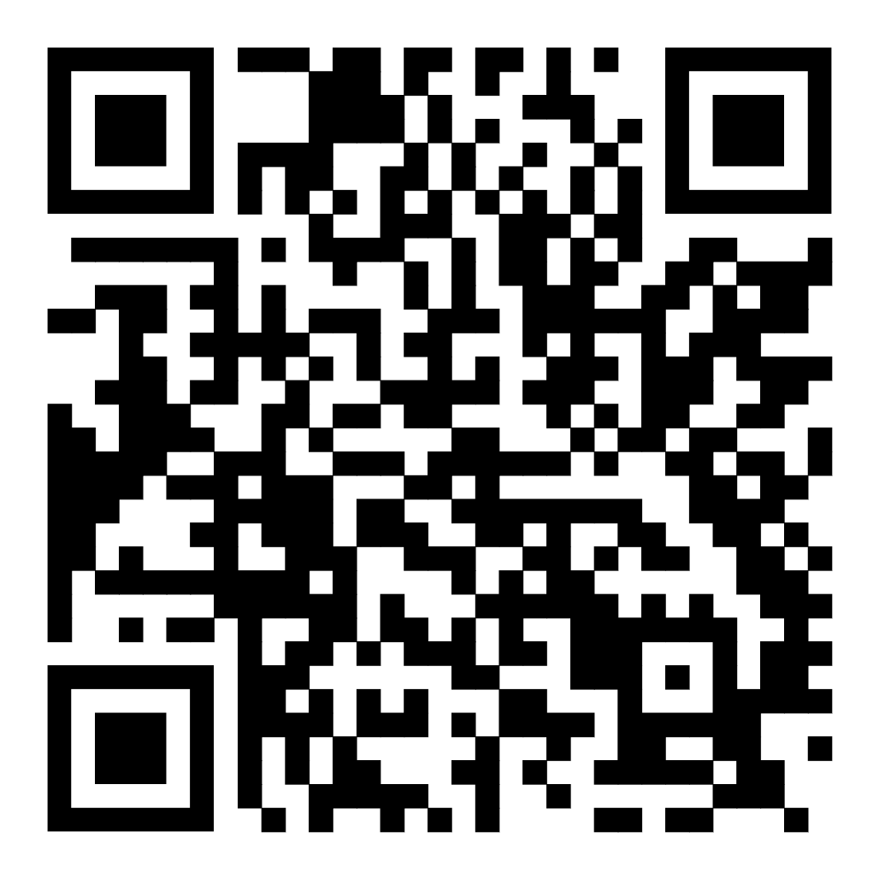

Contact Your State
Every state. Every territory. Every person.
Scan the QR code to discover your local AT Act Program.
Notes:
Find your state’s AT program via the AT3 Center or his QR code.

