Slide 1
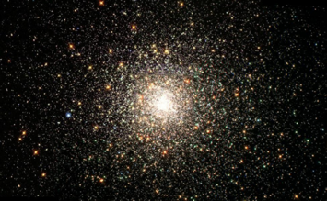
Disability and the Risks and Opportunities of
Artificial Intelligence
Jutta Treviranus
Inclusive Design Research Centre
OCAD University
Toronto, Canada
The ancestral and traditional territories of the Mississaugas of the Credit, the Hauenosaunee, the Anishinaabe & the Huron-Wendat
Attribution-NonCommercial 4.0 International License

Slide 2
“progress at the speed of trust”

Slide 3
“…trust us to break things, to make mistakes, to push forward.”
Notes:
Yesterday we heard the request to

Slide 4
disability & technology
Notes:
To have the right to ask this of us, you need to have a deeper understanding of the relationship between disability and technology.

Slide 5
“for most people, technology makes things convenient, if you have a disability, technology makes things possible.”
Notes:
There is a saying that for most people, technology makes things convenient, for people with disabilities technology makes things possible.
Therein lies an awesome responsibility.

Slide 6
To speak, read, write, learn, effect the world, navigate the world, eat, express love, remember, plan, breathe, ….live
Notes:
Technology is relied upon to ….
Our relationship to technology by necessity is more intimate. It is essential because we have no choice. It is what makes things possible. This relationship also makes us more vulnerable. We should not have to give our trust to an abusive partner. We are disproportionately vulnerable to the mistakes, to the breaking.
Beyond guarding our homes, It is implanted in our brains and in our vital organs

Slide 7
If you have a disability the opportunities and risks are at the extremes
Notes:
If you have a disability….
The extreme opportunities mean that people with disabilities are often the poster child of AI, we are used to justify the risks.

Slide 8
Extreme Opportunities..
Recognize speech, gestures, patterns
Find a target object or pattern
Match and label objects
Remember forever and remind on time
Sort possible paths to find the optimum
Detect common mistakes and correct them
Notes:
This provides people with disabilities extreme opportunities…

Slide 9
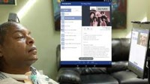
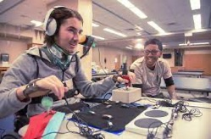

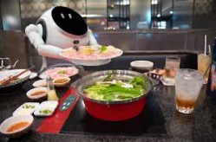
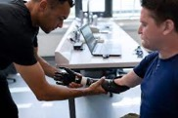
Mechanizing the Formulaic..
Notes:
Recognizing objects if you are blind, translating gestures, acting as robotic personal service workers, creating intelligent prosthetics, restoring vision, reading your mind through your EEG patterns…No wonder disability is the poster child of AI

Slide 10
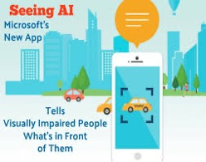
Current AT..
Image to text description (e.g., Be My Eyes, Seeing AI, JAWS PictureSmart AI)
Real-time captioning (e.g., Zoom, TranscribeGlass)
Sound filtering (e.g., Orka Two)

Slide 11
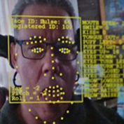
More Current AT..
Voice control (e.g., Voiceitt)
Personal Voice Output (e.g., Apple Personal Voice)
Exoskeleton optimization (e.g., Stanford E.)
Gesture Control (e.g., Cephable, The Wheelie)

Slide 12
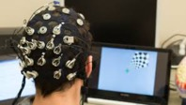
…and More Current AT
Smart home systems, & robotic assistants
Memory & recall (e.g., Rewind AI)
Simplification & Summation (e.g., Detangle AI)
Writing support (e.g., Chat GPT)….
Brain Computer Interface

Slide 13
Less known risk: an infrastructure of disability discrimination
Notes:
But with this comes extreme risk… we are creating an

Slide 14
Generations of AI
First: “here are the rules, follow then literally and accurately”
Second: “here is available data, use statistical reasoning to optimize the selected metrics”
Third: “here is all the data we have, you figure it out and make new connections and determine weights based on past relationships and possible combinations.”
Notes:
When people feel daunted by the complexity of AI I like to characterize it as three generations of how people have controlled AI:
Most people became concerned and aware of AI when it reached the third generation. I’m actually more concerned about the pervasive deployment of second generation AI in all our critical decisions. Especially when it is deployed in…

Slide 15
Finding, matching, sorting, labeling, measuring, optimizing, calculating, analyzing people… at scale

Slide 16
there is a problem..
& we are the collateral damage
Notes:
However, there is a problem with how AI is designed, and people with disabilities are the ones most vulnerable to the harm caused. We are often the collateral damage in the emerging AI race.
The way AI is currently designed is hostile to difference, and we are more than a little different.

Slide 17
the problem precedes AI
Notes:
However the problem precedes AI

Slide 18
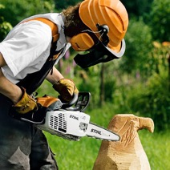

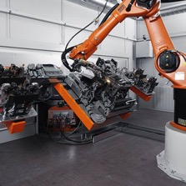
AI is a power tool…
Notes:
Artificial intelligence can be seen as a power tool, like moving from a hammer and chisel, to a powerful motor, it can do the things that we have done before but…

Slide 19
AI is mechanizing, accelerating, amplifying, and automating existing patterns
Notes:
AI is simply….

Slide 20
More efficiently, accurately, consistently..
Notes:
More accurately, consistently, and efficiently

Slide 21
..propagating discrimination faster, more efficiently, and accurately
Notes:
It is propagating the discrimination that was there faster, more efficiently, and more accurately….

Slide 22
missed by AI ethics efforts
Notes:
… despite the emergence of an AI ethics industry, current AI ethics initiatives are missing a fundamental risk.

Slide 23
existential flaw..
Notes:
I would say that this constitutes an existential flaw in our assumptions about truth, and our sense of what is of value.

Slide 24
my first alarm…
Notes:
My first alarm happened about a decade ago, this is a story that I have told many times and I’ve seen it retold.

Slide 25
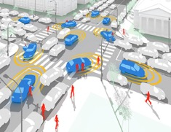
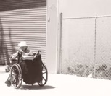
Alice and the unexpected…
Notes:
Back in 2013, we were engaged in helping the ministry of transport celebrate its 100th anniversary and preparing for the next 100 years. We were given the opportunity to test autonomous vehicle machine learning models that would be used to guide vehicles through busy intersections. I decided to test them with something unexpected, the capture of a friend of mine who moves backwards with her wheelchair. She is fast and efficient but erratic. Other people in the intersections often think she has lost control and try to push her back to the curb she has come from. All of the AI systems I tested chose to proceed and if they had been deployed they would have run her over.

Slide 26
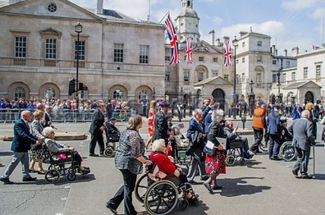
Smarter is not always better…
Notes:
They all said these AI systems are immature, we don’t have enough data about people in wheelchairs in intersections. Come back when we have trained them with more data. When I came back to test the AI systems that had been trained on a great deal of data, they chose to run her over with greater confidence, the AI was confident that people in wheelchairs moved forward.

Slide 27
My data set of human requirements….
Notes:
Of course I was alarmed, but I realized that this made sense…it confirmed a worry that I have had for some time. Let me explain…

Slide 28
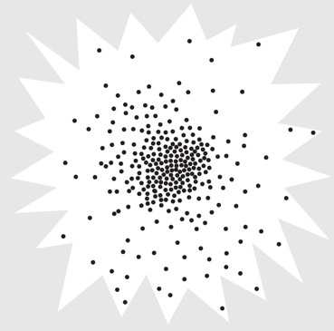
Our human starburst…
Notes:
Over my 44 years in the field I have been collecting data. What do people need to thrive? …the only way I can plot this is using a 3D multivariate scatterplot. The needs of any given population looks like a starburst, I've dubbed this the human starburst. Like a normal distribution 80 percent is clustered in the middle 20 percent of the space, and the remaining 20 percent are distributed in the periphery in the remaining 80% of the space.

Slide 29
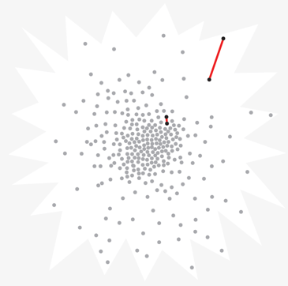
Difference…
Notes:
Data points in the middle are close together meaning they are more alike
Data points at the periphery are further apart meaning they are more different from each other.

Slide 30
Human Starburst and Design
Notes:
Because of economies of scale and conventions like the 80/20 rule that say to ignore the difficult 20% that take 80% of the effort almost anything that is designed works for the middle, is difficult to use as you deviate from the middle and doesn’t work for you if you are out at the jagged edge…. And the design of the AI ecosystem is no different.

Slide 31
Human Starburst and AI
Notes:
Any statistically determined prediction is highly accurate in the middle, inaccurate as you move from the middle and wrong as you get to the edge. Here I am not talking about Ais ability to recognize and translate things that are average or typical, like typical speech to text, or from one typical language to another, or to label typical objects in the environment, or to find the path that most people are taking from one place to another. But even there, if your speech is not average, or the environment you are in is not typical, AI fails.

Slide 32
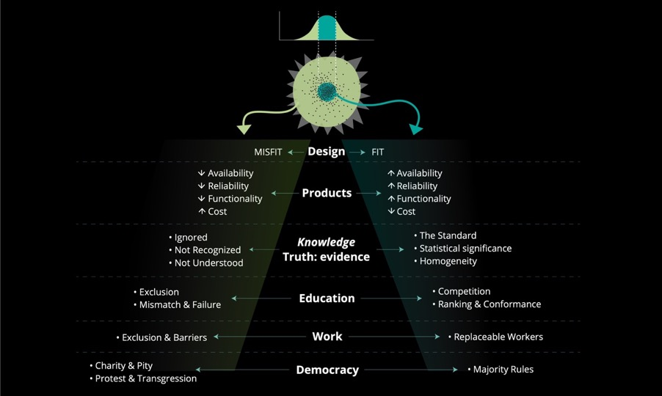
Pervasive Disparity
Notes:
It ripples through every aspect of out lives, creating greater and greater disparity..
whether it is in our designs, the products that make it to market, the knowledge we recognize as evidence, our education which pushes toward standardized learners, our systems of employment which attempt to create replaceable workers, and our systems of governance which in defending democracy have reduced it to one person one vote the critical needs of the margins are outweighed by the trivial needs of the majority.

Slide 33
Bad for the Majority
Notes:
It is detrimental to the edges but also to the majority in that it leads to …it compromises innovation.

Slide 34
Reducing diversity, denying complexity
Notes:
Diversity is the fuel of evolutionary advance… complexity is an undeniable reality.

Slide 35
homogenizing toward a monoculture..
Notes:
And we know that mono-cultures can be felled by a single crisis

Slide 36
The prediction with the greatest probability
Notes:
As Klaus mentioned yesterday, the only thing that is certain is death and disability.

Slide 37
Room for Change and Growth
Notes:
If we consider the hugely diverse margins we leave room for change and growth when the unexpected happens

Slide 38
Innovation and Weak Signals
Notes:
All of us here know that innovation is at the edge, not the complacent middle, and people at the edge are first to detect the weak signals of crisis to come.

Slide 39
Assumptions of Pervasively Deployed AI Decision Systems
Past success equals future success
Optimizing data characteristics associated with past successes increases future successes
The data characteristics that determine success need not be specified or known to the operators of the AI
Notes:
The assumptions these AI power tools are built upon are that:…
Scaling and replicating past success will bring about future success
Optimizing data characteristics associated with past successes increases future successes
The data characteristics that determine success need not be specified or known to the operators of the AI
And … the AI cannot articulate the highly diffuse and possibly adaptive reasons behind the choices. Current AI systems cannot explain themselves or their choices

Slide 40
Bias toward optimal pattern
=
Bias against difference
Notes:
The tools is built to be biased against difference, disability is difference, different ways of doing the job, different digital traces, different work and education history, different social media topics….an entangled profile of many differences.

Slide 41
AI getting better or more accurate
= getting more discriminatory
Notes:
As AI gets better or more accurate in its identification of the optima, AI gets more discriminatory and better at eliminating applicants that don’t match the optima in some way.

Slide 42
Pervasive….
Employment
Academic admissions
Medical calculators & triage tools
Policing and parole
Immigration & refugee adjudication
Tax auditors….loans, mortgages…security flagging
Notes:
This same pattern is happening with all life altering, difficult decisions …AI is being applied and offered to competitive academic admissions departments, to beleaguered health providers in the form of medical calculators and emergency triage tools resulting in more iatrogenic death and illness if you are different from your classification, to policing, to parole boards, to immigration and refugee adjudicators, to tax auditors meaning more taxpayers with disabilities are flagged, to loans and mortgage officers meaning people with unusual asset patterns won’t get credit, to security departments meaning outliers become collateral damage.

Slide 43
Community level..
Evidence based government investment
Political platform
Public health decisions
Urban planning
Emergency preparedness, security measures…
Notes:
At a community level we have evidence-based investment by governments, AI guiding political platforms, public health decisions, urban planning, emergency preparedness and security programs
None will decide with the marginalized outlier, and outliers will be marked as security risks.

Slide 44
Cumulative impact…
News coverage
Products marketed
GPS routes
Supply chain priority
Design features selected….
Notes:
These are monumental, life changing decisions, but even the smaller, seemingly inconsequential decisions can harm by a million cuts. What gets covered by the news, what products make it to market, the recommended route provided by the GPS, the priority given to supply chain processes, what design features make it to market…

Slide 45
Bad, unfair, inaccurate decisions
Notes:
This leads to bad, unfair, inaccurate decisions

Slide 46
Subject to false flagging in suspicion systems

Slide 47
Harm and incident databases
Disproportionate reports related to disability
Examples: parents with disabilities falsely flagged as unfit, false positive tax audits, false positive security flagging, excluded from optima filtering in employment and education, biased credit and asset rating, unfairly denied mortgage and loans, unfairly high insurance rates, depriortization of relevant information, iatrogenic death and illness…
Notes:
Since my first alarm a decade ago, I’ve been monitoring harm and incident databases and unfortunately it has become a depressing exercise in “I told you so.”

Slide 48

Privacy protections
Privacy bartered for essential services
Privacy protections don’t work
Privacy protections eliminate helpful data
Recovery from data abuse & misuse absent
Notes:
While many have focused on privacy the reality is that…
While people with disability are most vulnerable to data abuse and misuse, de-identification doesn’t work work if you are highly unique, you will be reidentified. Differential privacy will remove the helpful data specifics that you need to make the AI work for your unique needs.
Most people with disabilities are forced to barter their privacy for essential services.
We need to go beyond privacy, assume there will be breaches and create systems to prevent data abuse and misuse. We need to ensure transparency regarding how data is used, by whom and for what purpose.

Slide 49
Statistical reasoning as the means of making decisions does harm
Notes:
This harm predates AI. Statistical reasoning as the means of making decisions does harm, it does harm to anyone not like the statistical average or the statistically determined optima.

Slide 50
Assuming that what we know about the majority applies to the minority does harm
Notes:
Assuming that what we know about the majority applies to the minority, does harm.

Slide 51
More than…
Addressing data gaps
Removing human bias from algorithms
Removing stereotypes from labels and proxies

Slide 52
Statistical Discrimination in AI Ethics Measures
Insignificant when determining metrics and thresholds
Invisible or insignificant in error testing (Rich Caruana)
Notes:
The problem is that even the systems intended to remove bias, reduce risks, prevent harms use statistical reasoning
PwD are insignificant when
The statement by a previous speaker that it would take quite a few fatalities for a mistaken determination for an anomalous case to be detected by error testing

Slide 53
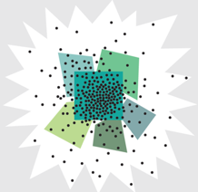
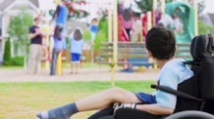
AI ethics auditing tools
Cluster analysis & comparison
No disability data cluster
Don’t detect bias against outliers or small minorities
“Falling through cracks and stranded at edges” of bounded clusters
Notes:
But wait don’t we have auditing tools that detect and eliminate bias and discrimination in AI?
Can't we test tools for unwanted bias?
AI auditing tools are misleading in that they don’t detect bias against outliers and small minorities, or anyone who doesn’t fit the bounded groupings. Most AI ethics auditing systems use cluster analysis…comparing the performance regarding a bounded justice deserving group with the performance for the general population. There is no bounded data cluster for disability. Disability means a diffuse and highly diverse set of differences.

Slide 54
Invisible in a risk-benefit framework
Notes:
PwD are invisible in a risk-benefit framework. The harm they are caused will be outweighed by the benefit to the majority. They will be a seen as a trivial sacrifice for the greater good.

Slide 55
“an anomaly”
“merely an anecdote”
Notes:
The specific risks will dismissed as anomalies, and merely anecdotes

Slide 56
AI in AT Considerations
Privacy breaches and data abuse and misuse
Surveillance and manipulation
Homogenization
Statistical discrimination
Connectivity
Hallucination

Slide 57
Privacy Breaches
Inaccessible terms of service
Data sharing
Cloud AI vs. on-device AI

Slide 58
Surveillance & manipulation
AT user and others
Targeted advertising
Stereotypical optimization metrics

Slide 59
Homogenization
Impact of “being typical”
Loss of differentiation

Slide 60
Statistical Discrimination
Works the worst for people that need it the most
Assumed accommodation

Slide 61
Connectivity
Cost of bandwidth
Power consumption and sustainability

Slide 62
Hallucination
Sounding believable, not telling the truth
“Producing believable bull**”

Slide 63
What data about disability have we fed AI?
Ablist slurs
Disabled people as inferior, unattractive, tragic victims, suffering
Bad jokes about disability
Benevolent ableism – “inspiration porn”
Notes:
What is the data we have fed AI about disability? It is a horrifying cocktail of ablist slurs, disabled people are seen as inferior, unattractive, tragic, victims, suffering,
there are plenty of bad jokes involving disability,
then we have benevolent ableism or what has been called inspiration porn.

Slide 64
Toxicity Censors
Captioning toxicity filters
Facial difference cancellation
Disability without sex

Slide 65
Flipping the perspective
Focus on the novel and unique
Inverting the metrics
Addressing the needs at the edge
Notes:
We flip the prioritization with tools like our inverted Wordle where it is not the popular, majority word that grows and moves to the middle but the novel, unique minority word or phrase.

Slide 66
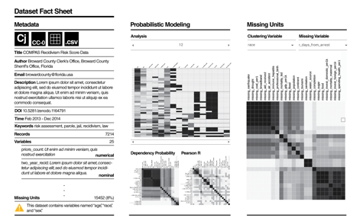
“Trust meter”
Suitability of decision system to instance before you
“Dataset nutrition label” or equivalent
Notes:
And creating tools to reduce harm by signaling when a model will be wrong or unreliable because the evidence based guidance is wrong for the person being decided about. Here we are using a tool called the dataset nutrition label that gives information about what data is used to train the model.

Slide 67
“lawnmower of justice”
Notes:
We provocate with models like the lawn mower of justice. Where we take the top off the Gaussian curve to remove the privilege of being the same as the majority, so the model needs to pay greater attention to the breadth of data

Slide 68
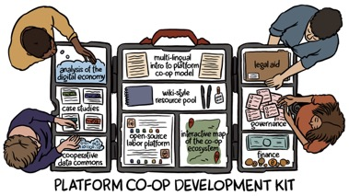
Data Co-ops
Cooperatively governed data trusts
Bottom-up community-led data ecosystems
Notes:
We are exploring bottom-up community-led data ecosystems. Where the members govern and share in the value of the data. This fills the gaps left by impact investing, for example when social entrepreneurship efforts can’t scale a single impactful formula sufficiently to garner support. It also works well to grow knowledge of rare illnesses that won’t garner a market for treatments.

Slide 69
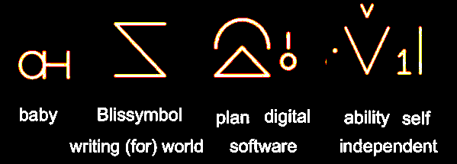
Baby Bliss Bot

Slide 70
Accessible and Equitable AI Standard for the Accessible Canada Act

Slide 71
Specific to Disability
Accessibility: Nothing without us
Statistical discrimination
Cumulative harm
Education

Slide 72
Phase 1: 4 Parts
Accessible AI
Equitable AI
Organizational Processes that support Accessible and Equitable AI
Education

Slide 73
… at the speed of trust
Notes:
There is a mantra within responsible AI that we will progress at the speed of trust

Slide 74
Intelligence that works with the edge of our human scatterplot is better able to ..
Adapt to change & respond to the unexpected
Detect risk
Transfer to new contexts
Results in greater dynamic resilience & longevity
Will reduce disparity
May hold the key to our survival

Slide 75
Continuing the conversation:
https://accessible.Canada.ca
https://idrc.ocadu.ca
https://wecount.inclusivedesign.ca
@juttatrevira
https://medium.com/@jutta.trevira
Notes:
Thank you

Slide 76
Blank

