Slide 1



ATAP & AT3 Center’s Aging Peer Action Learning Cohort-Session One
The Landscape of Assistive Technology (AT)
and Older Adults
Wednesday, January 14, 2026
3:00 - 4:30 pm ET
at3center.net
ataporg.org

Slide 2

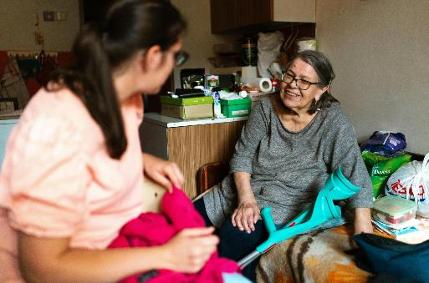

Reminders
To see captions, click on the CC button on the
control panel.
Please enter questions/comments in the Q&A window. Comments will be addressed at logical stopping points or at the conclusion of the webinar.
Please complete post-webinar survey that will immediately follow the webinar; we would like to know if the information provided was helpful.

Slide 3

Today’s Schedule
Intro
Overview, Goals & Objectives
Aging PAL Panel Speakers & Q&A
Closing reflection, Questions & Takeaways
Announcements and next sessions

Slide 4

Aging PAL Overview & Objectives
OBJECTIVES
Improve awareness and knowledge among AT Act programs and aging-related entities about services and structures
Strengthen collaborations among AT Act Programs and state and local entities supporting older adults.
Improve access to assistive technology for older adults.

Slide 5

Today’s Presenters
ANDREA ROUTH-Facilitator
Former Aging Service Director in Missouri and Founder of the Leading Impact LLC
HOLLY RILEY
Director of Aging Services for Advancing States
DEBORAH STONE-WALLS
Chief of Programs and Services at USAging
EMILY NABORS
Associate Director of Innovation at the National Council on Aging
HEATHER MARRIOT
Program Specialist-National Council on Aging’s Center for Healthy Aging
ARLENE LUGO
Director of the Connecticut Assistive Technology Act Program
SPEAKER BIOS

Slide 6
POLL
at3center.net
ataporg.org

Slide 7


Aging Peer Action Learning
January 14, 2026

Slide 8



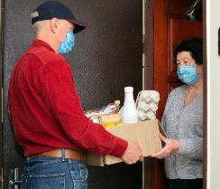
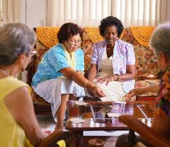
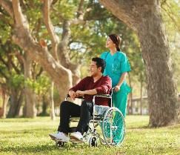

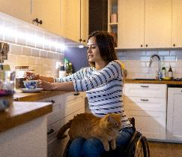
Vision and Mission
Our Vision:
Older adults, individuals with disabilities, and their caregivers will have access to the resources they need to live well & thrive in every community.
Our Mission:
To design, improve, and sustain state systems delivering long-term services and supports for people who are older or have a disability, and their caregivers.

Slide 9
ADvancing States contributes to shared success:
For state agencies:
We provide a state-to-state exchange of information that informs and enhances policy and program development, reaching beyond departments focused on aging and disabilities.
For federal partners:
We deliver accurate, timely, national and state specific information vital to the interests of older adults and persons with disabilities and their caregivers.
For the networks:
We contribute to meaningful collaboration among partners, including other national associations, to achieve desired results.
For individuals:
We enhance the ability to live healthily, safely and engaged in all communities with appropriate services, supports and opportunities.

Slide 10








We Provide Leadership, Technical Assistance, and Policy Support to State LTSS Systems in the Following Areas
ADvancing
Community Integration
ADvancing
Organizational Effectiveness
ADvancing
Health and Wellness
ADvancing
Participant Health and Welfare
ADvancing Consumer Access
ADvancing
Quality Outcomes
ADvancing
Caregiving and Workforce
ADvancing
Service Access
Notes:
AY

Slide 11
The Older Americans Act
A framework of supportive services so older adults are empowered to age with dignity, health, and independence.
The Older Americans Act (OAA) established the aging services network and is considered the major method for the delivery of supportive and nutrition services.

Slide 12
Who Does the OAA Serve?
All adults 60 and older are eligible for OAA programs, however the program has limited funding to support it.
All adults 60+
Services must be prioritized for people with greatest social and economic need with particular attention to and specific objectives for providing services to
low-income minority older adults,
older adults living in rural areas,
people with LEP, and
older adults with disabilities.
Targeted & prioritized groups

Slide 13
OAA Titles
Title I. Declaration of Objectives
Sets out broad policy objectives oriented toward improving the lives of all older people.
Title II. Administration on Aging
Establishes within the Department of Health & Human Services the AoA as the chief federal agency responsible for advocating for older adults; sets out responsibilities of AoA and the Assistant Secretary for Aging. Establishes aging network activities.
Title III. Grants for State and Community Programs on Aging
Authorizes activities of state & AAAs, funds for supportive & nutrition services, family caregiver support, and disease prevention & health promotion.
Title IV. Activities for Health, Independence, and Longevity
Authorizes research, training, and demonstration projects in the field of aging.

Slide 14
OAA Titles at a Glance, cont.
Title V. Community Senior Services Opportunities Act
Authorizes funds to support part-time employment opportunities for unemployed low-income people age 55 and older who have limited employment prospects. Administered through the Department of Labor.
Title VI. Grants for Tribal Organizations
Authorizes grants for supportive services, nutrition services, and caregiver services for Native Americans, Alaskan Natives, and Native Hawaiians.
Title VII. Vulnerable Elder Rights Protection Activities
Authorizes funds for the long-term care ombudsman program & services to prevent elder abuse, neglect, and exploitation.

Slide 15
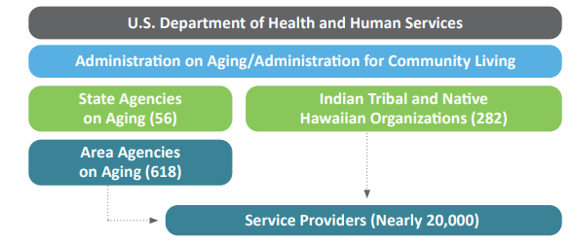
The Aging Network

Slide 16
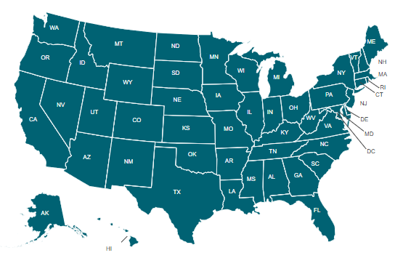
Engaging with SUAs
Useful for cross-state comparisons

Slide 17

Web: ADvancingStates.org
Email: Aging@advancingstates.org

Slide 18


Area Agencies on Aging: Local Leaders in Aging and Community Living
Deborah Stone-Walls, Chief of Programs and Services
Updated January 2026

Slide 19
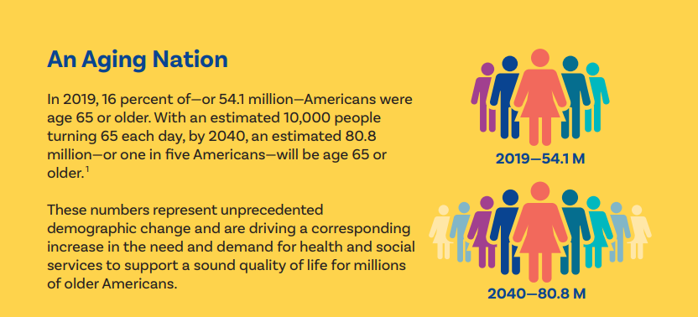
An Aging Nation

Slide 20
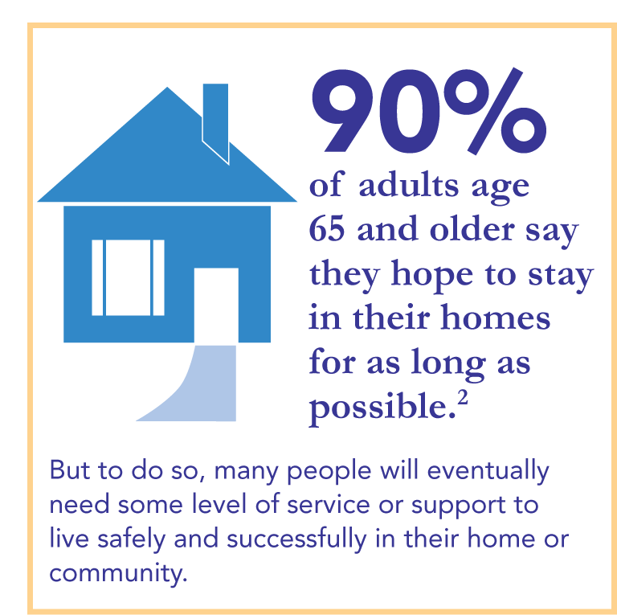
90% of Adults

Slide 21
The National Aging Network
Mission = To develop a comprehensive and coordinated system of home and community-based long-term services and supports (LTSS) that is responsive to the needs and preferences of older adults and caregivers
Meet people where they are, provide alternatives to nursing home care
Access point for information on all things LTSS

Slide 22
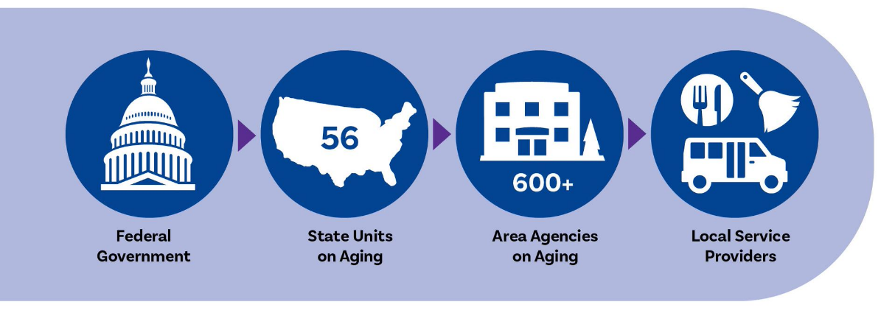
The Aging Network-2
TRIBES = Title VI Aging Programs

Slide 23
Nationwide Network with a Local Flavor
There are 613 AAAs serving older adults in virtually every community in the nation.
In a few small or sparsely populated states, the state serves the AAA function (AK, DE, ND, NH, NV, RI, SD, WY).
The OAA is foundational for all AAAs, but because the law calls for local control and decision-making, AAAs adapt to the unique demands of their communities to provide innovative programs that support the health and independence of older adults.

Slide 24
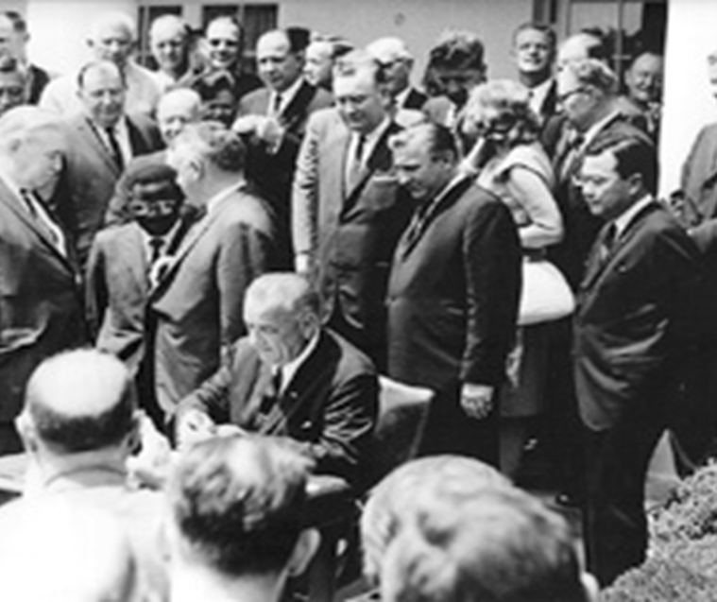
Older Americans Act (OAA)
Summer of 1965, days before Medicare and Medicaid
Created the National Aging Network over time
Remains the foundational core of the Network’s work today
Most of Act applies to those age 60 and older but the Aging Network targets services to the most frail and vulnerable, as well as those in greatest economic and social need

Slide 25
Timeline of Major Amendments to OAA
1965
1972 – Nutrition program
1973 – AAAs created; multipurpose senior centers and community service employment authorized
1978 – Title VI added, Home-delivered meals authorized and ombudsman services required
1992 – Elder rights recognized
2000 – National family caregiver support program
2006 – HCBS systems thru ADRCs; evidence-based health promotion services
2016 – Small changes to definitions, specific authorization levels
March 2020, P.L. 116-131
Increases in authorization levels, emphasis on social isolation, clarification of AAA activities outside OAA

Slide 26
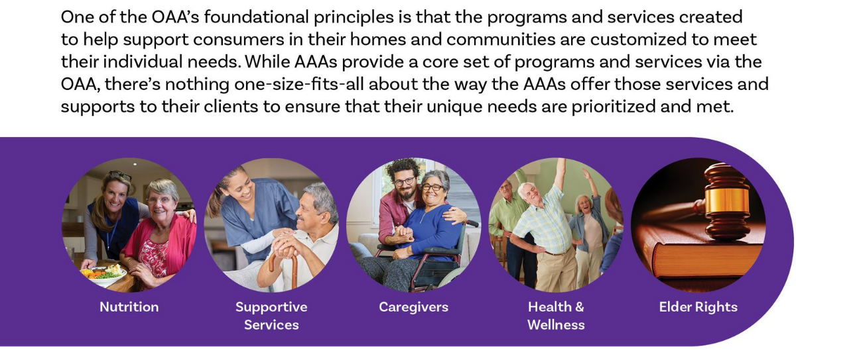
Core Services, Local Flexibility

Slide 27
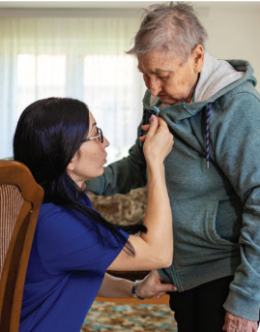
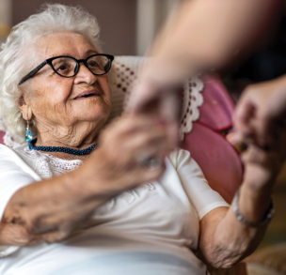
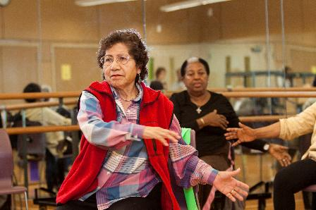
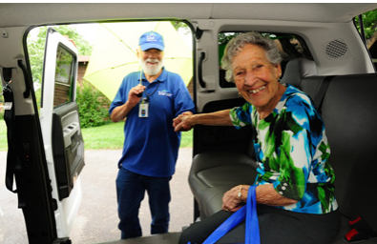
OAA Title III B: Supportive Services…
In-home help with living!
Transportation
Chore services
Home modifications
Social engagement activities
Senior Centers
Legal services
Adult day services
Any other services necessary

Slide 28
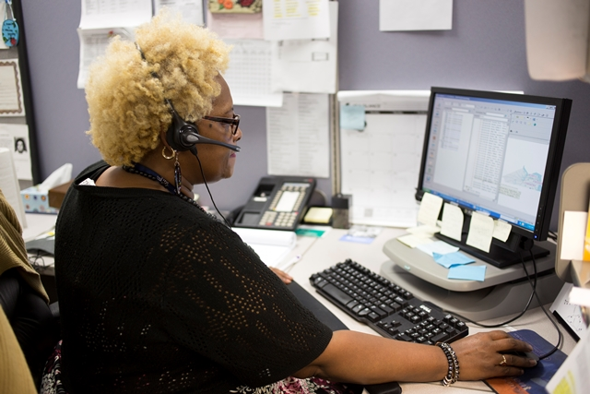
OAA Title III B: Information, Referral & Assistance
Local hotlines to connect callers to HCBS and related services.
Case management for HCBS
Benefits and eligibility counselors
Health insurance benefits counselors
Care Transitions coaches
Identification and prevention of elder abuse

Slide 29
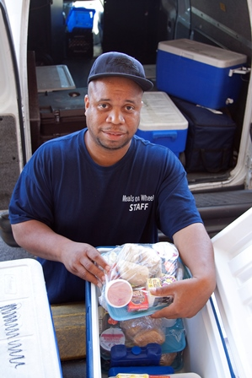
OAA Title III: There’s So Much More!
C: Nutrition Services
Home-Delivered Meals
Congregate Meals
Nutrition Services Incentive Program
D: Evidence-Based Disease Prevention and Health Promotion Services
Wellness and socialization programming at local senior/community centers
Chronic Disease Self-Management programs
Falls Prevention programs
E: National Family Caregiver Support Program
Respite
Support and navigation help
Caregiver training

Slide 30
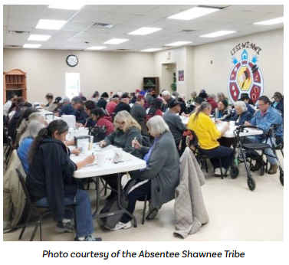
Older Americans Act
Title V Senior Community Service Employment Program is a low-income community service/employment program run by Dept. of Labor
Title VI: Native American Aging Programs, competitive grants to tribes for supportive services and meals (Part A), caregiver program (Part C)
Title VII: Elder Rights provides funding for Long-Term Care Ombudsman Program, elder abuse prevention, some legal services

Slide 31
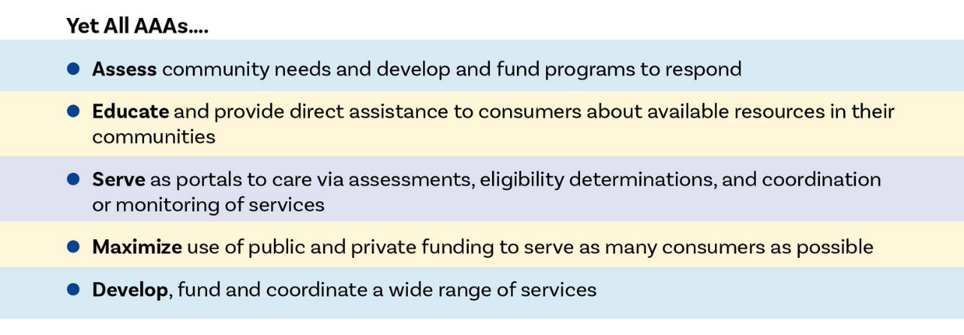
AAAs Serve Communities
Building on their designated roles under the OAA, AAAs tap other funding streams and take on other roles to further meet their missions and to serve more older adults and caregivers, as well as people of all ages living with disabilities.

Slide 32
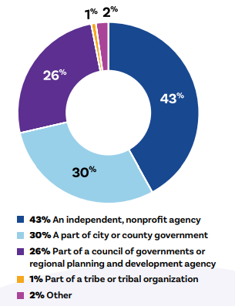
AAA Governance Structure

Slide 33
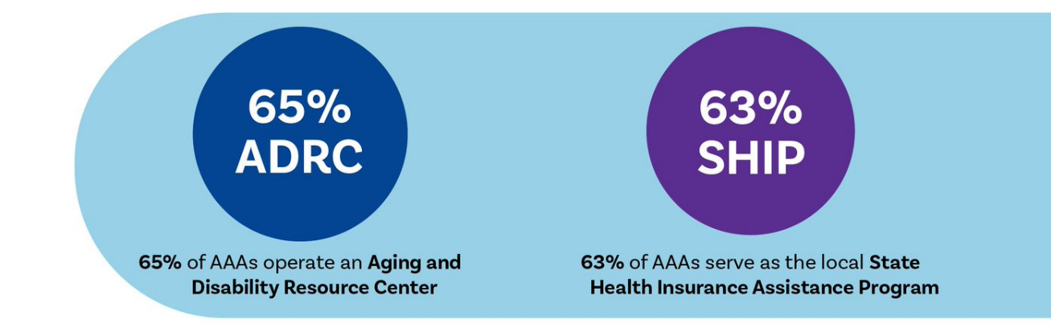
Many Names, Many Partners, Many Roles: One Mission
While only designated AAAs can use the Area Agency on Aging title, not all AAAs include "Area Agency on Aging" in their operating names. For example, a nonprofit AAA may be called "Senior Resources" or a county-based AAA may use "ABC County Office on Aging.“
AAAs administer many other well-known programs and services directly or in partnership

Slide 34
88 Percent of AAAs Serve Consumers Under Age 60
88% of AAAs serve individuals under 60
75% serve caregivers of all ages
71% serve individuals under 60 with a disability or chronic/serious illness
50% serve consumers with dementia of all ages
44% serve children or older relative caregivers raising them
34% serve veterans under 60
Notes:
Who are AAAs serving? 90 percent of AAAs provide services to consumers under age 60 in one of the following categories:
80% of AAAs serve individuals under 60 who have a disability or chronic/serious illness
75% serve caregivers of all ages
49% serve consumers with dementia of all ages
33% serve veterans under 60

Slide 35
Non-OAA Sources of Federal Funds
Medicaid Waivers
State Health Insurance Assistance Program (SHIP)
Federal Block Grants: Community Services Block Grant, Social Services Block Grant, Community Development BG
Low Income Home Energy Assistance Program (LIHEAP)
Demonstration/other $ from ACL (falls prevention, CDSMP, ADRCs)
Veteran-Directed HCBS programs
Senior Corps programs (Corp. for National & Community Service)
Demos under Centers for Medicare and Medicaid Services (CMS)

Slide 36
Reaching YOUR AAA
Look it up via usaging.org or eldercare.acl.gov
Make sure you know all that your local AAA can offer to you and members of your community (e.g., meals, rides, home modification, home health, caregiver respite, etc.)
Check their website or just call!
Get to know the I&R and case management staff

Slide 37
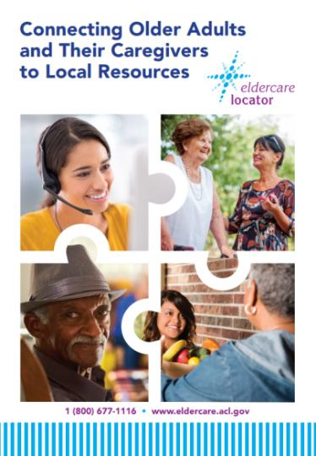
Eldercare Locator National Call Center
800.877.1116
Monday-Friday,
9:00 am ET to 9:00 pm ET
eldercare.acl.gov
Notes:
We are the Eldercare Locator!
The Eldercare Locator is a service that is funded by the Administration on Aging of the Administration for Community Living. We are administered by the National Association of Area Agencies on Aging. We work very closely with the NASUAD in the promotion of quality information and referral services nationwide.
We are 15 staff members strong –all with diverse educational backgrounds from psychology to pubic health to computer science and mass communications. Our staff have experience in human services fields such as working for the non profit health sector and several have worked in public transportation services. We also have several staff members with a background and study in IT and technology. What brings us all together is our common desire to enhance the lives of older adults, persons with disabilities and their caregivers by linking them to community resources, programs and services. I want you know about them and consider them your colleagues in our field.
Specifically, we have 8 Information and Referral Specialists. They form our foundation and are our front line staff answering calls on an ongoing basis.
We also have 4 staff who serve in the Enhanced Services area. I will explain this in more detail however, these staff members provide additional support to staff in complex calls and have additional responsibilities to ensure that we are running a responsive and trusted service.

Slide 38
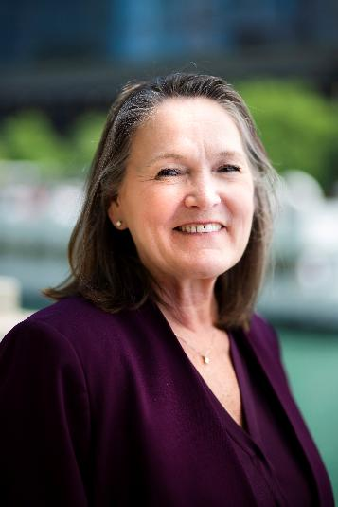
Debora Stone-Walls Info
Deborah Stone-Walls
Chief, Programs and Services
dstone-walls@usaging.org
1100 New Jersey Ave, SE, Suite 350
Washington, DC 20003
202.872.0888
www.facebook.com/theUSAging
www.x.com/theUSAging

Slide 39
Promoting Aging & Disability Partnerships
with Senior Centers and State Falls Prevention Coalitions
Emily Nabors
Associate Director of Innovation
Heather Marriott
Program Specialist, Center for Healthy Aging
January 14, 2026

Slide 40




National Council on Aging
The national voice for every person’s right to age well.
Resources
Best Practices
Trusted, unbiased information that enable older adults and their caregivers to take small steps that can have a big impact on their health and financial security
Technical assistance and support for professionals in community-based organizations who serve older adults every day
Tools
Advocacy
Personalized, online support for individuals to find benefits, choose a Medicare plan, prevent falls, and plan for a healthy and secure life
A national platform and voice to fight against ageism—and to strengthen the federal programs we all depend on as we age
Learn more at www.ncoa.org @NCOAging ​
​
Notes:
The National Council on Aging is the national voice for every person’s right to age well.
Working with thousands of national and local partners, we provide resources, tools, best practices, and advocacy to ensure every person can age with health and financial security.

Slide 41
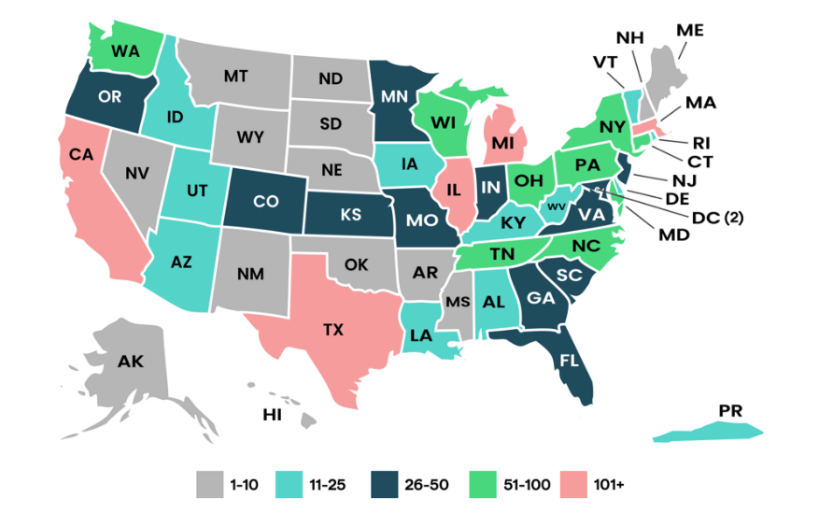
National Institute of Senior Centers – National Network for Senior Center Professionals
For more than 50 years, the National Institute of Senior Centers has been the nation's only membership network for senior centers. 2,700+ members.

Slide 42
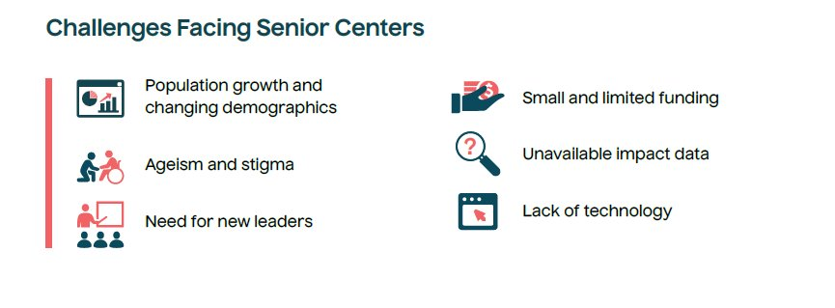
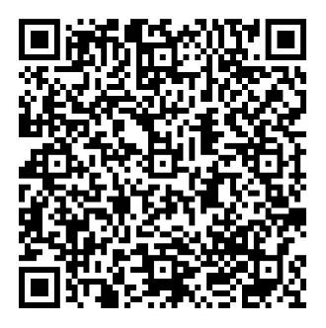
Engaging Senior Center Professionals
Notes:
A 2023 scan of senior center administrators and community stakeholders revealed some important findings on challenges and opportunities facing today's senior centers.
Among the main themes that emerged: trends in staffing and leadership; funding challenges; impact of technology; impact of COVID-19; and the role of NCOA's National Institute of Senior Centers.
These findings help guide current and future work of NISC. We continue to collect information from our senior center partners through an indepth survey around who they are serving, what takes place at their center, and how they operate.

Slide 43
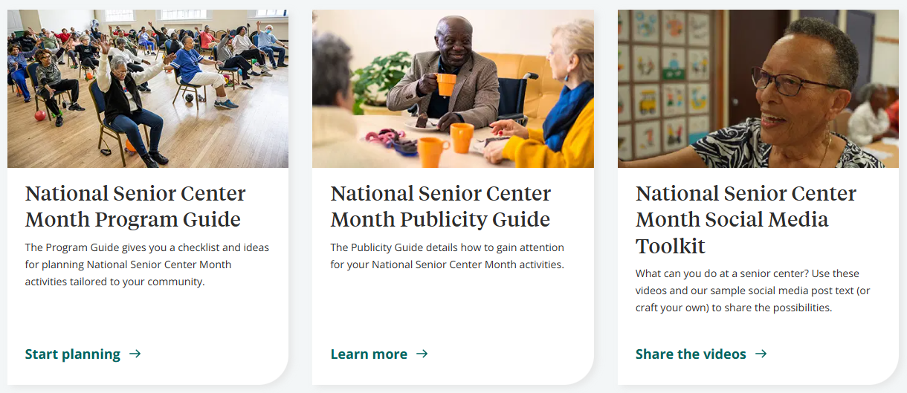
National Senior Center Month
Notes:
Every year NCOA hosts National Senior Center month, with a theme to share with our partners. We then develop tools and guides for how senior centers can engage their community and host events alongside our national network of senior center professionals.

Slide 44
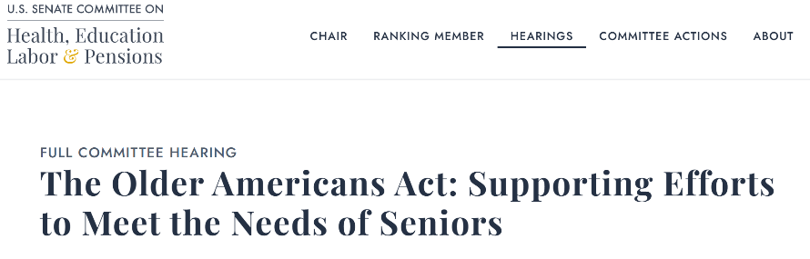
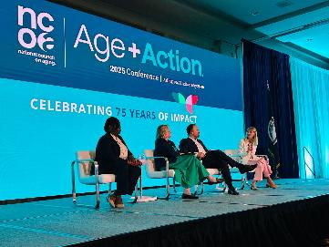
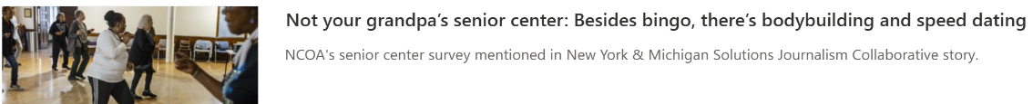
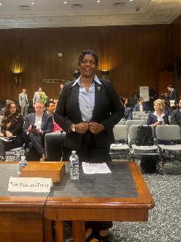
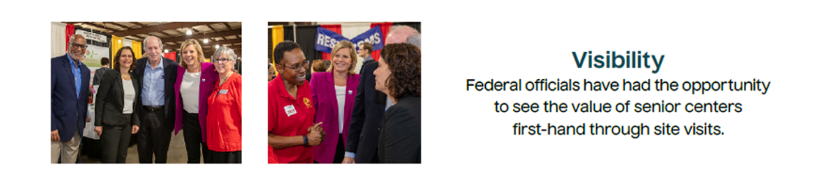
Advocating for Senior Center Needs
Notes:
NCOA meets monthly with a leadership collaborative with representatives from senior centers across the nation. We continue to ask for their updates from the field – the needs and opportunities that can align with our advocacy efforts on the hill. Through this partnerships, NCOA's advocacy work is responsive to the ever changing needs and concerns of our senior center partners. We have brought our senior center partners to the Hill to talk about the importance of the Older Americans Act to their programming and operations. We bring them in to speak at our national conference, we do site visits to centers so that we can share their stories at the national level, and even have had some federal funding partners visit centers with us.

Slide 45
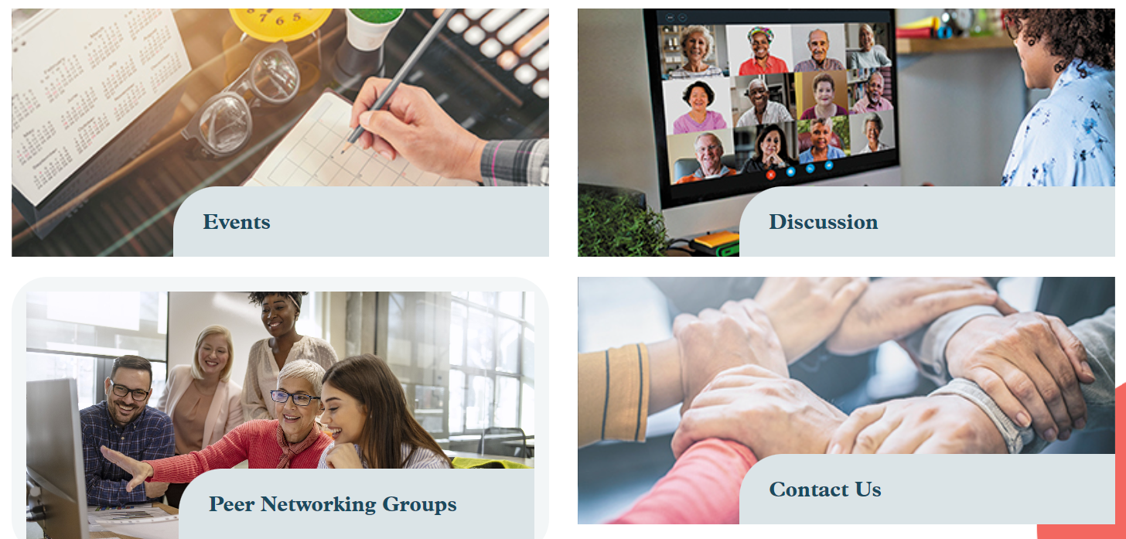
Online Learning and Peer Networking
https://connect.ncoa.org/senior-center-resource-center-home
Notes:
We host regular webinars, including senior center summits and programs of excellence presentations highlighting the top programs hosted by senior centers across the nation each year. We host many opportunities for networking for senior center professionals – including small group discussions around affinity groups, a regular newsletter, and a specific track within our conference.

Slide 46

Aging in Community
Most homes were not built to support aging
Homes age as people age, present barriers to aging in place, fall hazards
Safe, supportive housing is integral to age-friendly communities
Notes:
People want to stay in home, community
Aging in place maintains access to resources, social connections, and supports independence
Home is now a health care setting: Caregiving, home and community-based services
Problem: Housing does not support aging
More than half of all falls among adults age 65+ happen in the home
Most homes were not built with features that support individuals’ ability to perform their daily activities, such as bathing and cooking, should they develop mobility impairments. Fewer than four percent of U.S. residential units are suitable for people with moderate mobility disabilities; about one percent are wheelchair accessible. (Joint Center for Housing Studies, Harvard University, 2016)

Slide 47

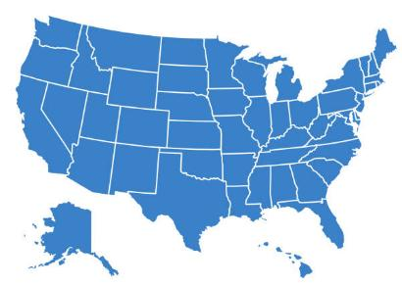
State Coalitions on Falls Prevention
State-based networks of partners dedicated to falls prevention
45 State Falls Prevention Coalitions
Coalition representatives convene quarterly
Notes:
45 active and in-development

Slide 48
State Falls Prevention Coalitions- Who’s involved?
Common Coalition Members
Aging
AAAs
ADRCs
State Units on Aging
Senior Centers
Aging Service Professionals
Disability
State AT Programs
Centers for Independent Living (CILs)
Rehab Centers
Health Care
Public Health
Health Systems
Primary Care Offices
OTs & PTs
EMS & Fire Depts
Home Health
Housing
Housing Depts
Home Improvement
Service Coordinators
Habitat for Humanity
Rebuilding Together
Also, people with lived experience, Tribal organizations, non-profits (Meals on Wheels), volunteer groups (Rotary clubs), libraries, faith-based groups, policymakers, and many others!
Notes:
AT supports individuals with disabilities and older adults to live at home independently and with a higher quality of life. Most AT for housing includes simple devices such as threshold ramps, grab bars, and transfer poles, assisting individuals in avoiding falls and saving thousands of dollars in healthcare costs. Smart home devices, including lights, thermostats, and security systems, now provide environmental control opportunities for residents with mobility limitations. Devices that support memory and cognition assist older adults and others in staying current with medications. Home modifications, such as ceiling track systems, can lift persons with paralysis and move them between rooms. Service providers can remotely monitor residents' routines using sensors and then drop in via video to provide assistance, support, and companionship.
Centers for Independent Living (CILs) are community-based organizations that support people with disabilities in achieving greater independence and improving their quality of life. They offer a variety of services, including connecting individuals with resources and services in the community for transportation, healthcare, and support with transitions to community living.

Slide 49
State Falls Prevention Coalitions- What do they Do?
Common Coalition Activities
Raise community awareness of falls risk and available resources
Identify priority community needs and share data
Host webpages to provide centralized resources and provider information
Improve service delivery and coordinate referral systems
Support implementation of evidence-based falls prevention programs
Educate professionals, providers, and students
Conduct home assessments and demonstrations
Present at health fairs
Advocate for funding and resources

Slide 50
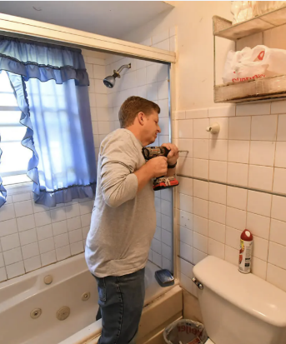
Sources of Information, Referrals
Local Area Agencies on Aging
Local Centers for Independent Living
State Assistive Technology Programs
Rebuilding Together and Habitat for Humanity
Meals on Wheels
HUD Older Adult Home Modification Program
State and local coalitions
Falls prevention
Injury prevention
Housing, home modification, home safety
Age-friendly
CICOA Aging & In-Home Solutions
(Area Agency on Aging) Central Indiana
Safe at Home Program
Notes:
In 2021, 70% of Centers for Independent Living (CILs) operated home modification programs to help people make their homes more accessible. Some CILs help recommend improvements, others help with minor home mods, and some CILs assist with everything from recommendations, planning, and construction.
AT – medical equipment closets, home mod programs, AT devices and tech, and demonstration centers.

Slide 51



Benefits of Coalition Involvement
Individual Benefits
Organizational Benefits
Community Benefits
Networking & mentorship
Develop new skills
Access new resources
Make your voice heard
Fulfillment
Build partnerships
Expand reach and impact
Grow organization recognition
Develop relationships with policymakers
Awareness of new opportunities, resources
Improved community health & well-being
Stronger helping systems
Services align with community needs
Streamlined referral processes
Prevent duplication of efforts
State Falls Prevention Coalitions

Slide 52
Thank you!
Emily Nabors
National Council on Aging
emily.nabors@ncoa.org
Heather Marriott
National Council on Aging
heather.marriott@ncoa.org
This project was supported by the Administration for Community Living (ACL), U.S. Department of Health and Human Services (HHS) as part of a financial assistance award totaling $5,000,000 with 100 percent funding by ACL/HHS. The contents are those of the author(s) and do not necessarily represent the official views of, nor an endorsement, by ACL/HHS, or the U.S. Government.

Slide 53


The Assistive Technology Act Programs & the CT Tech Act Project: Serving Individuals with Disabilities and Older Adults
Arlene Lugo, Program Director
CT Tech Act Project
A program within the Connecticut Aging & Disability Services

Slide 54

What is the Assistive Technology Act?
a federal law in the United States that provides funding to states and territories to support programs aimed at increasing the availability of, access to, and acquisition of assistive technology (AT) devices and services for individuals with disabilities.
Notes:
Includes older adults where they may not consider themselves as having a disability but may have some functional limittiations, such as hearing loss, vision loss, cognitive difficulties, balance and mobility issues, fine motor skills difficiulties and more.

Slide 55
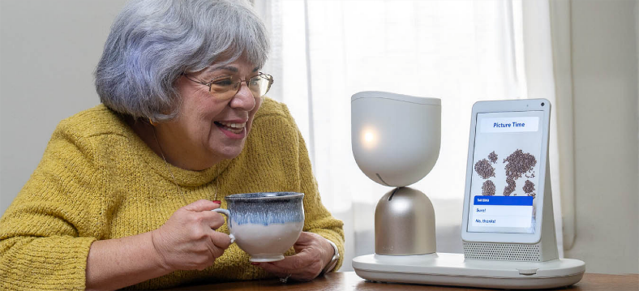
What is the Purpose of the AT Act?
Its primary purpose is to help people with disabilities of all ages and those aging into disability to more fully participate in education, employment, and daily activities by providing them with the tools and services they need to live more independently as well as to age in place and safely in the community of their choice.

Slide 56
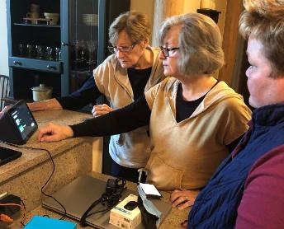
What is Assistive Technology?
ASSISTIVE TECHNOLOGY DEVICE: any item, piece of equipment, or product system, whether acquired commercially, modified, or customized, that is used to increase, maintain, or improve functional capabilities of individuals of all ages with disabilities and/or those aging into disability.
ASSISTIVE TECHNOLOGY SERVICE: any service that directly assists an individual with a disability in the selection, acquisition, or use of an assistive technology device such as an evaluation, training, equipment setup, equipment purchase, etc.
Notes:
As defined by the 21st Century AT Act legislation

Slide 57
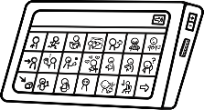



Core Services of AT Act Programs
Device Demonstration
Device Short-Term
Loans
Device Reutilization
Alternative Financing
See, touch, and try AT devices to help aid in the decision-making process.
Borrow AT to determine if a device meets an individual’s needs before making a purchase.
Receive gently used AT devices and durable medical equipment to use for as long as needed.
Purchase AT device or equipment with
various finance options
Notes:
In addition to these core services, we also provide I&A, Training, Public awareness and technical assistance activities.

Slide 58
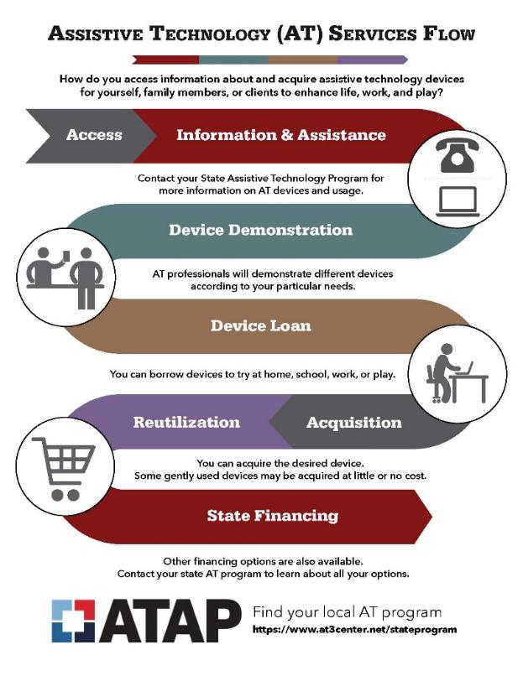
Services Flow of the AT Act Programs

Slide 59
The AT Act Summarized
AT Act Programs:
Increase awareness of AT.
Provide access to AT devices through demonstrations, loans, and reutilization programs.
Help individuals acquire AT through various financing options and support.
Offer training and technical assistance on the use and benefits of AT to individuals with disabilities, their families, and professionals.
Notes:
Every state and US territory has an AT Act Program

Slide 60
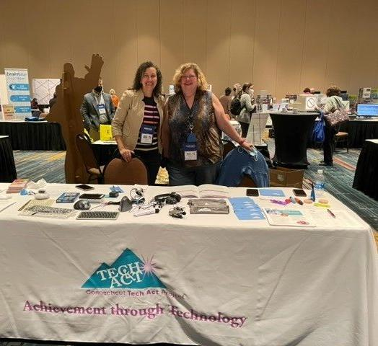
CT Tech Act Project
Mission:
To increase independence and improve the lives of individuals with disabilities through increased access to Assistive Technology for work, school and community living.
Notes:
The Connecticut Tech Project is small but mighty it’s made up of myself and my one staff person Muriel Aparo, who hopefully you have already met or will meet today at our table out in the preassembly area across from registration
If you didn’t know, the Connecticut Tech project has been around since the early 1990s. I joined in 2006 and had loved working with this program and with assistive technology where we help individuals with disabilities increase their access to AT home education and community living that’s our mission. We are happy to work with individuals with disabilities, family, members, educators, employers, professionals who seeking access to services and support.

Slide 61
CT Tech Act Project AT Partners
ACES
CREC
EASTCONN
Meriden ATECH
NEAT Center
SERC
SCSU – Center for Assistive and Educational Technology
UCP of Eastern CT
Notes:
In Connecticut, we provide these services internally myself and Muriel, but also through our excellent community AT partner agencies throughout our state who are amazing!

Slide 62
AT & Aging
AT can help aging adults live safely, independently, Age in Place, socialize, communicate, enjoy recreation, education and learning, participate in their communities, access telehealth, shop and so much more!
Individualized approach: What works for one, may not work for another.
Family, friends, support people should be involved.
We don’t expect all professionals or family members to know what’s needed – that’s why we’re here to help.
Notes:
AT helps all ages and for older adults it can mean living safely & independently, aging in place, staying connected and socializing and communicating with family, friends their community, accessing telehealth, recreation, lifelong learning, social media, shopping on line for groceries or books or other items and so much more.
Like with anyone – the right AT match is individualized depending on the person, their unique barriers or areas of difficulties, and the activities they are trying to do.

Slide 63
CTTAP programs for Aging Adults
Since 2020, the CT Tech Act Project and our Bureau on Aging have partnered to provide programs that help both people with disabilities and our aging adults in CT.
CARES funding → Stay Connected Program
Public Health Workforce Funds, along with Older Americans Act Funds & and ARPA → Bridging the Digital Divide & Virtual Senior Connections platform
Notes:
Focusing on reducing social isolation especially during COVID, we worked individually with PwD and Older adults, distributing technology and providing training. That transformed into the Bridging the Digital Divide program which we’ve run over the past 3 years, ending in June 2025. We served over 800 individuals and 70 entities across our state, connecting people to technology, helping them learn to use accessibility features, stay connected and access telehealth. We also were able to begin the process of implementing a virtual senior platform for seniors and senior centers.
Excited to report we may be bringing a version of the Bridging the Digital Divide program back under a new grant. We know we only served a small portion of our seniors and adults with disabilities and we identified many gaps. Hoping we can continue to work to fill those gaps together with our Bureau on Aging.

Slide 64
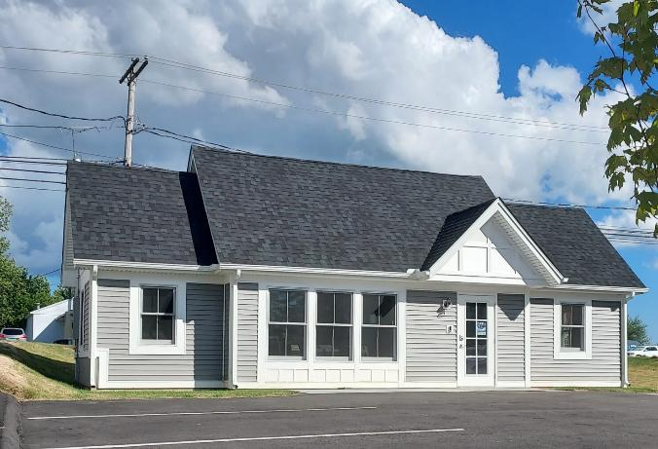
Smart Home Assessment Center
Opened fall 2025 in Meriden, CT
A place for people with disabilities, older adults, professionals & field staff and family members to visit and see / try out a host of Assistive & adaptive Technology, smart home tech, and remote supports.
Goal: increase independence, improve safety in the home and for aging in place.
Notes:
https://livingwithoutlimits.org/smart-home-2/
Living Without Limits has opened a stand-alone Smart Home to showcase various assistive technologies, as well as act as a statewide assessment center! The Smart Home contains a kitchen, living room, bedroom, and office that is contextually staged to demonstrate how different sensors and devices can be utilized within your home. Assessments can also be completed within the Smart Home either by Living Without Limits Assessors or an outside agency.
In addition our NEACT Center has a Smart Home on Wheels or the SHOW – a tinier home and UCP is also building a smart home show room.

Slide 65
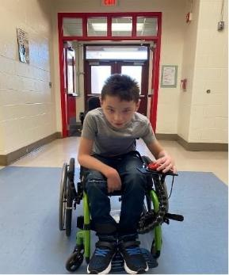
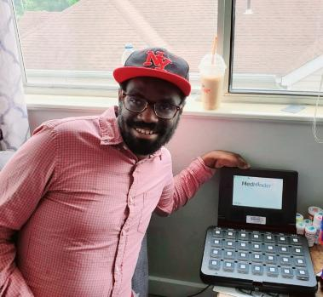
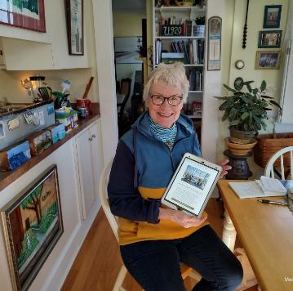
Conclusion – we’re here to help!
The AT Act Programs are available in each state and US territory.
We work with individuals with disabilities of all ages, including aging adults (and family members)
We’re here to help - raise awareness, offer direct hands-on demos, device lending, training and more!
Notes:
Remember: every state and US territory has an AT Act Program. We all provide the same core services – though how we provide them may differ. And some services may vary – so check with your state’s program to see what they have to offer.
We serve all ages and we’re here to help.

Slide 66
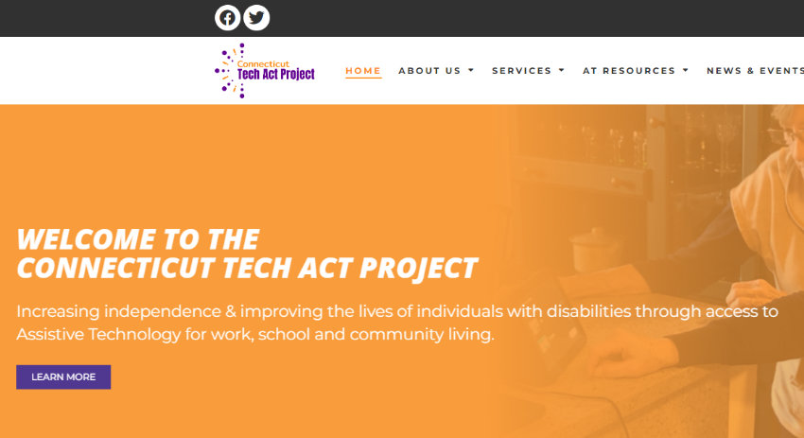


Contact for CT:
Arlene.lugo@ct.gov
Call / Text: 860-803-0588
Visit: www.CTtechact.com
Subscribe to our newsletter / Blog
Notes:
In CT, to reach me and learn more about the CT Tech Act Project you can vsist our website and view our blog and subscribe. You don’t have to live in CT to subscribe

Slide 67
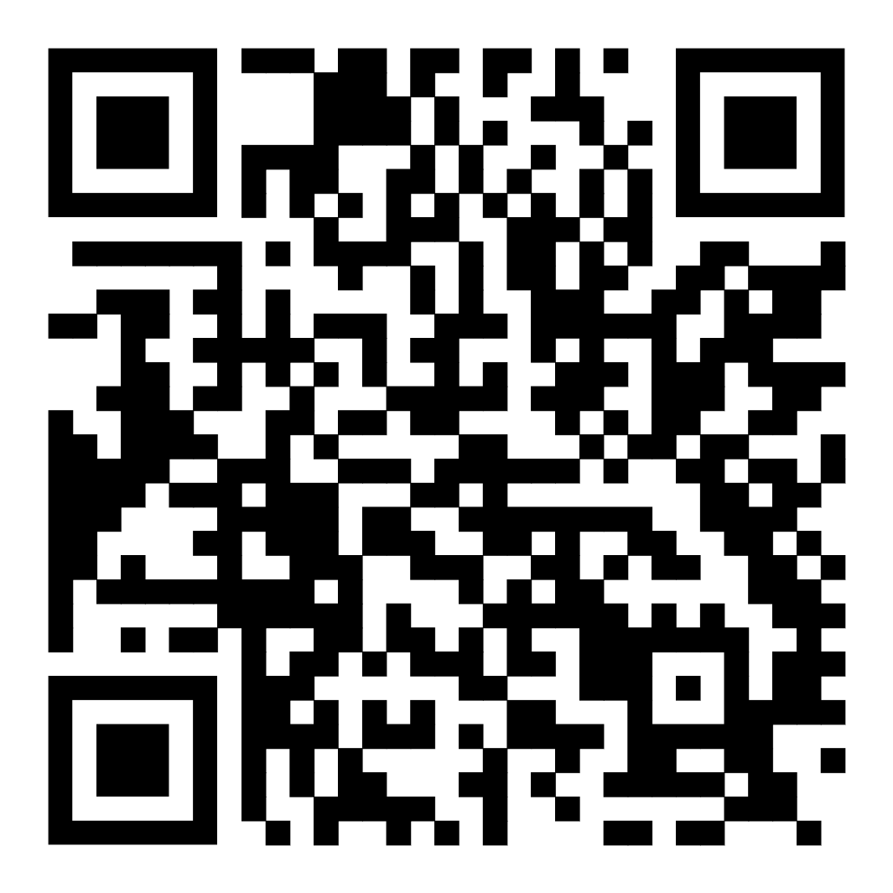
Contact Your State
Every state. Every territory. Every person.
Scan the QR code to discover your local AT Act Program.
Notes:
Find your state’s AT program via the AT3 Center or his QR code.

Slide 68
Closing Reflection, Questions, & Takeaways
at3center.net
ataporg.org

Slide 69
Upcoming Sessions & the Aging PAL Community Forum

Slide 70
Contact Info
Jamie Anderson-ATAP & AT3
Director of Membership & Operations
Jamie.Anderson@ataporg.org
Marty Exline-ATAP & AT3
Training & Technical Assistance Lead
Marty.Exline@ataporg.org
Jeannie Krull-ATAP & AT3
Executive Director
Jeannie.Krull@ataporg.org
at3center.net
ataporg.org

