Slide 1
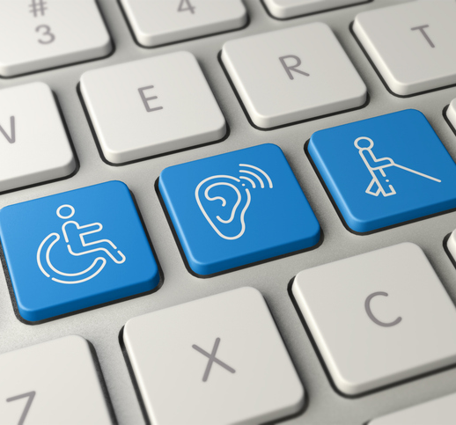
AEM & AT
ATAP/AT3 Ed PAL Cohort
Presenter: Cynthia Curry
September 11, 2024
Notes:
Decorative image by abdoudz available by subscription on iStock

Slide 2
Hello!
Cynthia Curry, MSEd
Associate Director, Technical Assistance Division of the Institute for Disability Research, Policy & Practice, Utah State University
Project Director of upcoming OSEP-funded National Center on Accessible Digital Educational Materials & Instruction (NCADEMI or “N-cademy”)
Former Director of Technical Assistance, CAST
Pre 2016:
  Disability Services Coordinator & Instructional Designer
  Project Director, OSEP 325T personnel development project
  Trainer for Maine’s AT Act Program, Maine CITE
  Statewide Technology Integration Mentor, Maine DOE
  Middle and high school science teacher
  Environmental engineer

Slide 3

Objectives
At the end of this presentation, you will understand:
The distinctions between and among accessible technology, AT, and AEM
Accessible technology, AT, and AEM are essential to digital accessibility for students with disabilities
The legal context for the provision of accessible technology, AT, and AEM for students with disabilities in elementary and secondary education
Sources of accessible formats and other media
Notes:
Image by 3D Animation Production Company from Pixabay

Slide 4
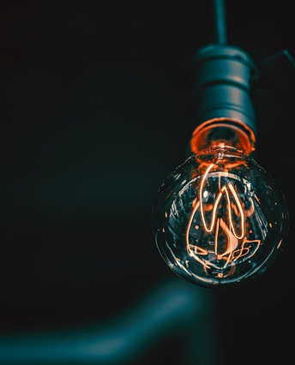
Opening Discussion
Please enter in the chat or un-mute your microphone to talk:
In your setting/from your perspective, what has been the biggest challenge for schools to provide accessible educational materials (AEM) for students with disabilities?
Notes:
Image by AJS1 from Pixabay

Slide 5
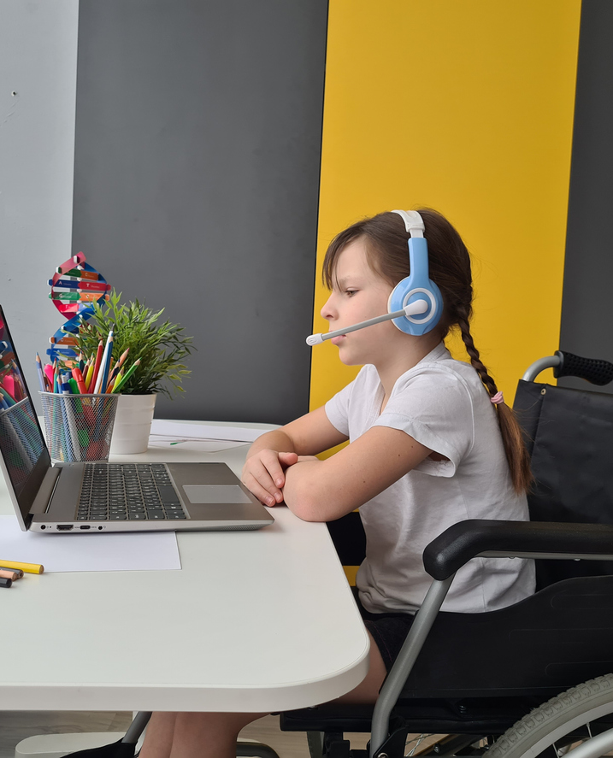
Starting with the Goal of Accessible Technology, AEM & AT:
Digital Accessibility for Students with Disabilities
Notes:
Image by RonBailey available by subscription on iStock

Slide 6
Frequently Used Interchangeably
“Accessible”
“Available”
“Inclusive”
“Affordable”
“Usable”

Slide 7

Definition in Federal Law & Guidance
An individual with a disability can
access the same information,
engage in the same interactions,
conduct the same transactions, and
otherwise participate in or benefit from the same services, programs, and activities
as individuals without disabilities, in a manner that provides substantially equivalent timeliness, privacy, independence, and ease of use.
Department of Justice, Civil Rights Division & Department of Education, Office for Civil Rights
Notes:
Decorative image by Schwarzenarzisse used under the Pixabay Content License: https://pixabay.com/photos/isolated-auction-dish-paragraphs-2532037/

Slide 8
Stated in the Context of Technology
“Like accessible buildings, accessible technologies afford disabled users the same freedom of digital movement and functionality that they afford non-disabled people; moreover, accessible technologies require disabled people to expend substantially equivalent effort as non-disabled people to access those affordances.
Conversely, inaccessible technologies exclude and stigmatize many disabled people, restricting or denying their forms of digital movement and interaction.”
-Shaheen, 2022 (page 2)
Notes:
Shaheen, N.L. (2022). Technology Accessibility: How U.S. K-12 schools are enacting policy and addressing the equity imperative. Computers & Education, 179. https://doi.org/10.1016/j.compedu.2021.104414.

Slide 9
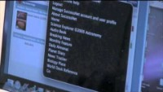
Digital Accessibility in Action (2008)
Notes:
Tyler Shows Us His Science Book is available on Maine CITE's YouTube channel: https://www.youtube.com/watch?v=UIZAvQWGyDE

Slide 10
Definitions
Accessible Technology
AT
AEM
Notes:
Image by RonBailey available by subscription on iStock

Slide 11
Components of Digital Access
AT
AEM
Accessible Technology

Slide 12
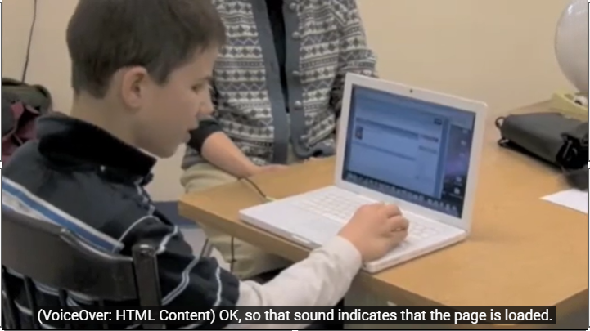
What AT is Tyler using?

Slide 13
Accessible Technology
Hardware and software that can be operated with a variety of input and output options needed or preferred by the user, including AT.
AKA, technology that works with a student’s AT and delivers AEM.
Examples of technologies that can be accessible
  Desktops & laptops
  Tablets & smartphones
  Learning management systems (LMSs)
  Curriculum software programs
  Apps
  Video players

Slide 14
What accessible technology is Tyler using?

Slide 15

Accessible Educational Materials (AEM)
“Print- and technology-based educational materials, including printed and electronic textbooks and related core materials that are required by SEAs and LEAs for use by all students, produced or rendered in accessible media, written and published primarily for use in early learning programs, elementary, or secondary schools to support teaching and learning.”
U.S. Department of Education, 2014 (footnote 10)
Notes:
U.S. Department of Education. (2014, May 9). Notice of Intent to Establish a National Center on Accessible Educational Mater [Notice]. Federal Register, 79(90), 26677-26679.
Image by Prostock-Studio available by subscription on iStock

Slide 16
AEM are…
Print (paper) or digital content delivered in a variety of media, including text, images, video, audio, braille, and tactile graphics
  Produced to be accessible from the beginning or
  Rendered in an accessible format
Accessible to the individual student with a disability
  What is accessible to one learner may be unusable by another (e.g., braille or audio)
The same content used by all students participating in a general education curriculum
  Same information, different presentation

Slide 17
Two Pathways to Provide AEM
A student needs AEM
Provide digital materials produced to be accessible from the beginning
Provide inaccessible materials rendered in accessible formats (e.g., braille, audio, accessible digital text, captions)

Slide 18
Two AEM Categories
Accessible Formats of Inaccessible Materials
Accessible Digital Educational Materials

Slide 19
What AEM is Tyler using?

Slide 20
Components of Tyler’s Digital Access
Accessible Technology
Laptop & digital book platform
AT
Screen reader program
AEM
Digital text & images (accessible digital educational material)

Slide 21
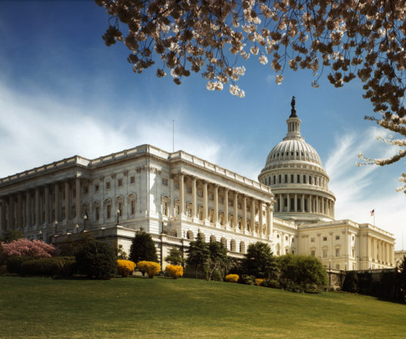
Relevant Legislation
Americans with Disabilities Act (ADA)
Section 504 of the Rehabilitation Act
Individuals with Disabilities Education Act (IDEA)
Notes:
Image available on Public Domain Media PICRYL: https://picryl.com/media/united-states-capitol-north-wing-3d7b45

Slide 22
ADA Title II vs. 504 & IDEA
Accessible Formats of Inaccessible Materials
504 & IDEA
Accessible Digital Educational Materials
ADA Title II
Notes:
Accessibility logo licensed under the Creative Commons Attribution-Share Alike 4.0 International license. Dave Braunschweig
Cartoon of stacked textbooks by Alexandra_Koch from Pixabay

Slide 23
ADA Title II
Final rule published by the Department of Justice in April 2024
Specific requirements about how to ensure that web content and mobile apps are accessible
Applies to State and local government entities, including state educational agencies and school districts
Conformance deadline occurs in April 2026 or April 2027, depending on population size
For more information, watch Lyssa Prince’s July 10th & 17th Ed PAL sessions – “What is digital accessibility?”

Slide 24
Section 504
Defines the rights of individuals with disabilities to participate in, and have access to, program benefits and services, and applies to all organizations and providers that receive financial assistance from any Federal department or agency.
The provision of free auxiliary aids and services includes materials in accessible formats pursuant to U.S. copyright law.

Slide 25
2004 Reauthorization of IDEA
To address delays in the provision of accessible formats of print instructional materials, Congress established:
National Instructional Materials Accessibility Standard (NIMAS)
National Instructional Materials Access Center (NIMAC)

Slide 26
NIMAS & NIMAC
NIMAS
A technical standard used by publishers to produce electronic source files of print instructional materials (NIMAS files) that can be converted to accessible formats for eligible students.
NIMAS files are not student-ready.
NIMAC
An online repository that receives, manages, and distributes NIMAS files for conversion to accessible formats.
Operated by the American Printing House for the Blind (APH).
Downloading of NIMAS files is restricted to Authorized Users selected by State educational agencies.

Slide 27
“Print Instructional Materials” under IDEA
2004: “Printed textbooks and related printed core materials that are written and published primarily for use in elementary school and secondary school instruction and are required by a State educational agency or local educational agency for use by students in the classroom.”
2020: A Notice of Interpretation clarified that the definition of “print instructional materials” includes digital instructional materials when those can be converted into the valid NIMAS format.

Slide 28
“Accessible Format” under U.S. Copyright Act
[A]n alternative manner or form that gives an eligible person access to the work when the copy or phonorecord in the accessible format is used exclusively by the eligible person to permit him or her to have access as feasibly and comfortably as a person without such disability.
-20 U.S.C. § 121(d)(1)

Slide 29

Student Eligibility
A student is eligible to receive an accessible format derived from a NIMAS file by meeting two conditions:
Is served under IDEA
Meets the criteria of “eligible person” established by the National Library Service (NLS guidelines)
Notes:
Image by Nadzeya Haroshka available by subscription on iStock

Slide 30
“Eligible Person” Criteria
(A)n individual who, regardless of any other disability—
  (A) is blind;
  (B) has a visual impairment or perceptual or reading disability that cannot be improved to give visual function substantially equivalent to that of a person who has no such impairment or disability and so is unable to read printed works to substantially the same degree as a person without an impairment or disability; or
  (C) is otherwise unable, through physical disability, to hold or manipulate a book or to focus or move the eyes to the extent that would be normally acceptable for reading.

Slide 31
“Competent Authorities”
Professionals who can certify that an individual is an eligible person:
doctor of medicine, doctor of osteopathy, ophthalmologist, optometrist, psychologist, registered nurse, therapist, and professional staff of hospitals, institutions, and public or welfare agencies (such as an educator, social worker, case worker, counselor, rehabilitation teacher, certified reading specialist, school psychologist, superintendent, or librarian)

Slide 32

Caution
A student’s need for accessible formats is separate from eligibility to receive accessible formats derived from NIMAS files.
Many sources of accessible formats that do not rely on NIMAS files exist. Materials from these sources can be provided to students who may not qualify under IDEA.
Open source and teacher-created materials can be converted to multiple formats for use by all students.
Notes:
Image by OpenClipart-Vectors from Pixabay

Slide 33

Sources of Free/Low-Cost Accessible Materials
Accessible Formats
Bookshare (bookshare.org)
APH (aph.org)
NLS (loc.gov/nls/)
State Instructional Material Resource Centers
Other Accessible Media
Described & Captioned Media Program (dcmp.org)
Notes:
Image by OpenClipart-Vectors from Pixabay

Slide 34
Preparing for Coaching Session
Share now:
  What is most important or relevant to you?
  What questions or concerns do you have?
  What kinds of resources would be most helpful?
Review “Providing AEM: Laws to Know”

