Slide 1
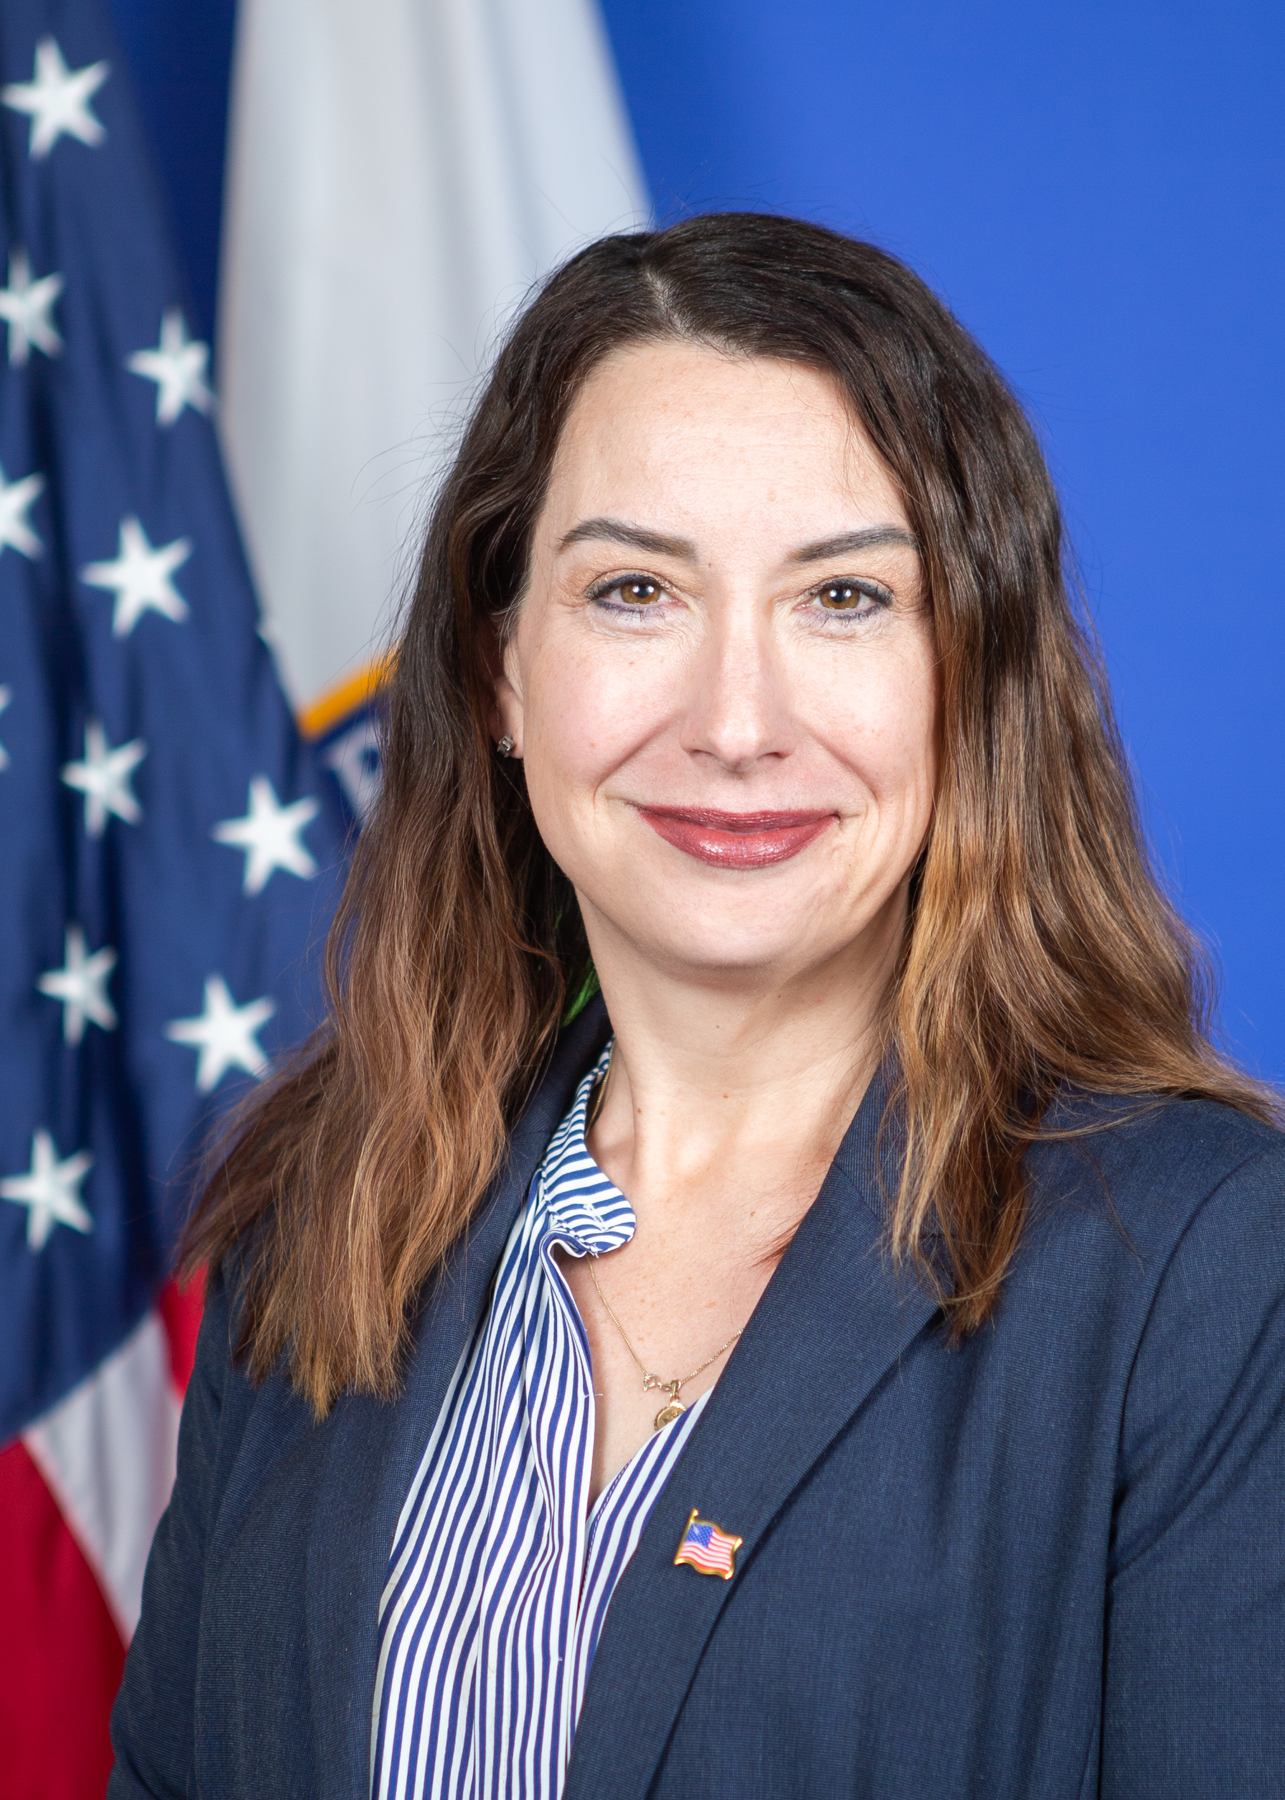
Glenna Wright-Gallo
Leading with Purpose: Designing Systems Resulting in Improved Outcomes for Individuals with Disabilities
Assistant Secretary
Office of Special Education and Rehabilitative Services (OSERS)

Slide 2
Raise the Bar: Lead the World
ACHIEVE
ACADEMIC EXCELLENCE
BOLDLY IMPROVE LEARNING CONDITIONS
CREATE PATHWAYS FOR GLOBAL ENGAGEMENT
Accelerate learning for every student
Deliver a comprehensive and rigorous education for every student
Eliminate the educator shortage for every school
Invest in every student’s mental health and well being
Ensure every student has a pathway to college and a career
Provide every student with a pathway to multilingualism
Raise the Bar Booklet

Slide 3
OSERS Mission and Priorities
To Improve Early Childhood, Education, and Employment Outcomes and Raise Expectations For All People With Disabilities, Their Families, Their Communities, and The Nation
Leading for Equitable outcomes
Prepared workforce
Remedy immediate staffing shortages and effectively deploy diverse and equipped educators, providers, and support personnel
Evidence-Based practices
Amplify, promote, and actively drive effective learning experiences, instruction, intervention, services, and support
Accessible technology
Accelerate usage of inclusive materials and technology for in-person and remote learning and employment
Stakeholders
Engage families, individuals with disabilities, educators, providers, policy makers, advocates, and communities to identify successes, barriers, and needs
Strategic RESOURCEs
Invest in data-aligned coordinated activities that advance Competitive Integrated Employment (CIE)

Slide 4
Intersecting Laws/Regulations
IDEA
ESSA
WIOA
Section 504
Rehab Act
ESSA/ ESEA
Section 504
Rehab
Act
IDEA
AT ACT
WIOA
ADA
Federal requirements impacting
children, youth, and adults with disabilities
(and their families)

Slide 5
Designing a System for Improved Outcomes
Students graduate prepared for college and career
Specially Designed Instruction
School to Post-School Planning and Services
EB Instruction in Rigorous Grade-Level Standards
* Reinforced by families, communities, and employers

Slide 6
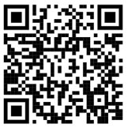
ED Guidance
Dear Colleague Letter on the Provision of AT Devices and Services for Children with Disabilities under the IDEA Co-Signed by ED Assistant Secretaries for Office of Planning, Evaluation and Policy Development (OPEPD) and Office of Special Education and Rehabilitation Services (OSERS)
​Myths and Facts Surrounding AT Devices and Services​
  AT Requirements Under Part B of the IDEA ​
  Common Myths and Facts about AT Devices and Services​
  Common Myths and Facts about Deploying AT Devices and Services​
  AT Requirements Under Part C of the IDEA​
  Common Myths and Facts about AT Costs and Funding Sources
National Educational Technology Plan — Office of Educational Technology

Slide 7
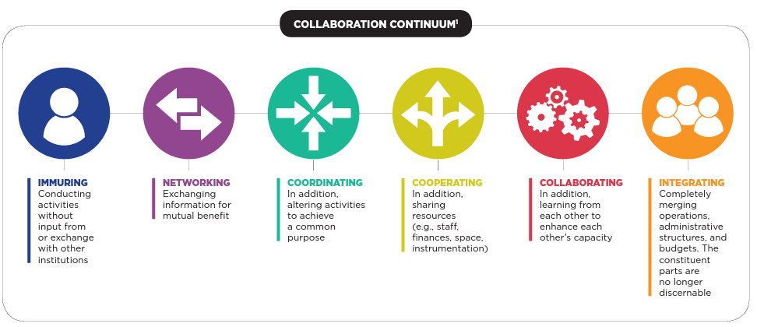
Collaboration Continuum
¹ Mashek,D. (June, 2015). Capacities and Institutional Supported Needed along the Collaboration Continuum.
A presentation to the Academic Deans Committee of The Claremont Colleges, Claremont. CA

Slide 8
AT ACT
AT3 Center List of AT Act Programs by State
  Continuum of specified State-Level and State Leadership activities that promote the ability of people with disabilities to know about, have access to, and ultimately be better able to obtain AT
    State-Level Activities
      AT demonstration, device loan, reutilization, and State financing
    State Leadership Activities
      Training, technical assistance, information and referral, and public awareness
  Advisory Council and stakeholder input
  Funds must supplement not supplant and cannot be used to reduce benefits under any federal law or for direct payment for AT for an individual with a disability

Slide 9
A Collective Purpose
Increase expectations for children, youth, and adults with disabilities
Increase understanding of the Individuals with Disabilities Education Act’s (IDEA’s) assistive technology (AT) requirements and the AT ACT
Reduce duplication and siloing of services
Dispel common misconceptions regarding AT
Provide examples of the active use of AT devices and services for children, youth, and adults with disabilities
Map educational technology and AT to instructional core and provide multiple access points
Increase access and use of AT for children, youth, and adults with disabilities to reduce barriers and increase opportunities

Slide 10
Alignment of a System of Support
Planning
Deployment
Check for Effectiveness
Example: Ed Week: DIF Grants Could Help Students with Disabilities Access Jobs

Slide 11
Our Role, Our Work, Our Community
“Do the best you can until you know better. Then when you know better, do better.”
Maya Angelou
How will we, together, amplify or accelerate the improvement efforts needed to ensure that every student with a disability not only has equitable access to high quality instruction and learning, but that they leave the preK-12+ education system fully prepared for further education, training, and independent living (that aligns with their goals and dreams)? How will we further support them in college and career?

