Slide 1
U.S. Access Board
Overview & Updates
Sachin Pavithran, Executive Director
Alison Levy, Director, Office of Technical & Information Services
AT3 Leadership Symposium,
April 23, 2024, Washington, DC

Slide 2
Session Overview
Meet the Access Board
Current Activities and Initiatives
Intersections with Assistive Technology Programs: How You Can Help
Notes:
Five years after the passage of the Architectural Barriers Act, the U.S. Access Board was created in 1973 by passage of the Rehabilitation Act (Section 502) to ensure access to federally funded facilities, the Access Board is now a leading source of information on accessible design.
The Access Board is an independent federal agency that promotes equality for people with disabilities through leadership in accessible design and the development of accessibility guidelines and standards.
Created in 1973 to ensure access to federally funded facilities, the Access Board is now a leading source of information on accessible design.
The Access Board develops and maintains design criteria for the built environment, transit vehicles, information and communication technology, and medical diagnostic equipment under the Americans with Disabilities Act of 1990 (ADA) and other laws.
It also provides technical assistance and training on these requirements and on accessible design, and continues to enforce accessibility standards that apply to federally funded facilities under the Architectural Barriers Act of 1968 (ABA).
The Access Board is structured to function as a coordinating body among federal agencies and directly represent the public, particularly people with disabilities. Its governing board is a twenty-five member board. Twelve of its governing board members are representatives from most of the federal departments. Thirteen others, who are appointed by the President, are members of the public, and most of them must have a disability. The Access Board also employs approximately thirty staff across four units: Office of Executive Director, Office of Administration, Office of General Counsel, and Office of Technical and Information Services.

Slide 3
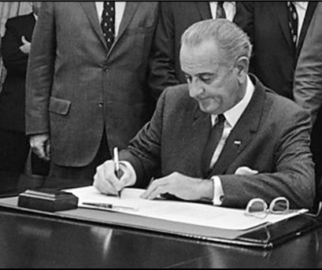
1968: Architectural Barriers Act (ABA)
First federal law to address access for people with disabilities
Covers facilities:
  constructed or altered by or on behalf of the United States
  leased, in whole or in part by the United States
  financed in whole or in part by a grant or loan made by the United States
Notes:
Raise your hand if you’ve heard of the Americans with Disabilities Act.
Raise your hand if you’ve heard of the Architectural Barriers Act
Five years following passage of the ABA, people needed to know how to comply with accessibility standards...
Requires that federal buildings designed, constructed, altered, or leased after August 12, 1968, be accessible

Slide 4
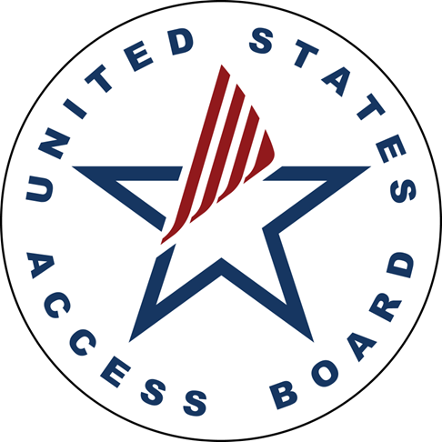
Rehabilitation Act (1973 & 1978)
Established & Expanded USAB
Mission/Functions
Develop accessibility guidelines & standards.
Enforce the ABA Standards.
Provide technical assistance & training on guidelines and standards.
Notes:
Five years after the passage of the Architectural Barriers Act, the U.S. Access Board was created in 1973 by passage of the Rehabilitation Act (Section 502) to enforce access to federally funded facilities.
1978, Rehab Act, Amended – Expanded role to establish minimum accessible design guidelines, expanded technical assistance role to include providing help on the removal of barriers as well as communication barriers in federally funded buildings and facilities and private entities.
It also provides technical assistance and training on these requirements and on accessible design, and continues to enforce accessibility standards that apply to federally funded facilities under the Architectural Barriers Act of 1968 (ABA).

Slide 5
Access Board Structure
An independent, federal micro agency comprised of:
  Up to 30 Staff
  25 Board Members
    13 public members appointed by the President
    12 federal members from cabinet-level agencies, the U.S. Postal Service (USPS), and the General Services Administration (GSA)
Notes:
25 Board members
13 public members appointed by the President(a majority of whom have disabilities), who are appointed by the President, and who typically have experience in accessible design or significant experience in disability policy
12 statutorily-designated federal members from cabinet-level agencies, the U.S. Postal Service (USPS), and the General Services Administration (GSA)
Federal members are typically designated by the agency head, but must be at Level IV or higher of the Executive Schedule (typically at the Assistant Secretary level in cabinet agencies)
The Access Board is structured to function as a coordinating body among federal agencies and directly represent the public, particularly people with disabilities. Its governing board is a twenty-five member board. Twelve of its governing board members are representatives from most of the federal departments. Thirteen others, who are appointed by the President, are members of the public, and most of them must have a disability. The Access Board also employs approximately thirty staff across four units: Office of Executive Director, Office of Administration, Office of General Counsel, and Office of Technical and Information Services.

Slide 6
USAB’s Evolution: A Legislative Timeline
1990 Americans with Disabilities Act (ADA)
1996 Section 255 Telecommunications Act Standards
1998 Rehab Act Sec. 508 - ICT Accessibility Standards
2010 Rehab Act Sec. 510 - MDE Accessibility Standards
Notes:
1990, ADA expanded USAB mission to establish accessibility guidelines for facilities and transportation systems
1996, USAB assigned authority to issues Sec. 255 Telecommunications Act standards
Section 255 of the Act authorized the Access Board to develop accessibility guidelines so that telecommunications products and services are accessible where readily achievable. Product manufacturers must ensure that products are designed, developed, and fabricated to be accessible to and usable by individuals with disabilities.
1998, USAB assigned to write Section 508 Information/Communication Technology Standards
2010, Rehab Act, Sec. 510 - USAB to issue standards for the accessibility of MDE

Slide 7
General Process to Developing
Board Guidelines & Standards
Advisory committee created to develop consensus recommendations on the rule;
Proposed rule drafted based on the committee’s recommendations and a preliminary regulatory assessment and submit to OMB for clearance;
Proposed rule published in the Federal Register for public comment; hold public hearings during the comment period (usually 90 – 120 days);

Slide 8
Guidelines and Standards Process, continued
Public comments reviewed and rule revised accordingly;
Final rule and regulatory assessment submitted to OMB for clearance;
Final rule published in the Federal Register.

Slide 9
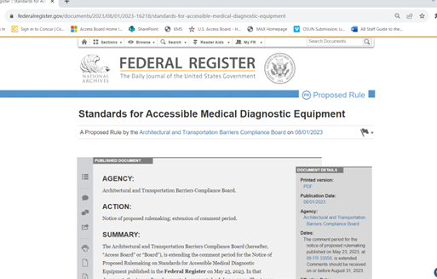
Public Comments: Your Call to Action!
Proposed rules are published in the Federal Register
Review and post your comments.
Share with others.
Notes:
Guidelines that the Access Board issues under the ADA do not become legally enforceable until adopted by enforcement agencies, usually DOJ and DOT
Enforcement agencies must undertake their own rulemaking process, including issuing an NPRM and Final Rule
Access Board guidelines are minimum standards; enforcement agencies may adopt standards that provide for greater accessibility, but not less
Access Board standards issued under Section 508 of the Rehabilitation Act are enforceable without further action by agencies
Access Board ABA Accessibility Guidelines become enforceable standards when adopted by the ABA standard-setting agencies: USPS, GSA, HUD, and DoD
Agencies are not required to adopt Access board standards for accessible medical diagnostic equipment, but at least two agencies – DOJ and HHS –have announced their intention to do so
Access Board standards are technical standards only
They do not include requirements for the number of each type of MDE that must be available in a medical office, hospital, or other facility; enforcement agencies may include such requirements

Slide 10
How Access Board Guidelines Become Enforceable Standards
Guidelines issued by the Access Board under the ADA do not become legally enforceable until adopted by enforcement agencies, usually DOJ and DOT.
  Enforcement agencies must undertake their own rulemaking process, including issuing an NPRM and Final Rule
  Access Board guidelines are minimum standards; enforcement agencies may adopt standards that provide for greater accessibility, but not less
Access Board standards issued under the ABA and Section 508 of the Rehabilitation Act are enforceable without further action.
Notes:
Access Board ABA Accessibility Guidelines become enforceable standards when adopted by the ABA standard-setting agencies: USPS, GSA, HUD, and DoD
Agencies are not required to adopt Access board standards for accessible medical diagnostic equipment, but at least two agencies – DOJ and HHS –have announced their intention to do so
Access Board standards are technical standards only
They do not include requirements for the number of each type of MDE that must be available in a medical office, hospital, or other facility; enforcement agencies may include such requirements

Slide 11
Accessibility Guidelines and Standards
The Board has developed technical accessibility guidelines and standards in the following areas:
Information & Communication Technology Standards
Telecommunications Act Accessibility Guidelines
Medical diagnostic equipment
Buildings and facilities
Transportation Vehicles
Public Right-of-Way
ABA Accessibility Guidelines
Prescription drug labels

Slide 12
Current Rulemaking Activities

Slide 13
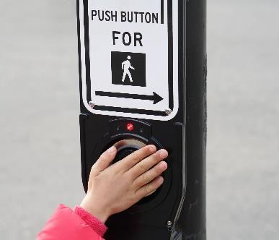


Public Right-of-Way Accessibility Guidelines
Final
Pedestrian Facilities in the
PROWAG
Published August 2023
Notes:
Provides standards for accessibility of sidewalks, intersections, transit stops in the public right-of-way, on-street parking, shared use paths, and other facilities and elements that pedestrians use
Guidelines will apply to State and local government entities and to public-rights-of-way subject to the ABA

Slide 14
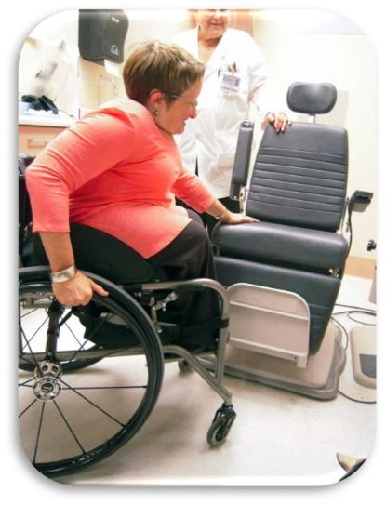
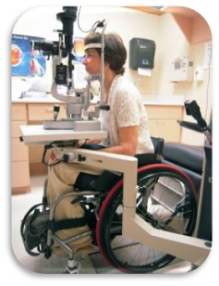
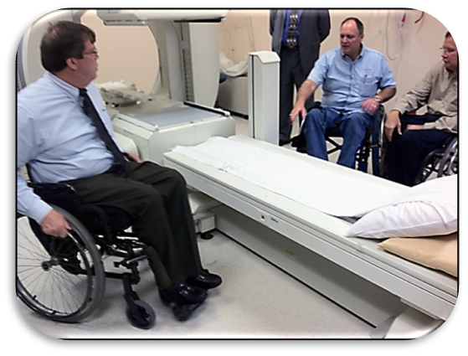
Standard for Medical Diagnostic Equipment
In Development
January 2017: Published with an outstanding issue on low transfer height for examination tables and chairs
May 2023: Access Board issued an NPRM, setting 17 inches as the low transfer height.
Notes:
Examples include: Examination tables, Examination chairs (including those used for dental or optical exams)
Weight scales, Radiological equipment such as X-ray machines, MRI, CT Scan, Mammography equipment
Other MDE
Final Rule is anticipated by end of 2024.

Slide 15

Accessible Electric Vehicle Charging Stations
In Development
  August 2022: Access Board issued a technical assistance document with accessible design recommendations
  New rule will amend both the ADA Accessibility Guidelines (ADAAG) and the ABA Accessibility Guidelines (ABAAG) to include accessible E/V charging station standards.
Notes:
Infrastructure legislation calls for construction of 500,000 EV charging stations nationwide through grants administered by DOT, in addition to other EV charging stations made available by State and local governments, private businesses, and at federal facilities
Final Rule anticipated in late 2024/early 2025

Slide 16
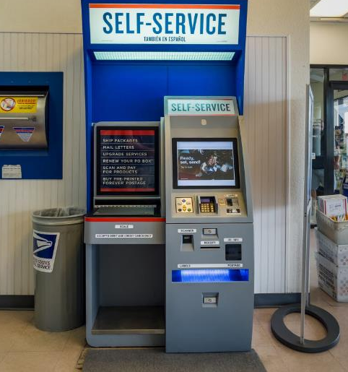
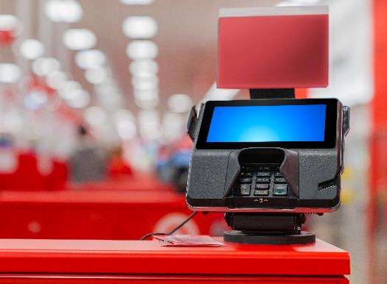
Self-Service Transaction Machines
September 2022: Published an ANPRM
Preparing an NRPM.
Notes:
Final Rule anticipated late 2025

Slide 17

Guidelines for Passenger Rail Vehicles
Further action anticipated in 2025.

Slide 18
Recent Government Actions Promoting Digital Accessibility

Slide 19
Congressional Actions
Senate Aging Committee Report: Unlocking the Virtual Front Door
Section 752 of the 2023 Congressional Authorizations Act (CAA)
Notes:
Unlocking the Virtual Front Door (Senate Aging Committee)
An examination of federal technology’s accessibility for people with disabilities, older adults and veterans
Lays out four primary findings and plans to address the lack of digital accessibility across the federal government
Section 752 of the 2023 Congressional Authorizations Act (CAA)
Directs Office of Management and Budget (OMB) in consultation with GSA and the U.S. Access Board to release criteria for organizations to assess their own digital accessibility
Directs GSA in coordination with OMB to create a report based on the findings from these criteria

Slide 20
The Governmentwide Accessibility Assessment: Findings (249 agencies)
Accessibility conformance was relatively low on average.
Program maturity was relatively low and could be improved across government
Heavily used ICT was either not tested or did not conform to accessibility standards
2023 Report to Congress: https://www.section508.gov/manage/section-508-assessment/2023/message-from-gsa-administrator/.

Slide 21
Office of Management & Budget (OMB) Memoranda
M23-22: Delivering a Digital First Public Experience
Provides agencies with guidance for designing digital experiences.
M24-08: Strengthening Digital Accessibility and the Management of Section 508 of the Rehabilitation Act
Provides guidance to agencies in improve digital accessibility in accordance with Section 508.
Notes:
M23-22: Delivering a Digital First Public Experience
Implementation guidance for 21st Century Integrated Digital Experience Act (IDEAct)
Agencies must design and develop high-quality digital experiences that are simple to use, seamless across journeys, and secure by design
M24-08: Strengthening Digital Accessibility and the Management of Section 508 of the Rehabilitation Act
Provides guidance to help agencies advance digital accessibility by maintaining an accessible federal technology environment, promoting accessible digital experiences, and continuing the implementation of accessibility standards in accordance with Section 508 of the Rehabilitation Act of 1973, as amended

Slide 22
What Can YOU Do?
Subscribe to news updates: info@access-board.gov.
Share our info with your networks.
Provide your input via agency review or public comments when NPRMs are posted.
See something say something: ABA enforcement.
Contact us with questions!
Notes:
Parking: Lack of accessible parking spaces, including lack of access aisles and/or signage, insufficient number of spaces, and improper dimensions
Accessible routes: Non-compliant entrance ramps and curb ramps, and improper changes in level
Toilet rooms, lack of grab bars, insufficient maneuvering clearance, and dispensers outside of proper reach ranges
Entrances: Lack of entrance ramps, insufficient maneuvering clearances, and doors that are too narrow

Slide 23
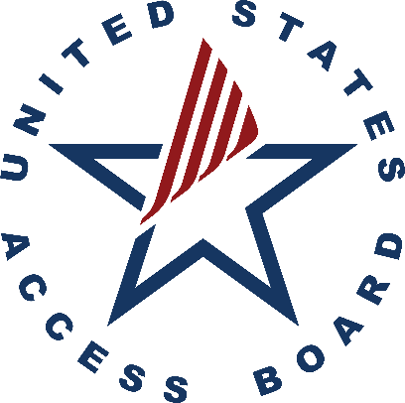
U.S. Access Board
Contact Information
(202) 272-0080, Ext. 3
ta@access-board.gov
www.access-board.gov
U.S. Access Board on YouTube
“Advancing Full Access and Inclusion for All”

