Slide 1
Post Secondary Transition in VR
Emily McKeough
AT Access Coordinator
Emily.mckeough@dars.virginia.gov
Notes:
Good afternoon my name is Emily McKeough and today we will be exploring how transition services in Vocational Rehab support students and adults with disabilities here in VA. Transition services are about bridging the gap between school and adult life.

Slide 2
Agenda
Transition Services Overview
Pre-ETS in Virginia
College Prep Summer Program
VR Services
Time management Classes
Assistive Technology
Conclusion & Q&A

Slide 3
Introduction to Transition Services
Bridge from school to work
Goal: independence, confidence, employment
DARS role: statewide coordination with schools, families, and employers
Notes:
Transition services are coordinated activities designed to help students with disabilities move smoothly from high school into postsecondary education, training, or employment
Without structured transition planning may students face barriers from navigating college systems to finding accessible workplaces. VR helps remove those barriers
Tranision services are not just about jobs and school it is about confidence, independence and dignity

Slide 4
Pre-Employment Transition Services (Pre-ETS)
Career exploration counseling
Work-based learning (internships, job shadowing)
Postsecondary counseling (college/training prep)
Workplace readiness (soft skills, teamwork)
Self- advocacy training
Notes:
Career exploration counseling is interest inventories and discussions with counselors
Internship job shadowing
Guidance on college programs, financial aid, and accommodations
Soft Skills communication team work and punctuality
Teachign students to request accommodations and speak up for themselves

Slide 5
Tech Tools for College Program
Study & Organization Skills
Campus orientation and navigation
Advocacy practice for accommodations
Time management strategies
Assistive Technology on campus
Campus Resources

Slide 6

Agenda
Energy Levels
Notetaking
Reading
Writing
Organization
Managing Stress
Resources on Campus
Accommodations
Notes:
Emily

Slide 7
Differences in Accommodations
High School | College
Accommodations provided through IEP/504 | Accommodations requested by student, reviewed
School provides accommodations | Student requests accommodations
More support from teachers | Support initiated from student
6 hours class time= 2 hours homework | 2 hours class time= 6 hours homework
Notes:
Emily

Slide 8
Technology for Reading
Text to Speech
Microsoft Immersive Reader (Edge, Word)
Natural Reader (App, online, Chrome extension)
Word Read OutLoud
Text to Speech on mobile devices
Devices
Your phone camera!
C Pen Reader
CCTV
Magnifier
Apps
Google Lookout or Seeing AI
Voice Dream Reader
Speechify
Claro ScanPen Reader (Apple & Android)
Notes:
Carrie
https://www.naturalreaders.com/online/

Slide 9
Campus Resources for Writing
Look for Writing Center (and Tutoring!)
review your drafts for errors​
provide input on organization​
discuss style changes
Notes:
Emily

Slide 10
Transition Services in VR
Supports youth with disabilities moving from school to work or college
Career counseling tailored to transition goals
Training and skill development for workplace readiness
Job exploration and placement with employer partnerships
Independent living skills for adult success
AT Consultations, loans, and workplace consultations
Notes:
VR picks up where Pre-ETS leaves off, guiding young adults into the workforce with individualized plans
Once clients are out of Pre-Ets and part of VR more AT services can happen. This is where we can do more one on on conultations and trainings that are tailored to the individual.

Slide 11
Let's Get Organized Program
Researched based program
Teaching organization and productivity skills
Focus on planning, prioritizing, and managing time
Tools: calendars, apps, checklists, and routines
Builds independence for school, work, and daily live
Supports smoother transitions for different aspects of life

Slide 12
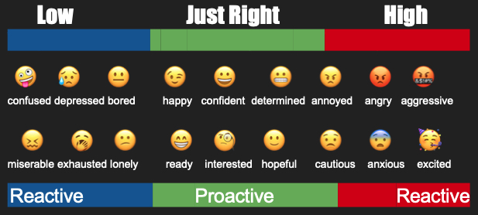
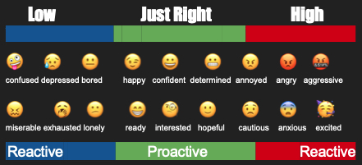
Check In On Your Energy and Emotions
Low Just Right High
Very Low Just Right Ver y h
🤪 😥 😐 😉 😀 😬 😠 😡 🤬
confused depressed bored happy confident determined annoyed angry aggressive
😖 🥱 😕 😁 🧐 🙂 😟 😨 🥳
miserable exhausted lonely ready interested hopeful cautious anxious excited
Low Just Right High

Slide 13
What new sensory strategy can you try today?
Calming:
warm drink
smooth/creamy snack
hard candy
wrap in a blanket
rock in a rocking chair
dim lights
warm room
Alerting:
cold drink
crunchy snack
sour or hot candies
snap a rubber band on wrist
stand up/move around in seat
bright lights
cool room
Both Calming AND Alerting:
squeeze a stress ball or use a fidget
pushups in chair
chew gum, chewy foods or candies
tap with a beanbag or hand
Notes:
These are strategies that provide sensory input. Remember the 5 senses? There’s actually a few more than that. Sensory input is what helps us stay just right.
Calming sensory experiences tend to be mild, warm, smooth, sweet, repetitive, slow
Alerting sensory experiences tend to be strong, cold, crunchy/sharp, spicy/sour, unpredictable, fast

Slide 14
Case Study : Miss Allen
Miss Allen lives with her boyfriend, Mr. Jones. Miss Allen is very excited about beginning her new volunteer job tomorrow. She will be working from 1:00-3:00 PM every Tuesday and Thursday. She will also continue to attend a training program from 9:00 AM to 1:00 Pm daily. Miss Allen’s new job is close to her apartment, but 10 minutes from her program. Miss Allen needs to walk her dog as soon as she gets home from the program because the dog is very eager to go out.
Miss Allen misses her daughter but gets to pick her daughter up from school once a week on Thursday at 3:00 PM. The daughter’s school is ½ hour away from Miss Allen.

Slide 15
 | Mon | Tues | Wed | Thur | Fri | Sat | Sun
8 am
9 am | training | training | training | training | training
10 am | training | training | training | training | training
11 am | training | training | training | training | training
Noon | training | training/travel | training | training/travel | training
1 pm | Walk dog | Work | Walk dog | Work | Walk dog
2 pm |  | work |  | Work/ travel
3 pm |  |  |  | Pick up daughter
4 pm
5 pm
lives with Mr. Jones
working 1-3 on Tuesdays and Thursdays
Training 9 a.m - 1 p.m. M-F
10 mins from job to training
walk dog after training
pick up daughter at 3:00 on Thursdays
½ hour from school to home
Notes:
Clear for each session and fill in together

Slide 16
Partnership with VATS and DARS
Joint mission: Expand access to assistive technology across Virginia
DARS provides VR and transition services and VATS offers statewide AT resources
Collaboration ensures students and adults receive AT assessments, trainings and device loans
Partnership supports independence, education, and employment outcomes
Shared outreach: workshops, resource guides, and community training

Slide 17
Questions??

