Slide 1
Disability and Disaster Planning for Response and Recovery
2024 Leadership Symposium
April 22, 2024

Slide 2
Presenters
Sherman Gillums, Jr. FEMA Disability Coordinator
Maureen Melonis – Director, Colorado Assistive Technology Program
Chris Brand – CEO, FODAC

Slide 3
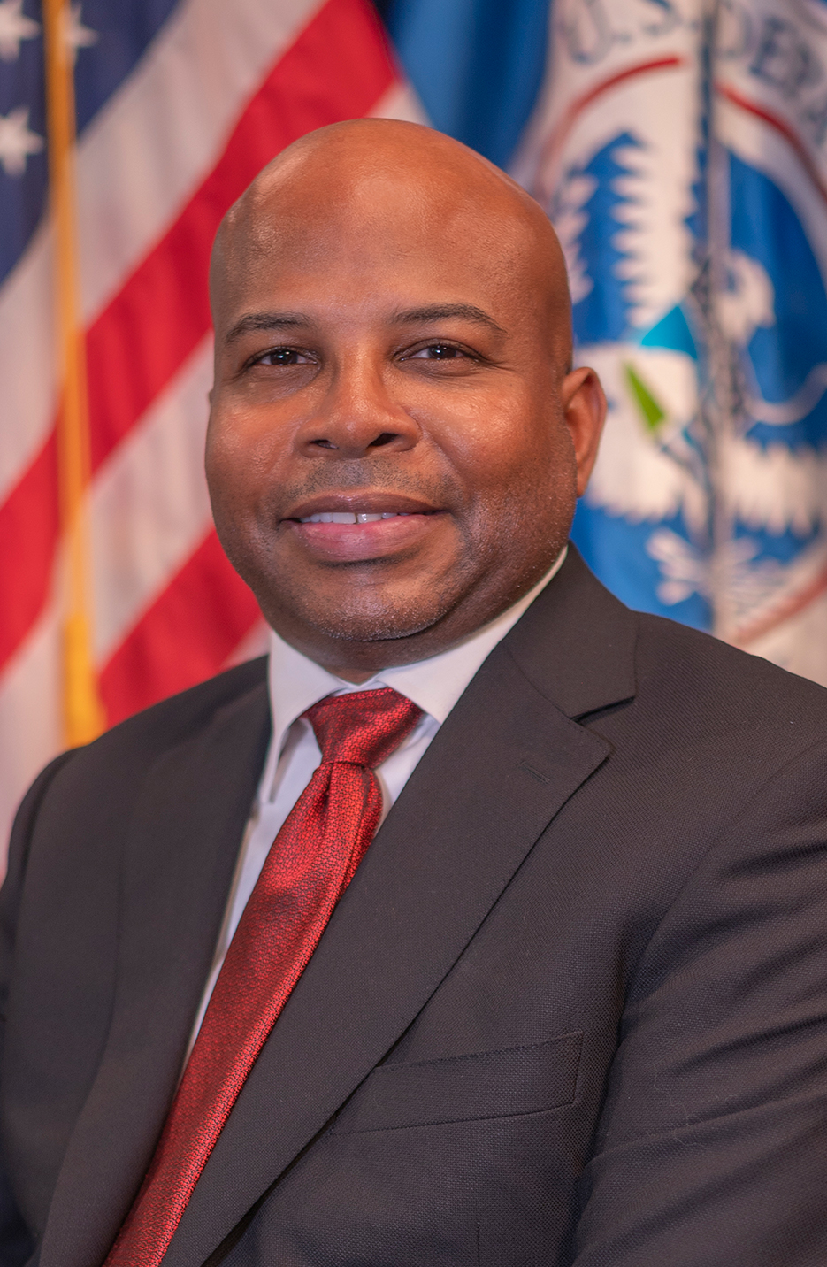
Sherman Gillums Jr.
FEMA Disability Coordinator
Director, Office of Disability Integration and Coordination (ODIC)

Slide 4
Post-Katrina Emergency Management Reform Act
§321b. Disability Coordinator
(a) In general
After consultation with organizations representing individuals with disabilities, the National Council on Disabilities, and the Interagency Coordinating Council on Preparedness and Individuals with Disabilities, established under Executive Order No. 13347, the Administrator shall appoint a Disability Coordinator.
The Disability Coordinator shall report directly to the Administrator, in order to ensure that the needs of individuals with disabilities are being properly addressed in emergency preparedness and disaster relief.
Source: Title 6, Chapter 1, Subchapter V at https://uscode.house.gov/
Federal Emergency Management Agency

Slide 5

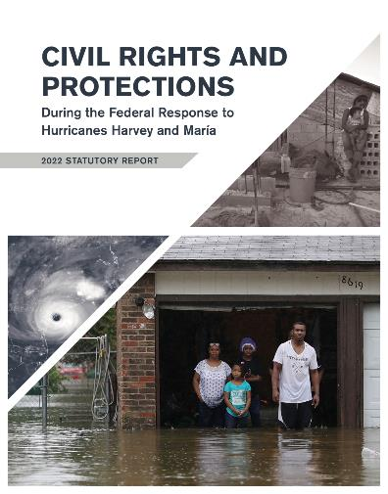
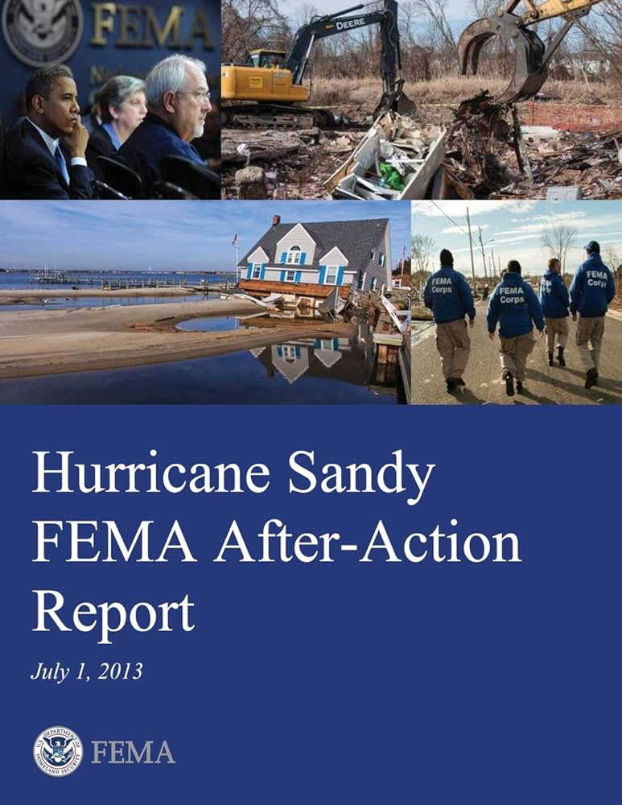
Lessons Learned
Federal Emergency Management Agency

Slide 6



Data-informed Disaster Risk Profile
  PRIMARY DATA:
  Population disability data (U.S. Census)
  Social Vulnerability Index (CDC/ATSDR)
  emPOWER Data (HHS)
  IA Disability Applications (FEMA IA Program)
  SECONDARY (CONFIRMATORY) DATA:
  Regional/SLTT Partners (EM/DI/AFN)
  FCO/COS, IMAT Leadership
  EA Listening Reports, National/Local Media, Social Media
  Stakeholders (Nonprofits, NGOs, Volunteer Organizations)
Federal Emergency Management Agency
Notes:
We start our response to a disaster well before a declaration is issued by developing a DI risk profile based on four datasets.
[Explain]
Census – How many and characteristics
SVI – How serious (gravity of risk)
Empower – How urgent (time is of the essence)
IA Registration – How many we have accounted for (first two weeks post declaration 20% target)
This is not OUR information. It is FEMA’s information (DSAT, DRO, EAS, VOAD)
Here, it helps to revisit the core question of what problem we are trying to solve: Shorten the disaster cycle.

Slide 7
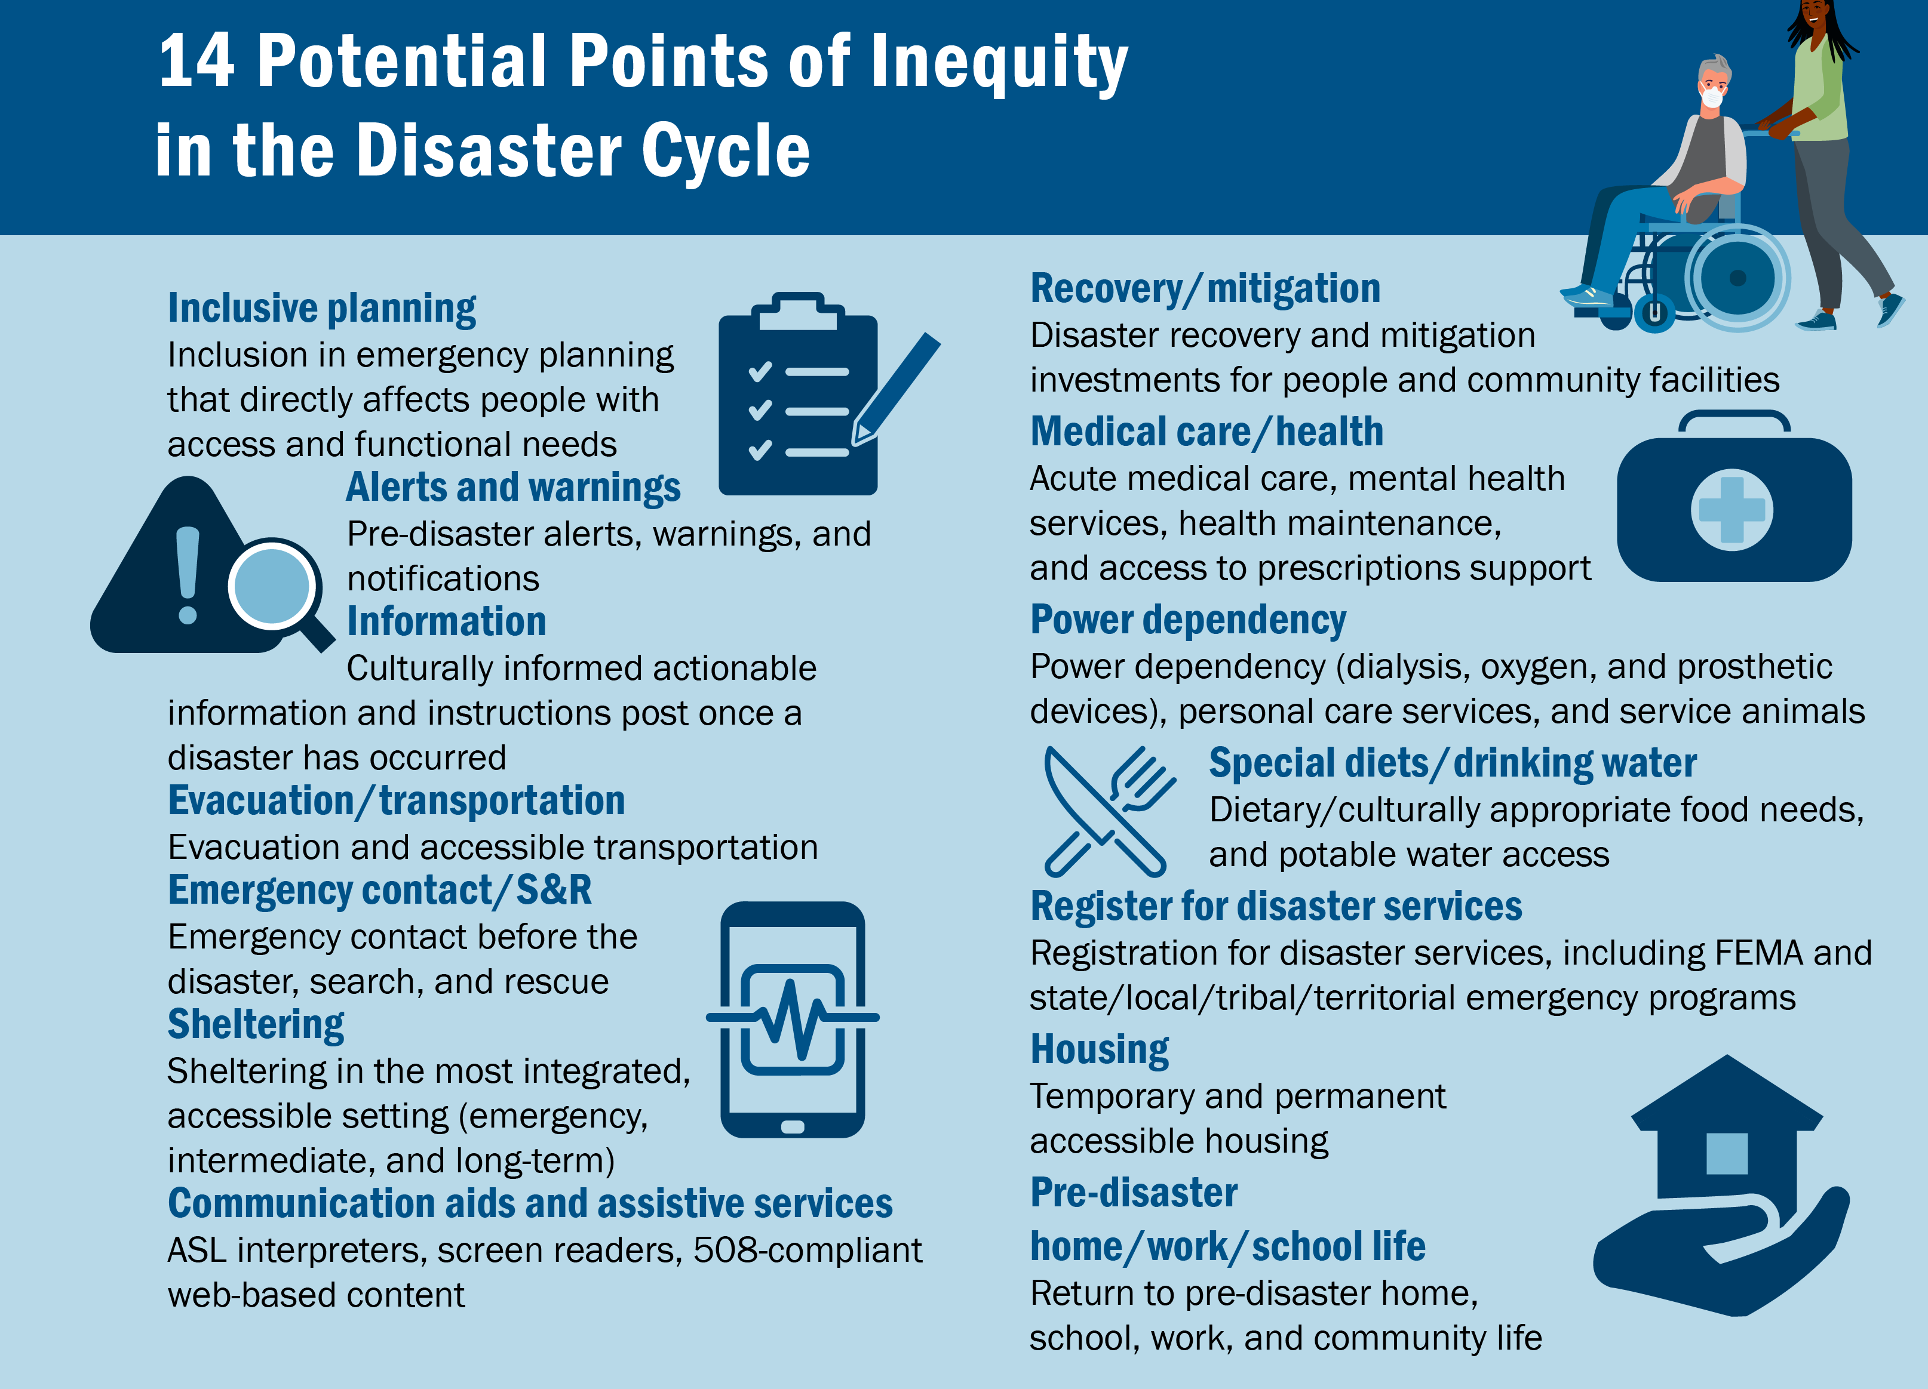
14 Potential Points of Inequity in the Disaster Cycle

Slide 8
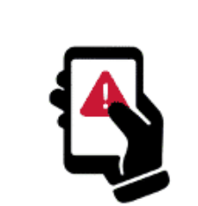





Socio-Behavioral Model of Warning Response
ALERT
RELEASED
MESSAGE RECEIVED
MESSAGE PERCEIVED
BEHAVIORAL
RESPONSE
BELIEF OF SAFETY
Perception shift from a belief of safety to a sense of risk to motivate timely action
SENSE
OF RISK
MESSAGE CONTENTS
Source
Hazard
Location
Guidance
Time
MESSAGE STYLE
Clear
Complete
Consistent
Certain
Accurate
CONFIRMATION
Milling >>> Moving
Understand
Believe
Personalize
Decide
Source: Dr. Dennis Mileti, former Director of the National Hazards Center, University of Colorado Boulder
Federal Emergency Management Agency
Notes:
The hazards included in the Warning Lexicon list conform primarily to the initial guidelines issued by FEMA on the appropriate use of WEA (McGregor et al. 2014). These guidelines include the following:1.
The event must be urgent, that is, classified as either immediate, requiring immediate responsive action, or expected, requiring responsive action within 1 h.
2.
The event must be severe; that is, the severity of the event must be classified as either extreme or severe, posing an extraordinary or significant threat to life or property.
3.
The event must be certain; that is, the certainty of the event must be classified as observed, determined to have occurred, or ongoing, or, likely, determined to have a probability of occurrence of 50% or greater.
Several years after these criteria were issued, FEMA amended the guidelines, acknowledging that some messages may also be sent for nonimmediate events that also pose a degree of danger and demand knowledge or action among members of the public. Described as “public safety” messages, these hazards include, for example, 911 service outages, contaminated water, and messaging about infectious disease outbreaks, in addition to law enforcement-oriented messages directing the public to “be on the lookout” (FEMA IPAWS 2021).

Slide 9
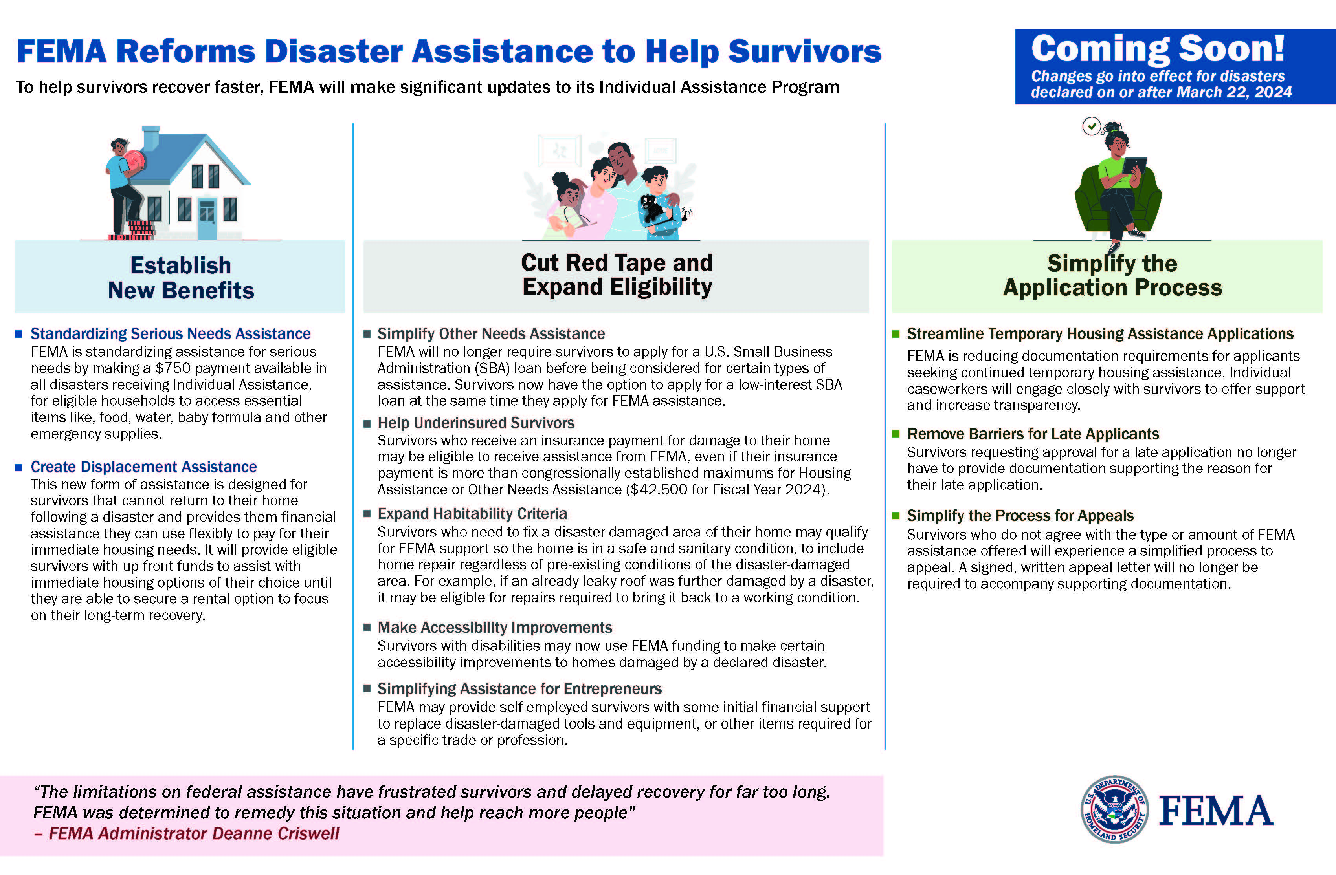
FEMA Reforms Disaster Assistance to Help Survivors
Federal Emergency Management Agency 15

Slide 10

“Ready State” Preparedness
Format: Independent study
Audience: State, local, tribal, territory, and community partners
Purpose: Increase awareness and enhance coordination in meeting the need for full inclusion of disaster survivors with disabilities and access and functional needs during disaster response.
https://training.fema.gov/
Federal Emergency Management Agency
Notes:
Planning for success

Slide 11
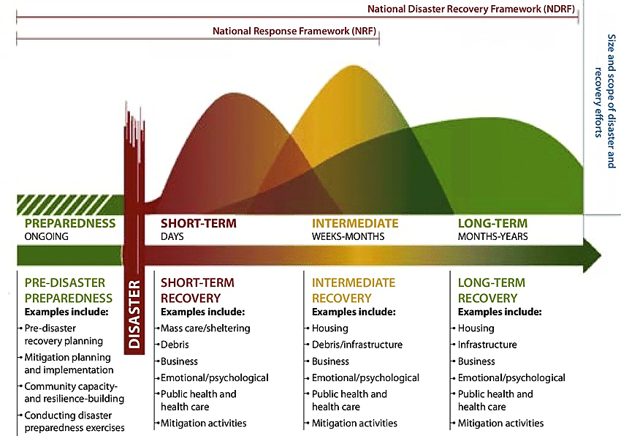
End Goal:
Shorten the Disaster Cycle for All Survivors
Federal Emergency Management Agency

Slide 12
Contact Slide Option 2
Sherman Gillums Jr., FEMA Disability Coordinator
Director, Office of Disability Integration and Coordination
Federal Emergency Management Agency
U.S. Department of Homeland Security
sherman.gillumsjr@fema.dhs.gov

Slide 13
CIDE Emergency Preparedness Training & Education Services
Maureen Melonis, MNS, CCC-SLP
Associate Director

Slide 14
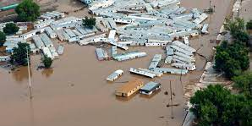
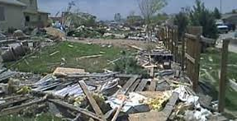
Colorado Disasters
Wildfires
Floods
Mass Shootings
Tornadoes/High Winds
Snowstorms
2013 Floods
2008 Windsor Tornado

Slide 15
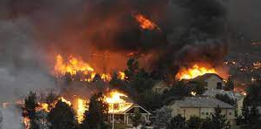
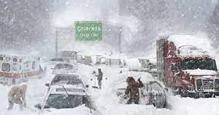
CIDE Emergency Preparedness
Since 2007…
  Planning
  Training
  Support
2012 Waldo Canyon Fire
2024 Spring Snowstorm

Slide 16
Training Components - Community
Disasters/Hazards/
Disruptions
Community Alerts
Shelter in Place Plans
Backup Power Plans
School Emergency Response Plans
Service Animal/Pet Plans
Personal Support Networks
Communication Plans
AT & DME Replacements
Emergency Go Kits
Continue Education Plans

Slide 17
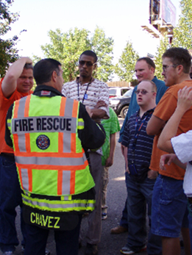
Training - First Responders, Emergency
Managers/ Planners
Emergency Communication Techniques
Outreaching to Access and Functional Needs Community
Response, Rescue and Service Animals
Mobility Devices and First Responders
Plan, Prepare, Respond
Train-the-Trainer

Slide 18
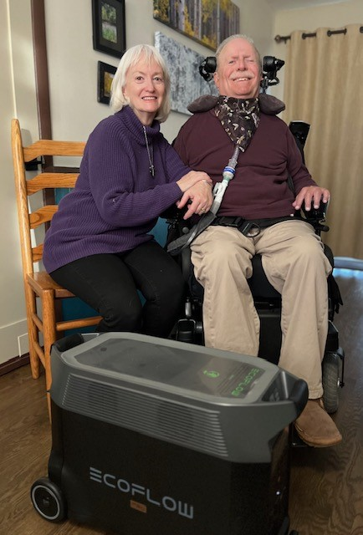
Back up Power and Digital Literacy
Surviving in Place
Over 1000 applications received
Over 800 battery systems shipped
Backup Battery Participants

Slide 19
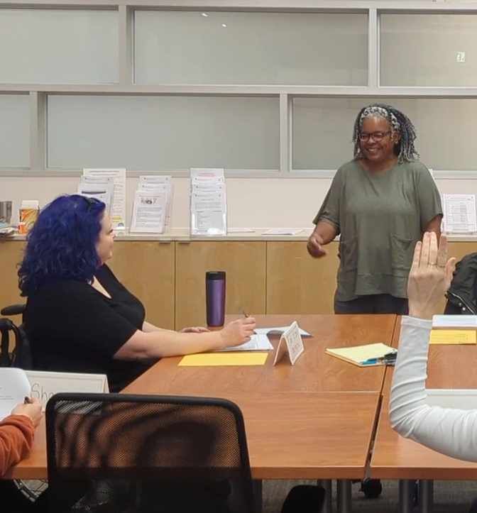
Back up Power and Digital Literacy (cont.)
Digital Literacy
Focus on foundational skills, access to online healthcare resources and promoting digital equity
Surviving in Place Training

Slide 20

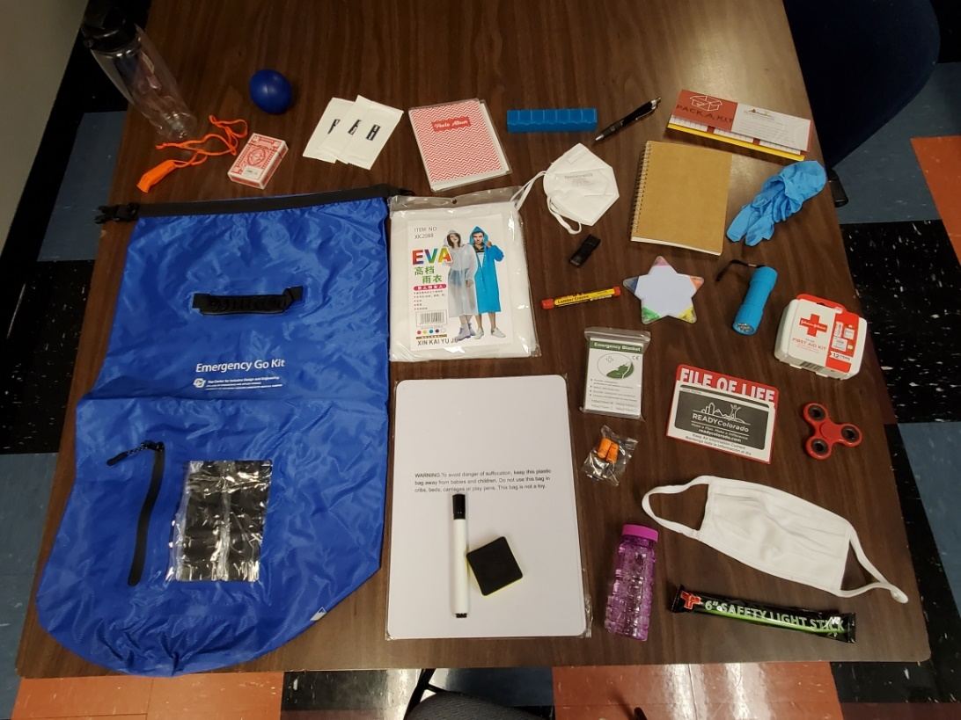
Emergency Go Kits
Ready to go supplies in a waterproof bag, customized to your needs.
Over 850 applications received
Over 370 kits shipped

Slide 21
Websites
  Emergency Preparedness Services
  (42 Resource Documents & Online Training)
  https://www.ucdenver.edu/centers/center-for-inclusive-design-and-engineering/community-engagement/emergency-preparedness-for-individuals-with-disabilities
  Moodle Trainings
  https://cide.moodlecloud.com/login/index.php
  Surviving in Place
  (Power Backup Battery Systems & Emergency Go Kits)
  www.ucdenver.edu/cide/sip

Slide 22
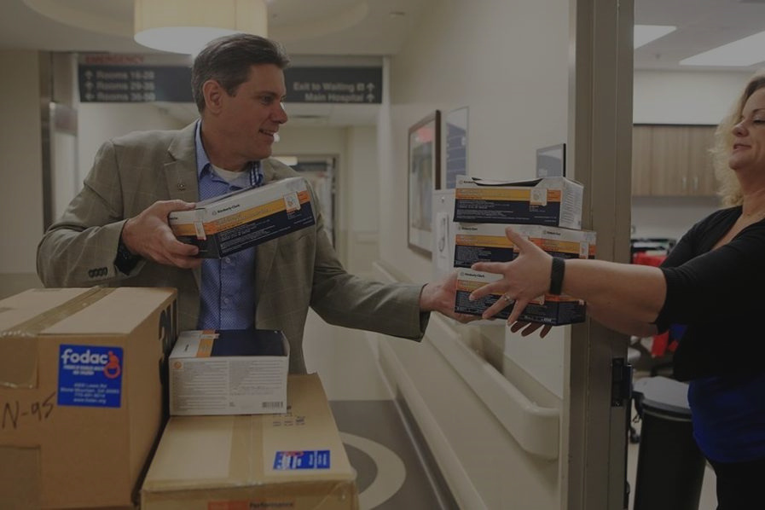

Friends of Disabled
Adults and Children
4900 Lewis Rd.
Tucker, Georgia 30083
(770) 491-9014
FODAC.org

Slide 23
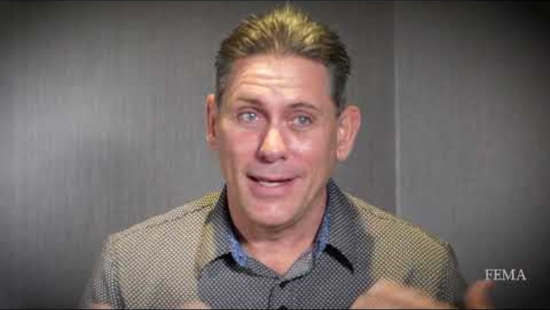
FEMA Partnership

Slide 24

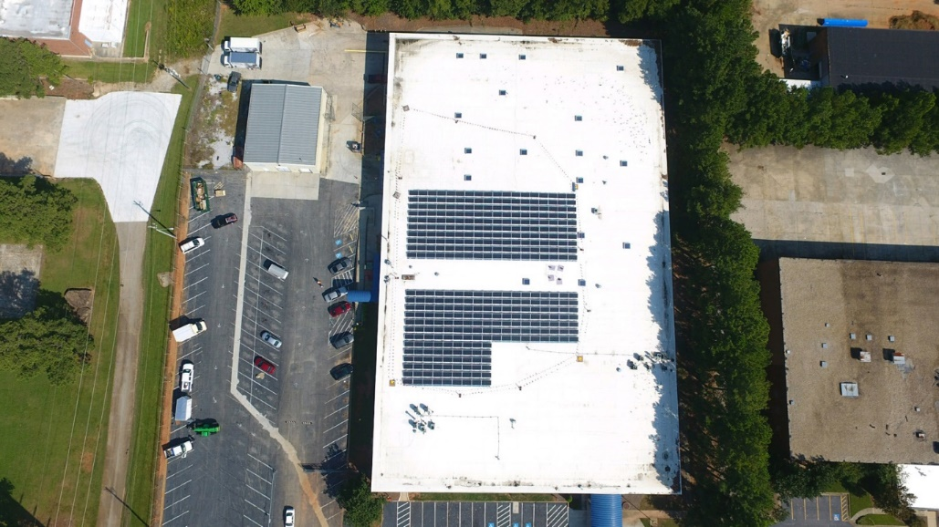
Facilities
FODAC HQ is currently housed in a 64,800 square foot building in Tucker, Georgia with a staff of 42, and an annual budget of over $2.4 million.

Slide 25
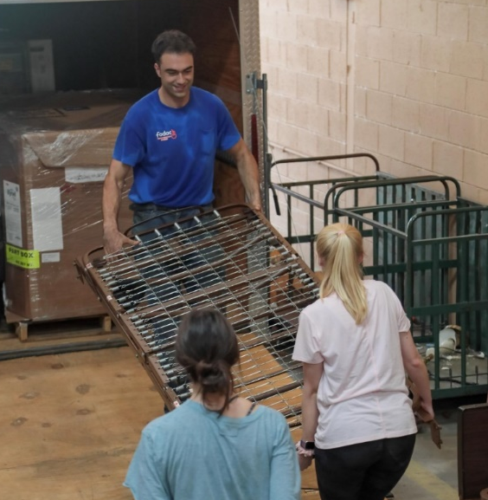
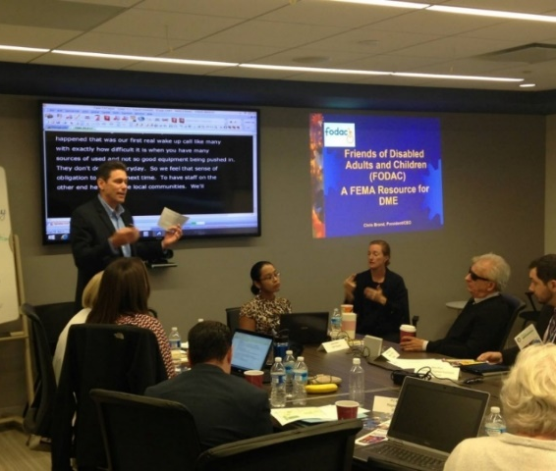
Disaster Relief
Thanks to partners like Amazon and UPS Foundation, FODAC has delivered DME for disaster relief to 23 states, 4 U.S. territories, and 82 countries.
FODAC is a member of the National Voluntary Organizations Active in Disaster (NVOAD).

Slide 26

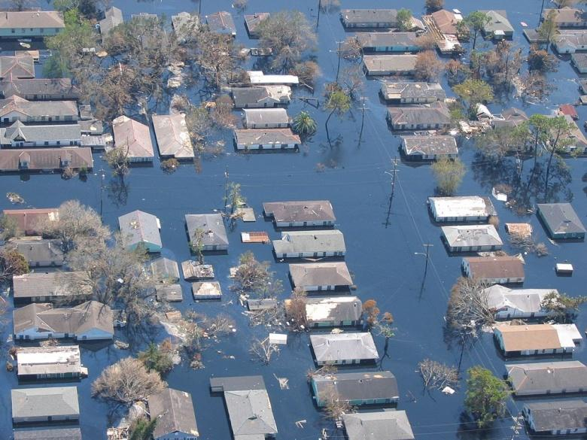
Responding to Disasters
Notes:
How?
Who ? Individuals, businesses, and agencies – drop off at our Tucker office or if 10 systems or more pick up is considered
To help defray the recycling costs

Slide 27

FEMA Functional Needs
Support Services Guidance
Intended to ensure that individuals who have access and functional needs receive lawful and equal assistance before, during, and after a disaster or public health emergency.
The American Disabilities Act (ADA) of 1990, Fair Housing Act (FHA) of 1968, and civil rights requirements are not waived in disaster situations.
Emergency managers and shelter planners have the responsibility to ensure that sheltering services and facilities are accessible.
Most individuals with access and functional needs can be accommodated in a general population shelter with support.
Functional Needs Support Services (FNSS) must be incorporated into existing shelter plans and resources.
  https://www.phe.gov/Preparedness/planning/abc/Pages/functional-needs.aspx
Notes:
How?
Who ? Individuals, businesses, and agencies – drop off at our Tucker office or if 10 systems or more pick up is considered
To help defray the recycling costs

Slide 28
Identifying the Needs of Persons with Disabilities in Disasters
IDENTIFYING THE NEEDS OF PERSONS WITH DISABILITIES IN DISASTERS
Communications Support
Assistive Technology
Durable Medical Equipment (DME)
Consumable Medical Supplies
Pharmaceuticals
Access to power
Notes:
How?
Who ? Individuals, businesses, and agencies – drop off at our Tucker office or if 10 systems or more pick up is considered
To help defray the recycling costs

Slide 29
Early Disaster Relief
2005-06 Hurricane Katrina/Rita Relief
FODAC partnered with several agencies, including Centers for Independent Living (CIL) in Hattiesburg, Biloxi and Baton Rouge to assist the effort with six containers of DME.
DME and medical supplies were donated from multiple providers along with donations from FODAC inventory.
Transportation of these items was provided by in-kind trucking companies.
Distribution partners locally were the CIL’s.

Slide 30
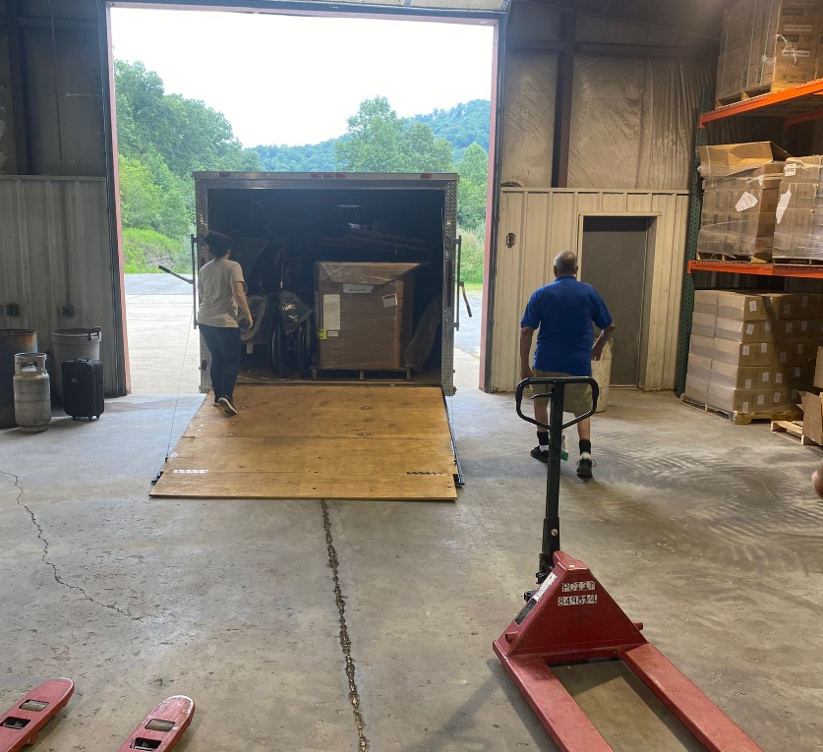
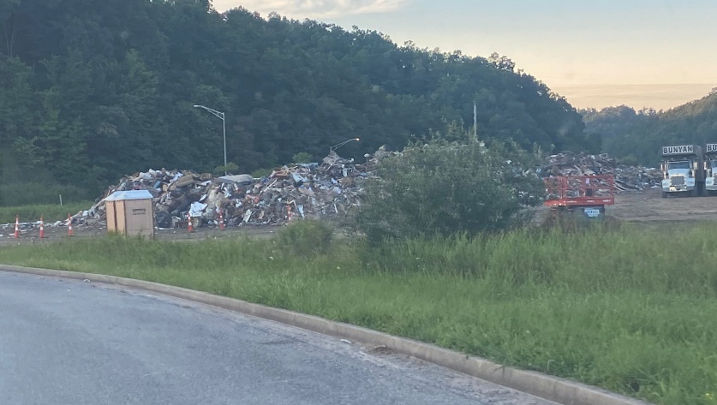
Recent Disaster Relief
2022 Kentucky Floods Relief:
FODAC partnered with the Kentucky Department of Health to assist the effort in Eastern Kentucky.
DME equipment and medical supply donations Came from FODAC inventory and GEMA donations.
Transportation: was facilitated by a kind-hearted Rotary volunteer using our 24' enclosed trailer.
Distribution: Once there, the Kentucky Department of Health collected the items worth $62,000 at one of their staging warehouses in the disaster area.

Slide 31
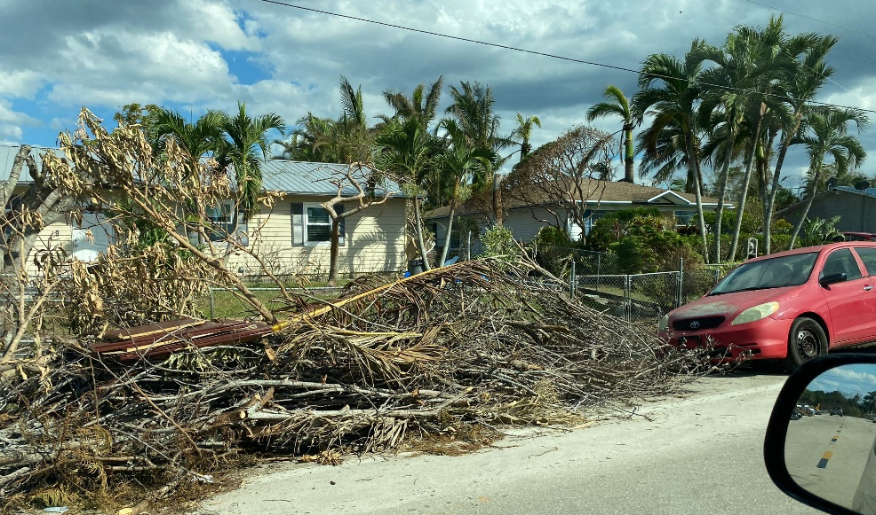
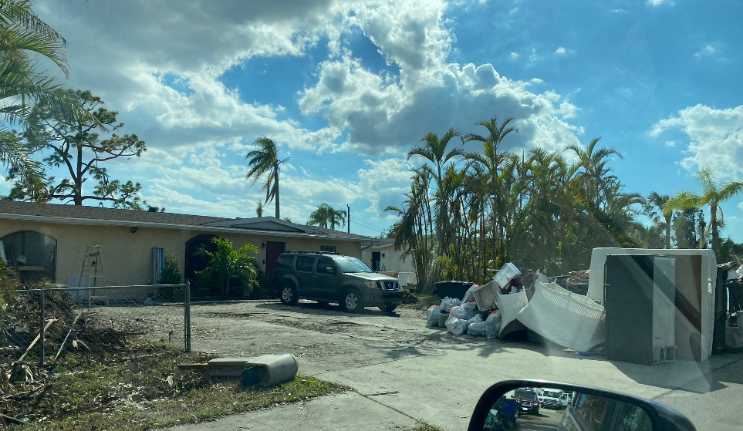
Recent Disaster Relief
2022 Hurricane Ian Relief
FODAC partnered with several agencies including FEMA disability integration specialists and Florida VOAD to assist the collaborative efforts in SW Florida.
DME equipment and medical supply donations: from FODAC inventory.
Transportation: of equipment was supplied by Team Rubicon using FODAC's 24' trailer.
Distribution: partners in the area are The Center for Independent Living Gulf Coast, Caring & Sharing Center for Independent Living, Inc, the Area Agency on Aging for Southwest Florida, and the Dr. Piper Center for Social Services, with $65,000 worth of equipment delivered to those in need.

Slide 32
Recent Disaster Relief
2022 Hurricane Fiona Relief
FODAC partnered with several agencies, including FEMA, NVOAD, PRVOAD, disability integration specialists, to assist the collaborative efforts in Puerto Rico.
DME equipment and medical supply donations: from FODAC inventory and the Tennessee AT Act program.
Transportation: of equipment was supplied by Civil Air Service and Total Quality Logistics.
Distribution: Our partners in Puerto Rico are PRATP for local distribution. A total of $50,691 worth of equipment was delivered to those in need on the island.

Slide 33
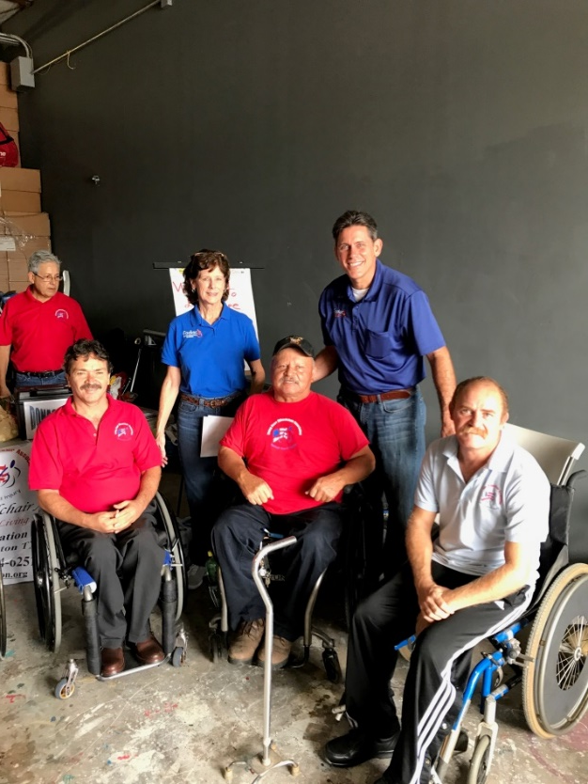
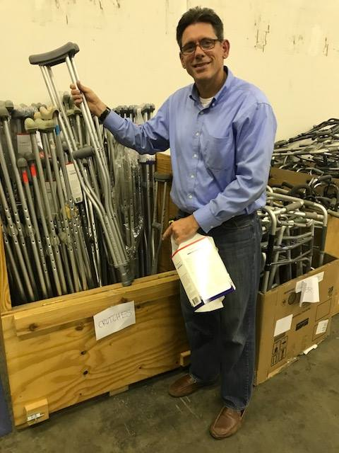

FODAC sent relief to Houston
FODAC went to Houston to help distribute HME to Harvey survivors in need. Chris Brand, Ruth Rust and Leo Phillip coordinated service and outreach for weeks.

Slide 34
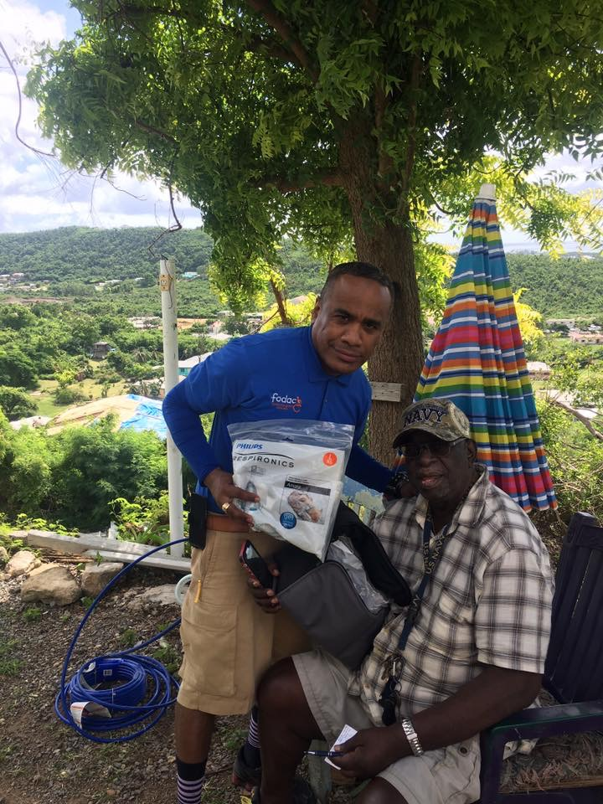
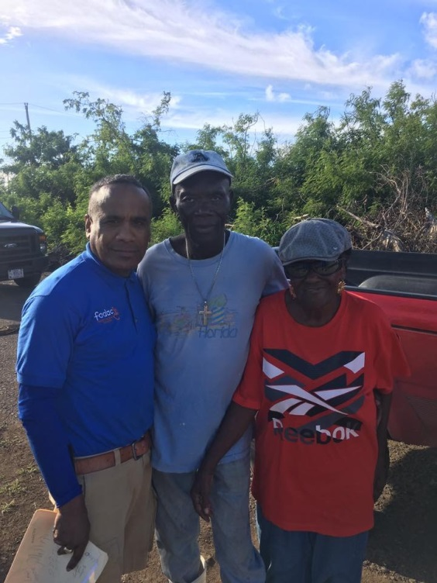
Disaster Relief
Leo Phillip and a St Croix hurricane survivor receiving vital equipment
FODAC sent over 150 pallets of HME to Puerto Rico and the Virgin Islands along with staff on the ground to help distribute.

Slide 35

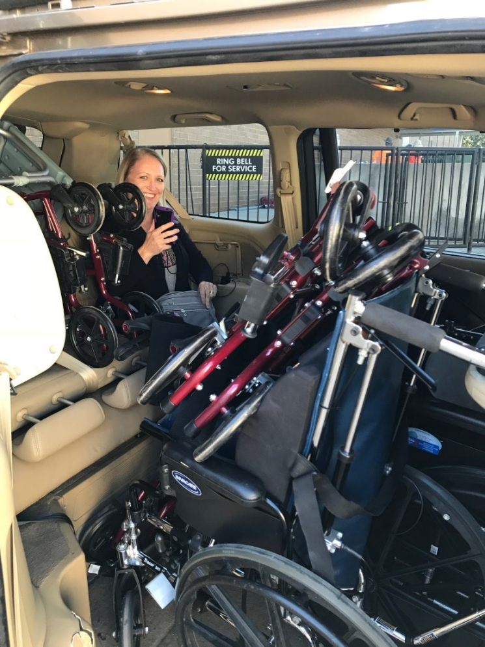
FODAC provided over 250 HME items to hurricane survivors from Maria relocated in Atlanta!
FODAC/
FEMA/
Tools for Life
Partnership

Slide 36
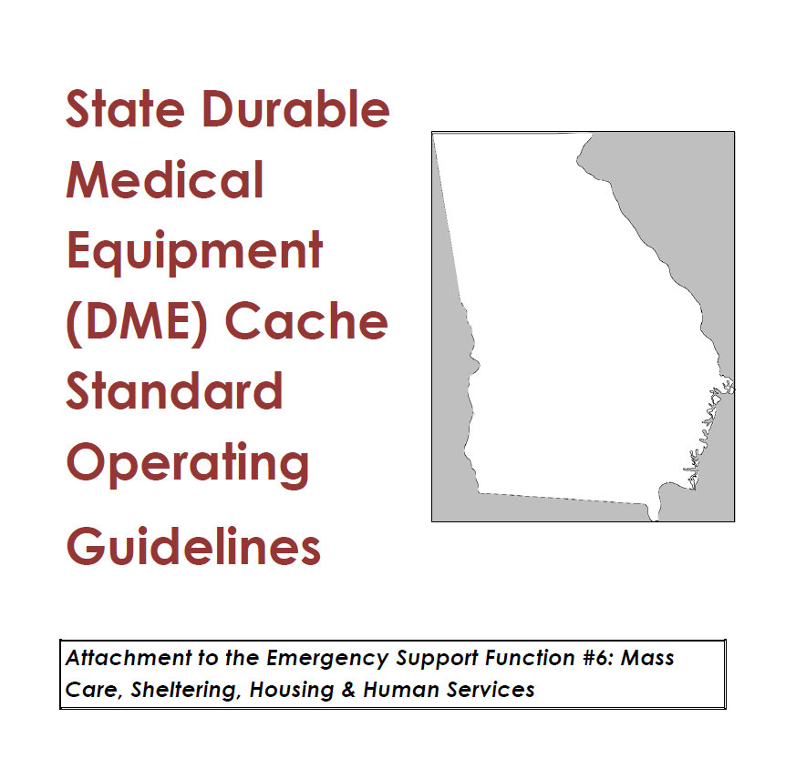
State Durable Medical Equipment Cache

Slide 37
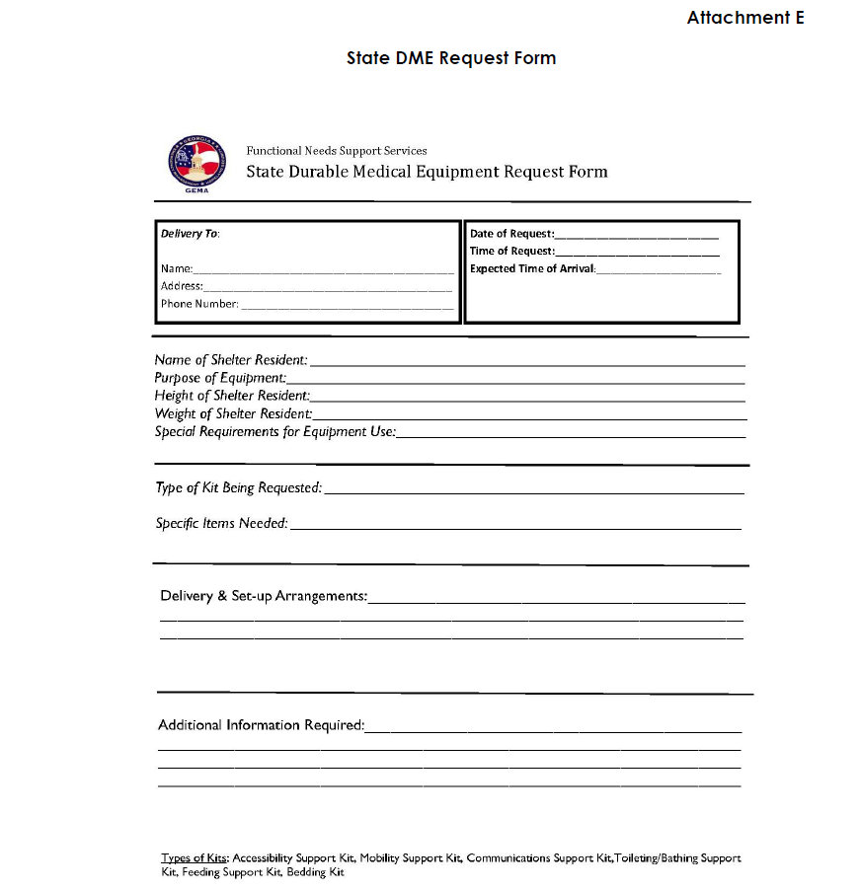
State DME Request Form

Slide 38

GEORGIA RESOURCES
GA State ADA Coordinators Office
  https://ada.georgia.gov/helpful-resources/emergency-preparedness
GA Emergency Prep Coalition for PWD and Aging
  http://web.gsfic.ga.gov/ADA/FNSS%20Toolkit.htm
Statewide Independent Living Council of GA
  https://www.silcga.org/
GA Emergency Management Agency
  https://gema.georgia.gov/plan-prepare
GA VOAD (Voluntary Agencies Active in Disaster)
  https://www.gavoad.org/
Atlanta Office of Emergency Preparedness
  https://www.atlantaga.gov/government/mayor-s-office/executive-offices/office-of-emergency-preparedness
Friends of Disabled Adults and Children
  https://www.fodac.org

Slide 39
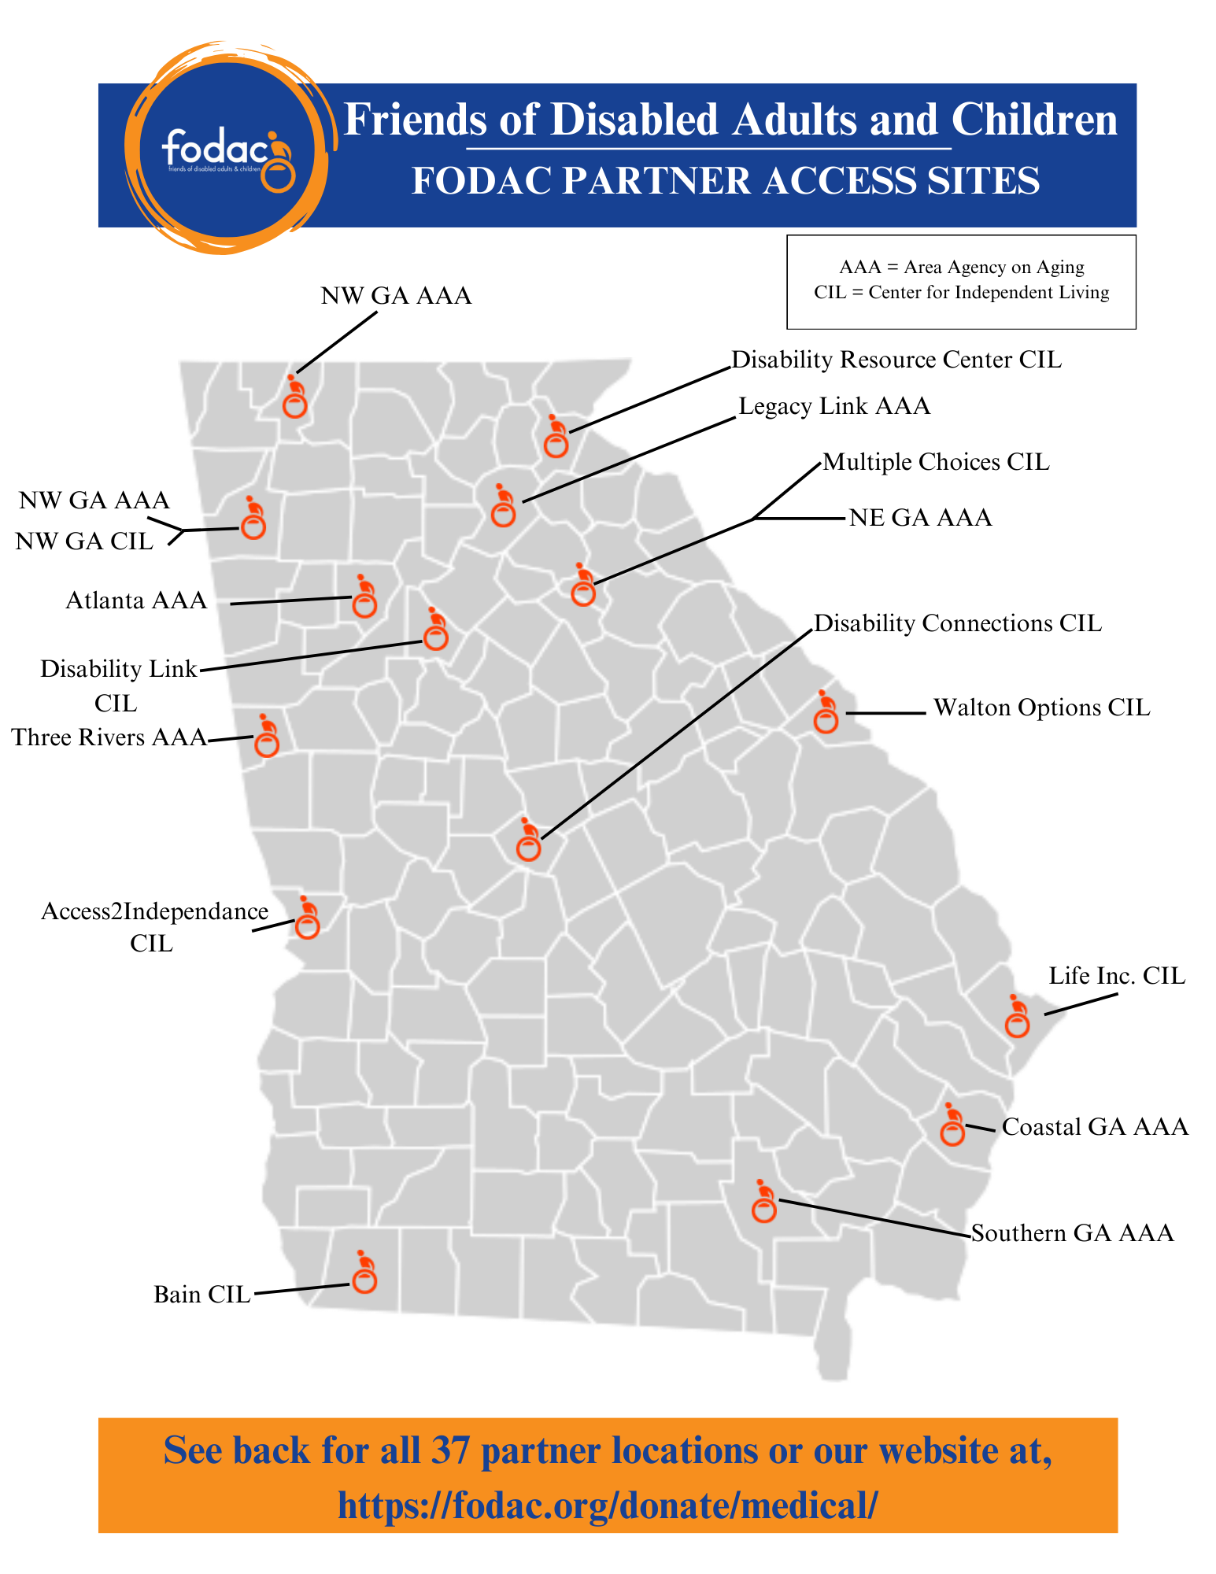
FODAC Partners Across Georgia
Notes:
Insert FEMA Val Map

Slide 40
NATIONAL RESOURCES
FEMA Office of Disability Integration and Coordination (ODIC) www.fema.gov/office-disability-integration-and-coordination/​
FEMA Voluntary Agency Liaisons (VALS)​
  www.fema.gov/voluntary-faith-based-community-based-organizations​
ADA National Network: www.adata.org/emergency-preparedness​
Association of University Centers on Disability: www.aucd.org/template/index.cfm​
AT Act Community: www.at3center.net/​
Partnership for Inclusive Disaster Strategies: www.disasterstrategies.org/​
National VOAD (Voluntary Agencies Active in Disaster)​: www.nvoad.org/​
National Disability Rights Network: www.ndrn.org/​
National Council on Independent Living: www.ncil.org/ ​

Slide 41
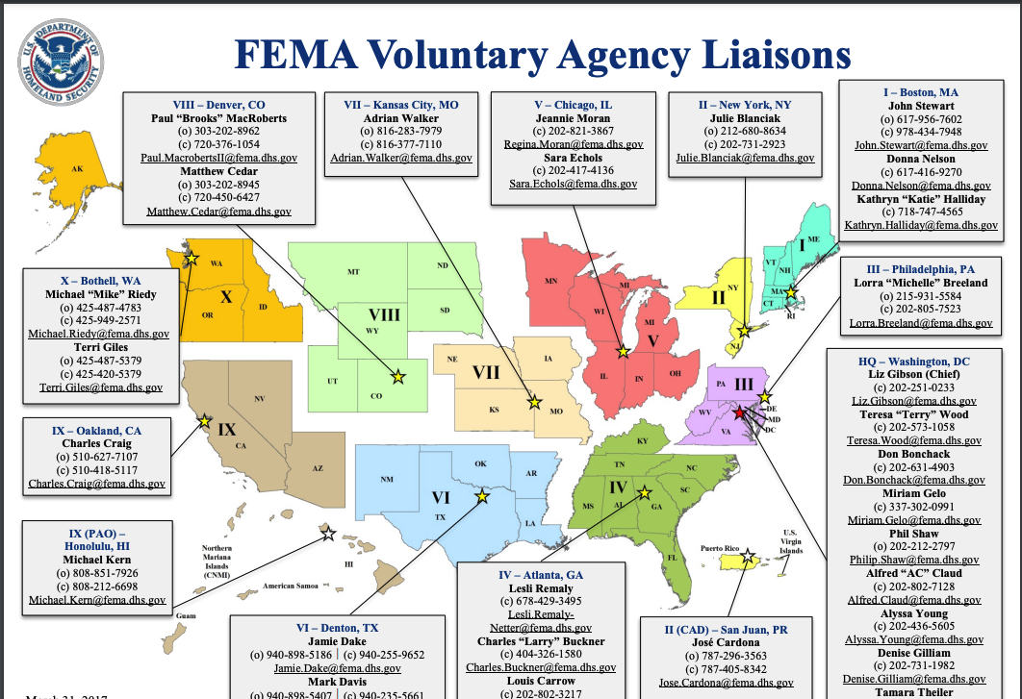
FEMA Voluntary Agency Liaisons
Notes:
GA map

Slide 42
Questions?
Chris Brand or Travis Stone
chrisbrand@fodac.org
travisstone@fodac.org
Like us on Facebook and LinkedIn
See our website for more
information:
www.fodac.org
Friends of Disabled
Adults and Children
Notes:
How?
Who ? Individuals, businesses, and agencies – drop off at our Tucker office or if 10 systems or more pick up is considered
To help defray the recycling costs

Slide 43
Q&A
Questions and Discussion

