Slide 1
How to Fund Parts B & C
Presented by Allyson Robinson
with much credit due ATAP and AT3
Notes:
Vice-President of Easter Seals Crossroads in Indianapolis

Slide 2
Reminders
To see captions, click on the CC button on the control panel.
This webinar will be recorded and can be accessed moving forward.
Please enter comments or questions in the chat. We will answer them as time permits.

Slide 3
Webinar Evaluation
You will receive a short evaluation survey for this webinar. It will be posted as a link to the chat just prior to the end of this webinar. When you receive it, please take a moment to respond.

Slide 4
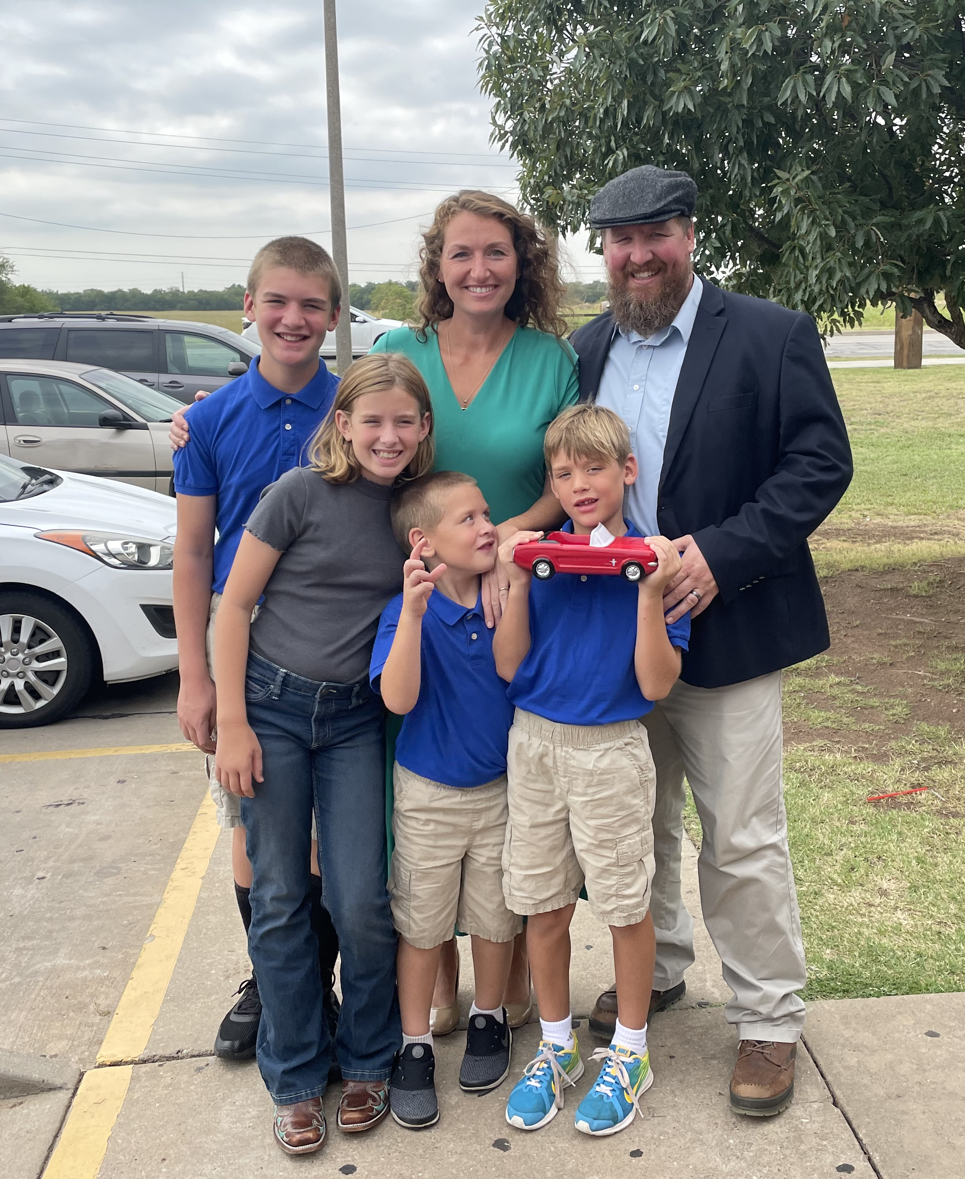
Allyson Robinson, M.A. CCC-SLP
Director of Accessibility Programs

Slide 5
Learning Objectives
Explain steps and strategies to acquire funding for assistive technology for children with disabilities.
List types of sources and eligibility determinations for funding options for children with disabilities.
Discuss specific funding options available for children with disabilities.
Notes:
Goals of this session

Slide 6
Outline
6 Steps to Acquiring Funding
10 Tips Re: Grant Writing
Grant Opportunities
Success Stories
Homework, Questions, & Contact Info

Slide 7
The first thing to remember when seeking funding for assistive technology is that funding is usually available!

Slide 8
Myths and Facts 2
Myth 2
Fact 2
Providing AT devices and services is optional under the Individuals with Disabilities Education Act (IDEA) and a Local Education Agency (LEA) does not have to provide AT devices and services if there are no funds available for the AT device and service.
IEP Teams consider AT devices and services for all children with IEPs and must provide the AT devices and services *at no cost to the child/family* if the team determines they are necessary to provide a Free and Appropriate Public Education (FAPE).
Notes:
https://www.ecfr.gov/cgi-bin/text-idx?SID=f768b2d0479dad50ca81a2fbac000e46&mc=true&node=pt34.2.300&rgn=div5#se34.2.300_1105
34 CFR 300.105

Slide 9
Best Practices in Provision of AT Devices and Services
Myths and Facts Surrounding Assistive Technology Devices and Services
U.S. Department of Education
https://www.ecfr.gov/cgi-bin/text-idx?SID=f768b2d0479dad50ca81a2fbac000e46&mc=true&node=pt34.2.300&rgn=div5#se34.2.300_1105
34 CFR 300.105

Slide 10
Steps to Acquire Funding
Define and document the need.
Identify the equipment and/or services needed.
Determine if an alternative device will meet the need.
Determine potential funding sources.
Gather all essential information to be submitted including prescriptions and other justifications.
Seek appeals as appropriate.

Slide 11
Steps 1, 2, and 3!
All these steps will be completed when an AT assessment is conducted!
We like using the SETT (Student Environments Tasks Tools) Framework from Joy Zabala and the WATI (Wisconsin Assistive Technology Initiative) forms to collect information during the process.
We substitute “Child”, “Infant”, Toddler”, etc. when using forms created for “Students”.

Slide 12
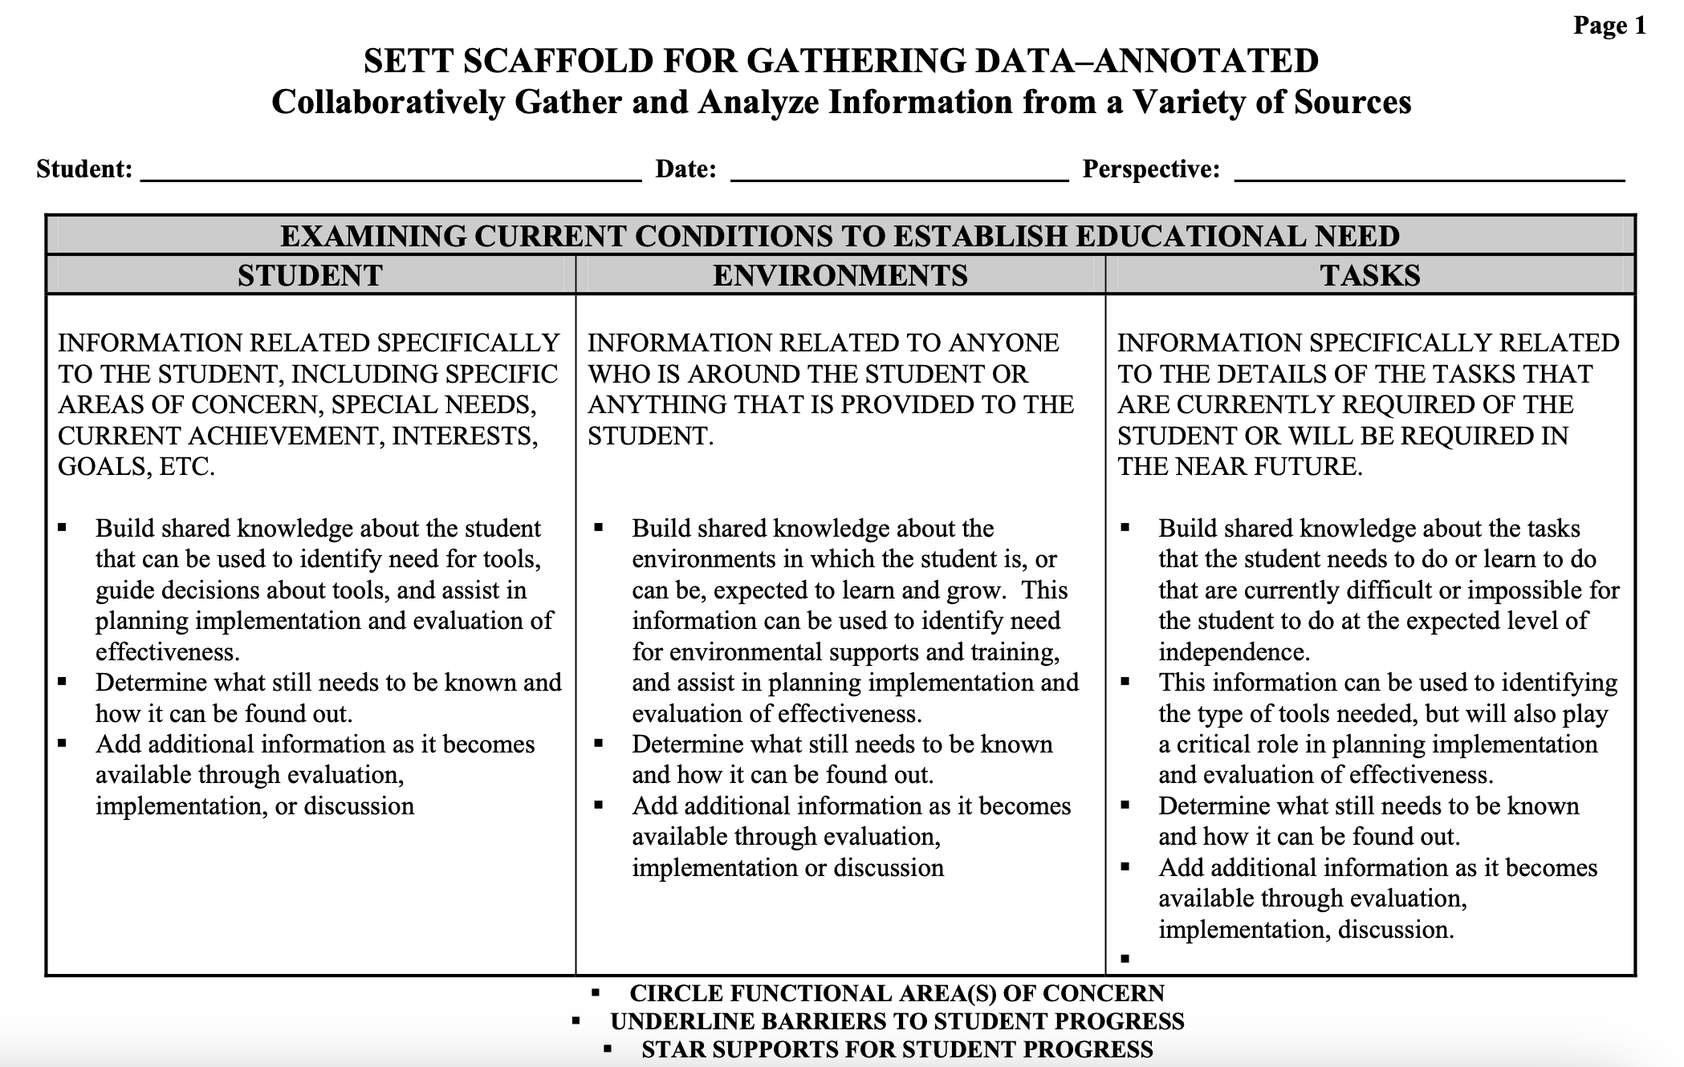
SETT Framework
joyzabala.com

Slide 13
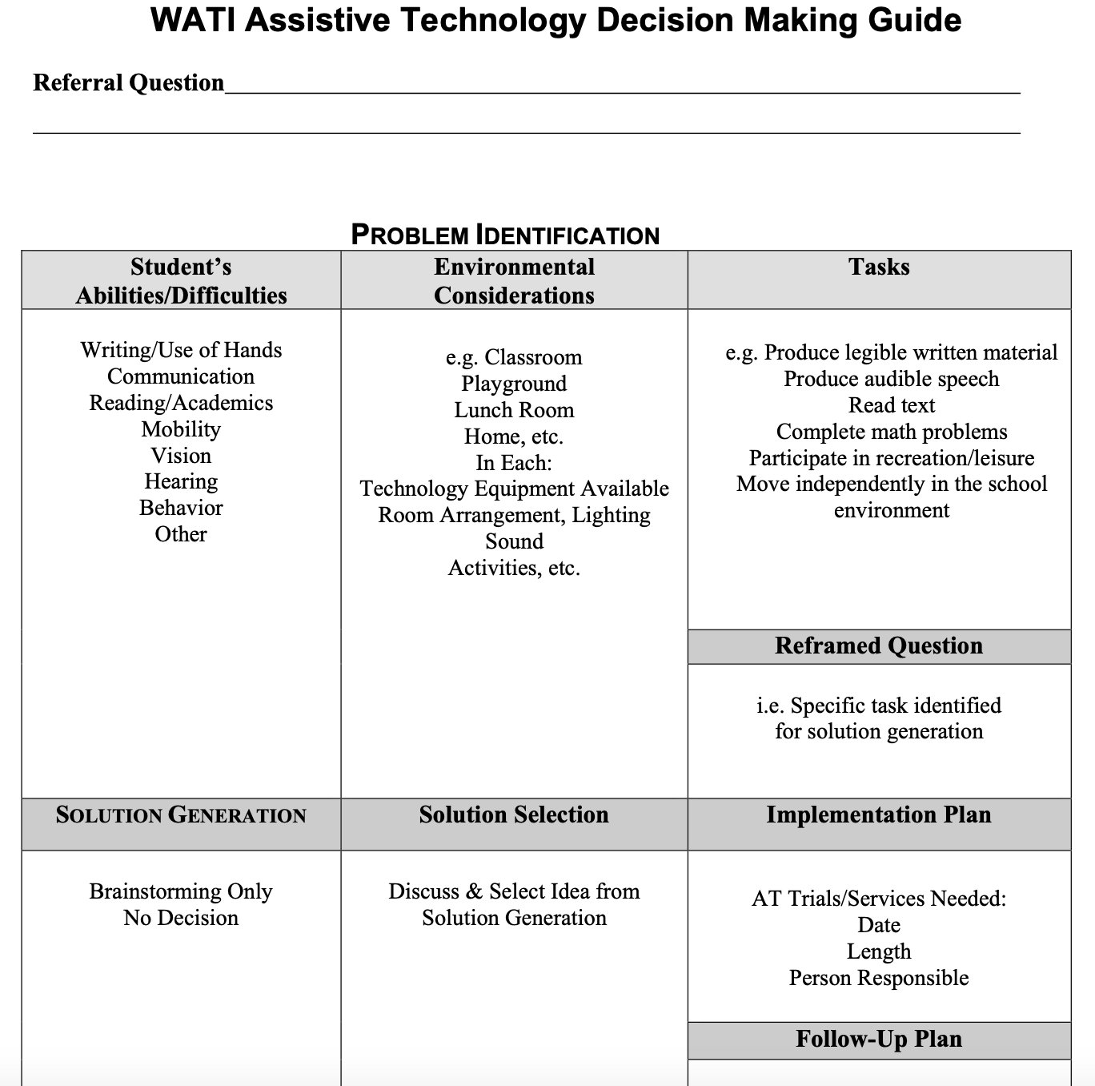
WATI Decision-Making Guide
wati.org

Slide 14
Step 4: Determine Potential Funding Sources
Does the child already have access to funding through a public source?
Are there any sources legally mandated to assist with the purchase of AT?
Does the individual/family want to personally own the AT?
Is/Can the device be used for medical purposes?
If it can be used for medical purposes, does the individual have insurance that will cover the device?
Notes:
Payor of last resort?

Slide 15
Step 4: More Questions to Consider
Is the individual working with a provider whose scope of practice it is to document the need for the device (i.e., SLP for speech communication device)?
Will more than one source be needed to cover 100% of the cost of the AT?
What is the wait time once the application/paperwork has been submitted?
Once purchased/acquired, who owns the AT?
What is the individual’s age and diagnosis(es)?

Slide 16
Discussion 1
What questions do you think of first?
What questions have you received?
Notes:
Could help us modify the training content to better meet participants’ needs
Could help us know if we’re on the right track with content

Slide 17
Two Sources of Funding
Public
  Agencies
Private
  Nonprofits
  Foundations
  Organizations
  Trusts

Slide 18
Typically start with Public sources then go to Private sources as necessary

Slide 19
Case Study 1: SETT
S – Infant / Toddler with cerebral palsy presenting with mobility and communication impairments
E – Stays at home with mom
T – Eat, sleep, play!
T – Aids for Daily Living, Communication, and Mobility

Slide 20
Case Study 1: Potential Funding Sources
Public
Private
SoonerCare / Medicaid
SoonerStart / Early Intervention Program
Ability Connection Oklahoma / an affiliate of United Cerebral Palsy
Ability Found / Nonprofit

Slide 21
Case Study 1:
Funding Communication Device
SoonerCare / Medicaid
SoonerStart / Early Intervention Program
Evaluation Report
Order/Referral/Prescription
Letter of Medical Necessity
Copy of Doctor’s Notes
Release of Liability
Copy of Insurance Card
AT Request for Use of SoonerStart / Early Intervention Program Funds
AT Order Information
Supporting / Relevant Documentation

Slide 22
Case Study 2: SETT
S – Student with developmental delays presenting with challenging behaviors and communication impairments
E – 4th grade regular and special ed classrooms
T – Working towards OK Academic Standards
T – Environmental and Communication

Slide 23
Case Study 2: Potential Funding Sources
Public
Private
Insurance
Local Education Agency
Donna Nigh Foundation
WovenLife / Easter Seals

Slide 24
Case Study 2: Funding AT for Environmental Adaptations
Local Education Agency
Donna Nigh Foundation
IEP Documentation
AT Request Form
Application

Slide 25
Case Study 3: SETT
S – High school student with autism presenting with difficulties transitioning between tasks
E – High school and work study
T – Working towards OK Academic Standards and work-readiness skills
T – Learning, Cognition, Development

Slide 26
Case Study 3: Potential Funding Sources
Public
Private
Local Education Agency
State Education Agency
ABLE Tech Financial Loan Program
Individual / Family
Grant

Slide 27
Case Study 3: Funding Learning, Cognition, Development AT
Local Education Agency
ABLE Tech Financial Loan Program
IEP Documentation
AT Implementation Form
AT Request Form
Application

Slide 28
Step 5: Gather All Essential Information
The following list contains information typically required by most funding sources:
  Age
  Disability / Medical diagnosis
  Financial status
Notes:
Age
Disability/Medical diagnosis
Prognosis
Evaluation reports, etc.
Financial status
Employment status
Level and source of income

Slide 29
Step 6: Seek appeals as appropriate.
The appeals process is an opportunity to approach the funding source and ask for a review of the initial decision.
All public or governmental agencies have an appeals process.
You have a right to request an appeal and to have your request or claim reviewed.
Notes:
Insurance – Medicaid – SoonerSelect transition peer-to-peer – changed denial to approval

Slide 30
Discussion 2
What questions do you have about this process at this point?

Slide 31
Operational Procedures
The Quality Indicators for AT (QIAT) recommend having clearly defined procedures developed and used by everyone involved in the assessment process.
qiat.org
Notes:
From helping 1 to helping all

Slide 32
10 Things Dr. Gretchen Cole-Lade Learned About Writing Grants

Slide 33
Top 10
Know your grantor
Pick your project well
Know what AT device(s) you need
Collaborate
Consumable vs non-consumable
Think big; ask big
Think small; ask small
School foundations
Follow the directions
Thank you!

Slide 34
1. Know Your Grantor
Research who their targeted grantees are and what they have funded in the past.
Schools may not want to pay to join a “Grant” website.
Nonprofit organizations may.

Slide 35
2. Pick Your Project Well
What gets funded?
Pick a Catchy Name
Literacy
Early Intervention
Inclusion
Service Learning Projects
Valentine’s for Vets
  Requested accessible art supplies with the intent to create Valentine’s for Vets (and other projects)
Notes:
Spread the Word to End the Word was removed

Slide 36
3. Know What AT Device You Need
Research online
Participate in professional development (Ex. ATiA AT Demo Days)
Participate in demonstrations of AT
Trial AT

Slide 37
4. Collaborate
Questions to ask yourself:
  Who will the grant impact?
  With whom can I collaborate?
    Other content area teachers, school or public librarians, Special Education (SPED) teachers, other schools in and out of your district
Make sure that everyone you know (and everyone who knows them) know that you are ALWAYS looking for funding for your program….
Notes:
200 blood pressure monitors

Slide 38
5. Consumable Vs. Nonconsumable
Consumables may be necessary; however, consider the need to reapply for funds on a more regular basis.
Nonconsumable items are reusable and can provide benefit for longer / for more children.
Some funding sources may not fund consumable items.
Option: GoFundMe
https://www.gofundme.com

Slide 39
6. Think Big; Ask Big
Consider asking for large amounts of AT to use on-site and assist with decision-making
Option: Christopher and Dana Reeve Foundation
https://www.christopherreeve.org

Slide 40
7. Think Small; Ask Small
Some small-dollar grants are perfect for small asks (consumables?).
Option: Limeades for Learning
https://www.donorschoose.org

Slide 41
8. School Foundations
Examples:
  Enid Public School Foundation
    Online Google Docs
  OKC Public School Foundation
    https://www.donorschoose.org
No Foundation? No Problem!
  Create one!
  Oklahoma Schools Foundation Network
    https://ofe.org

Slide 42
9. Follow the Directions!
Answer the questions.
If unsure, call or email the grantor for clarification.
Submit EARLY.

Slide 43
10. Thank you!
Especially if you received the grant.
  Send pictures of what you did with the grant!
Student made cards/signatures are the best!
Follow up if required!
And send one even if you didn’t get it.
  Consider asking for suggestions for next time.

Slide 44
Discussion 3
Any questions about these tips?

Slide 45
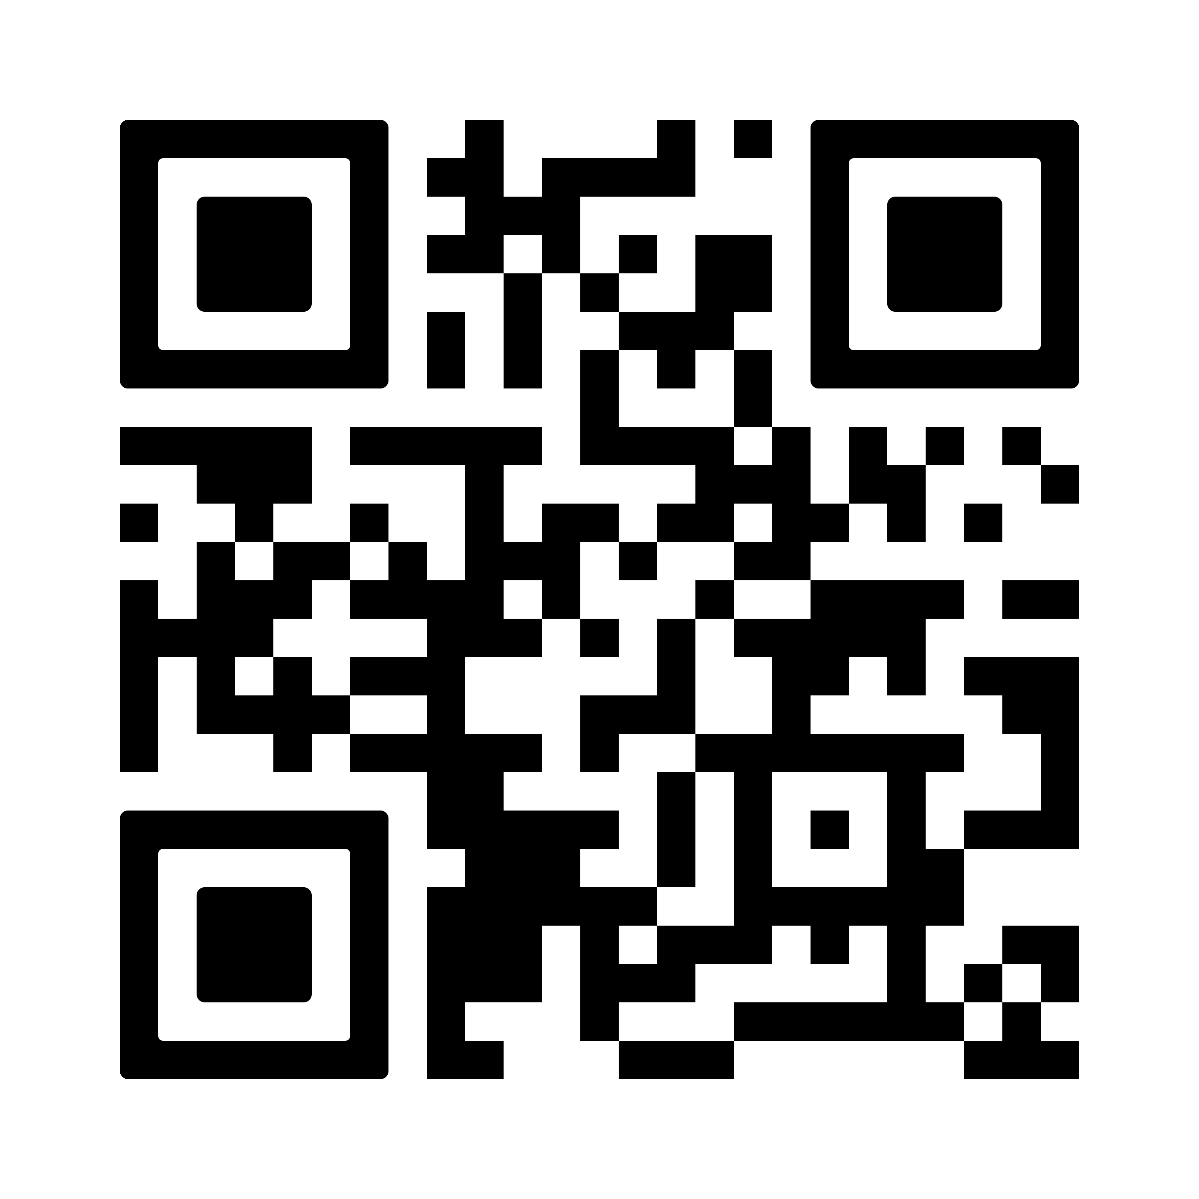
Grant Opportunities

Slide 46
Success Stories

Slide 47

Funding Vision AT – AIM Center
Student who was blind needed a more portable reading solution
Teacher of the Visually Impaired (TVI) trialed a Braille Trail Refreshable Braille Display from ABLE Tech
Acquired the Braille Trail Reader through the AIM Center at the Oklahoma Library for the Blind

Slide 48
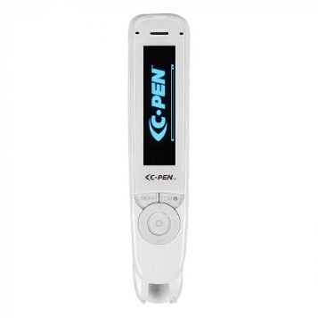
Funding Learning / Cognition /
Development AT – Public School and Parent Teacher Association (PTA)
Student with dyslexia had difficulty reading along with peers in class
Teacher trialed a C-Pen reader from ABLE Tech with multiple students
School administrator approved using IDEA funds to purchase the device for the initial student
Teacher reached out to the local PTA who funded the purchase of 10 C-Pen readers to be used throughout the school

Slide 49
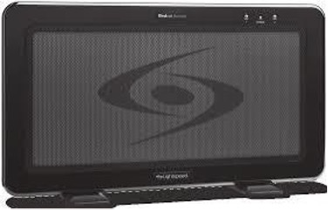
Funding Hearing AT – Annual Town Grant
Students with auditory processing difficulties, attention disorders, and overall listening difficulties in a special education classroom
Speech pathologist and special education teacher believed a classroom amplification system would benefit students
They sought information from ABLE Tech regarding the AT and vendor then wrote for an annual town grant and received 3 RedCat Amplification Systems

Slide 50
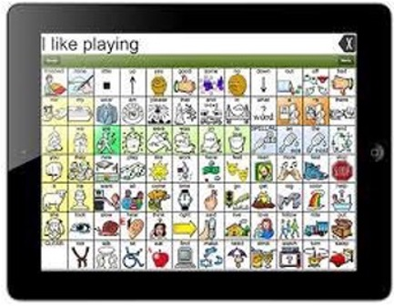
Funding Speech/Communication AT –
Oklahoma Health Care Authority (OHCA)
5-year-old little girl, has Microcephaly, ADHD, a speech/language impairment, minimal natural speech
Speech pathologist (SLP) trialed 3 different Augmentative and Alternative Communication (AAC) language systems
SLP submitted required documents to ABLE Tech to process and submit, and OHCA paid for an iPad, LAMP WFL app, protective case with strap, screen protector and keyguard
Notes:
3 minutes
Evaluation Report
Video
Order/Referral/Prescription
Letter of Medical Necessity
Copy of Dr. Notes
Release of Liability
Copy of Insurance Card

Slide 51
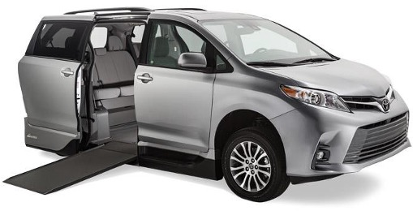
Funding Modified Vehicle AT –
OkAT / ABLE Tech’s Financial Loan Program
Student with mobility impairments uses a wheelchair, relies on grandparents for transport/travel who are unable to lift him in and out of a vehicle
Went to a modified vehicle vendor and received a demonstration then learned about OkAT / ABLE Tech’s Financial Loan Program
Grandparents applied and qualified for a low interest loan with easy repayment terms and were able to purchase the vehicle

Slide 52
Homework, Questions, & Contact Info

Slide 53
Homework due next week!
One or more funding sources specific to your state
Questions you have about funding processes and sources
Funding resources you have found/created

Slide 54
Questions?

Slide 55
Contact Information
Allyson Robinson
allyson.robinson@okstate.edu
405-744-4608
Notes:
Thanks so much for joining us today! We hope you learned a few things today.
Please reach out to us if you have questions or need assistance in the future. (Read contact information.)​
​
Thanks and enjoy your day.​

Slide 56
ATAP and AT3
The Association of Assistive Technology Act Programs (ATAP) facilitates the coordination of state and territory assistive technology (AT) programs nationally to maintain and enhance a strong, effective, and efficient national network of state and territory wide AT programs. As part of this mission and effort, ATAP also provides technical assistance and support to its members through the Assistive Technology and Training Technical Assistance (AT3) Center.
The AT3 Center provides training and technical assistance for all AT Act Section 4 State and Territory AT Programs to support quality implementation of state-level and state-leadership activities.
ATAP and AT3 both support national assistive technology internet sites that make general AT information available to the public and other stakeholders. To learn more visit us at
https://ataporg.org
https://at3center.net

