Slide 1

www.LaurieGuest.com

Slide 2
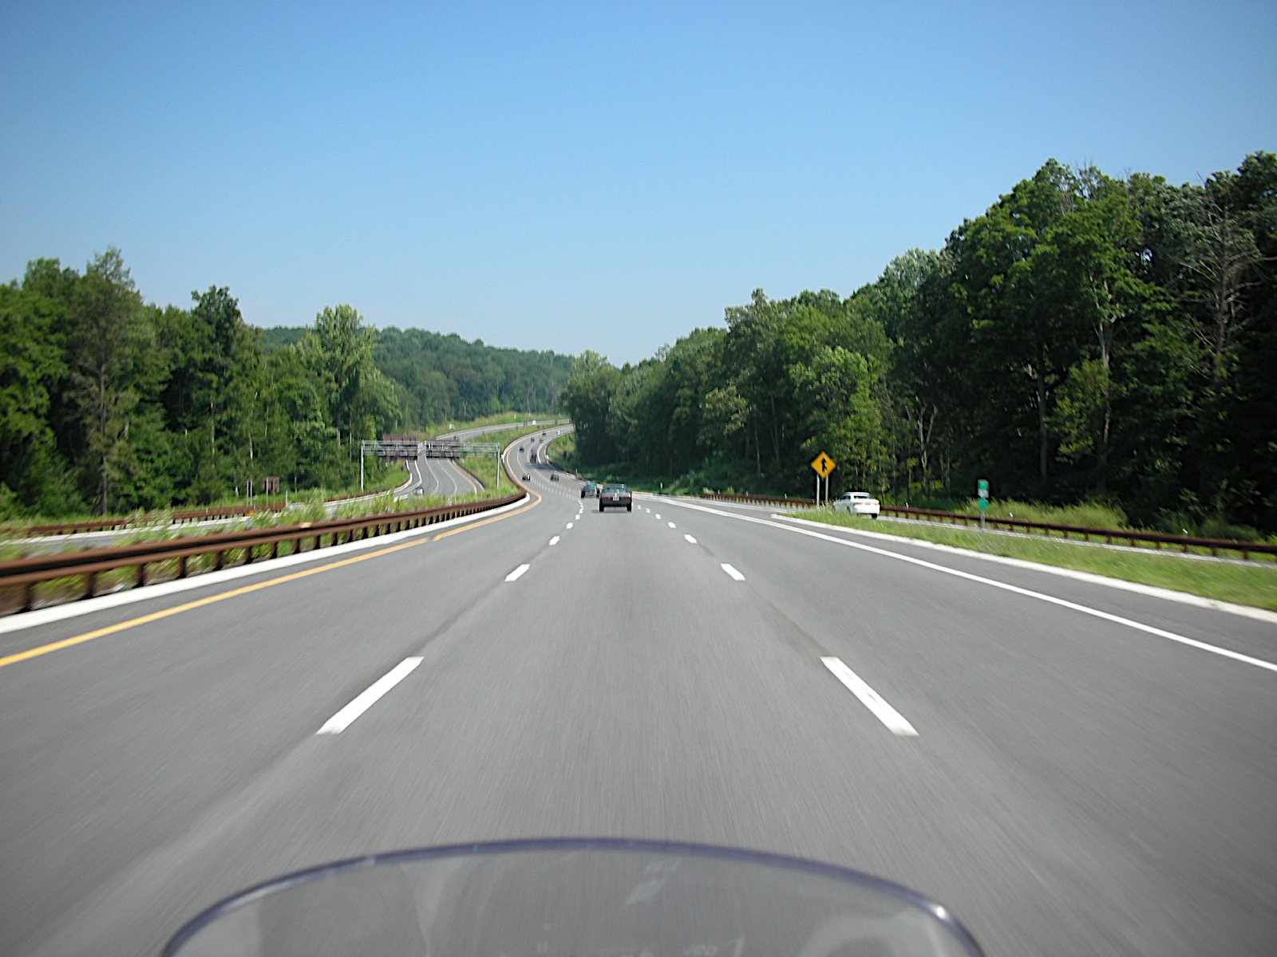
Road

Slide 3
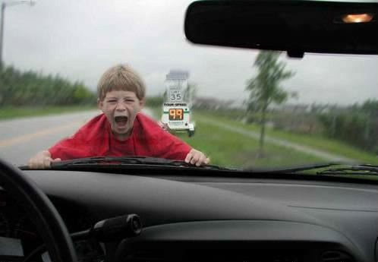
Speeding

Slide 4
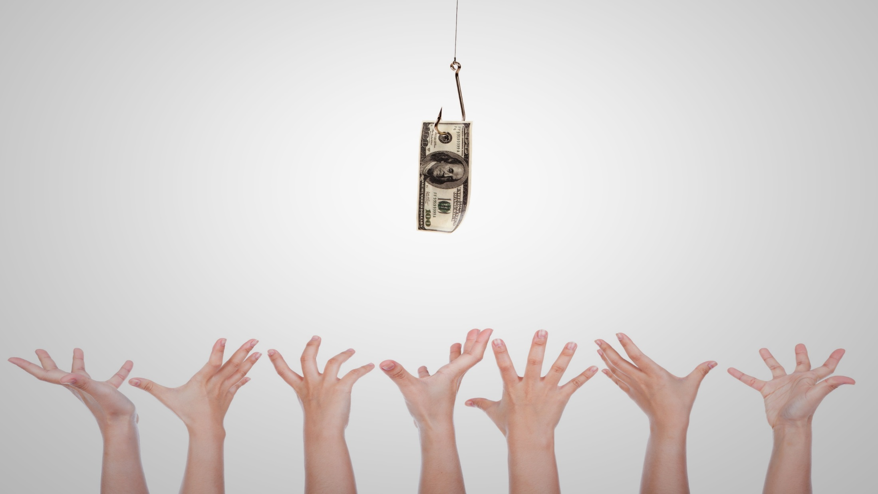

Pick Me

Slide 5

Take in the surroundings

Slide 6
Forsake the Mistake

Slide 7
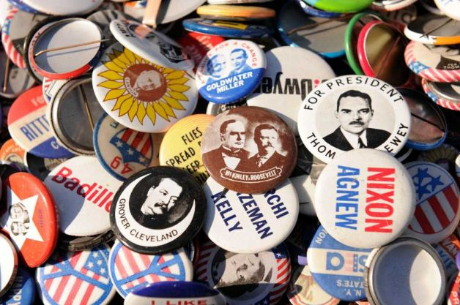
Presidential Button Collection

Slide 8

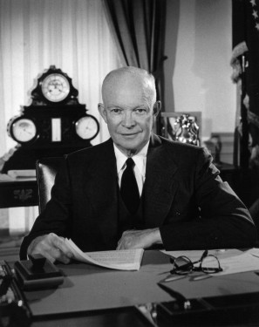
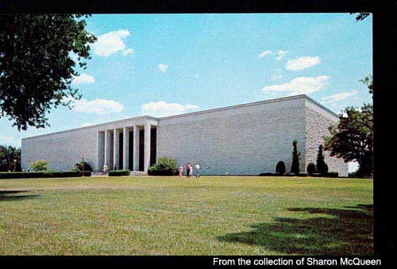
Dwight D. Eisenhower

Slide 9
How do I deal with those who make mistakes?
Make faults seem easy to correct
Share your own mistake stories
Be a leader others can bring mistakes to

Slide 10
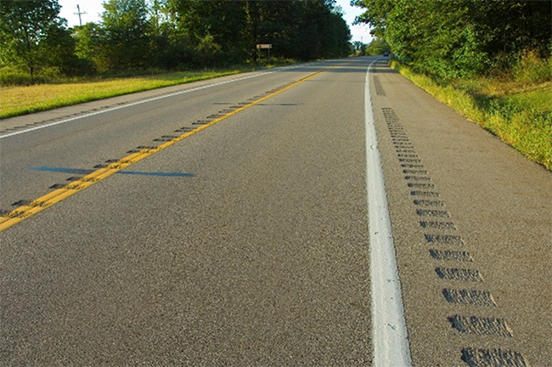
Winding Road

Slide 11


Double Shot of I.B.H.T.
One Action to Become
Indispensable at Work

Slide 12
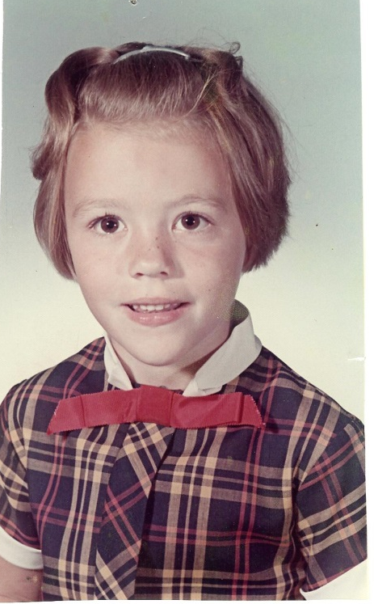

Beginnings

Slide 13

I’d be happy to…

Slide 14
Cup of G.U.T.S.Y to Go

Slide 15
G U T S Y rapport
G enuine interest in other people
U se a person’s name
Talk less, listen more
S mile (know your body language)
Y es, Yes (get others saying it)

Slide 16
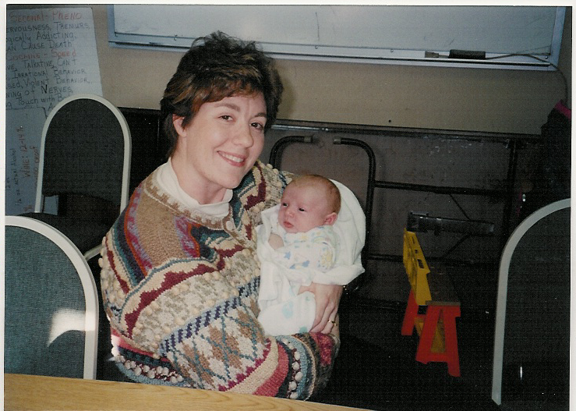
Evan Thomas Guest

Slide 17
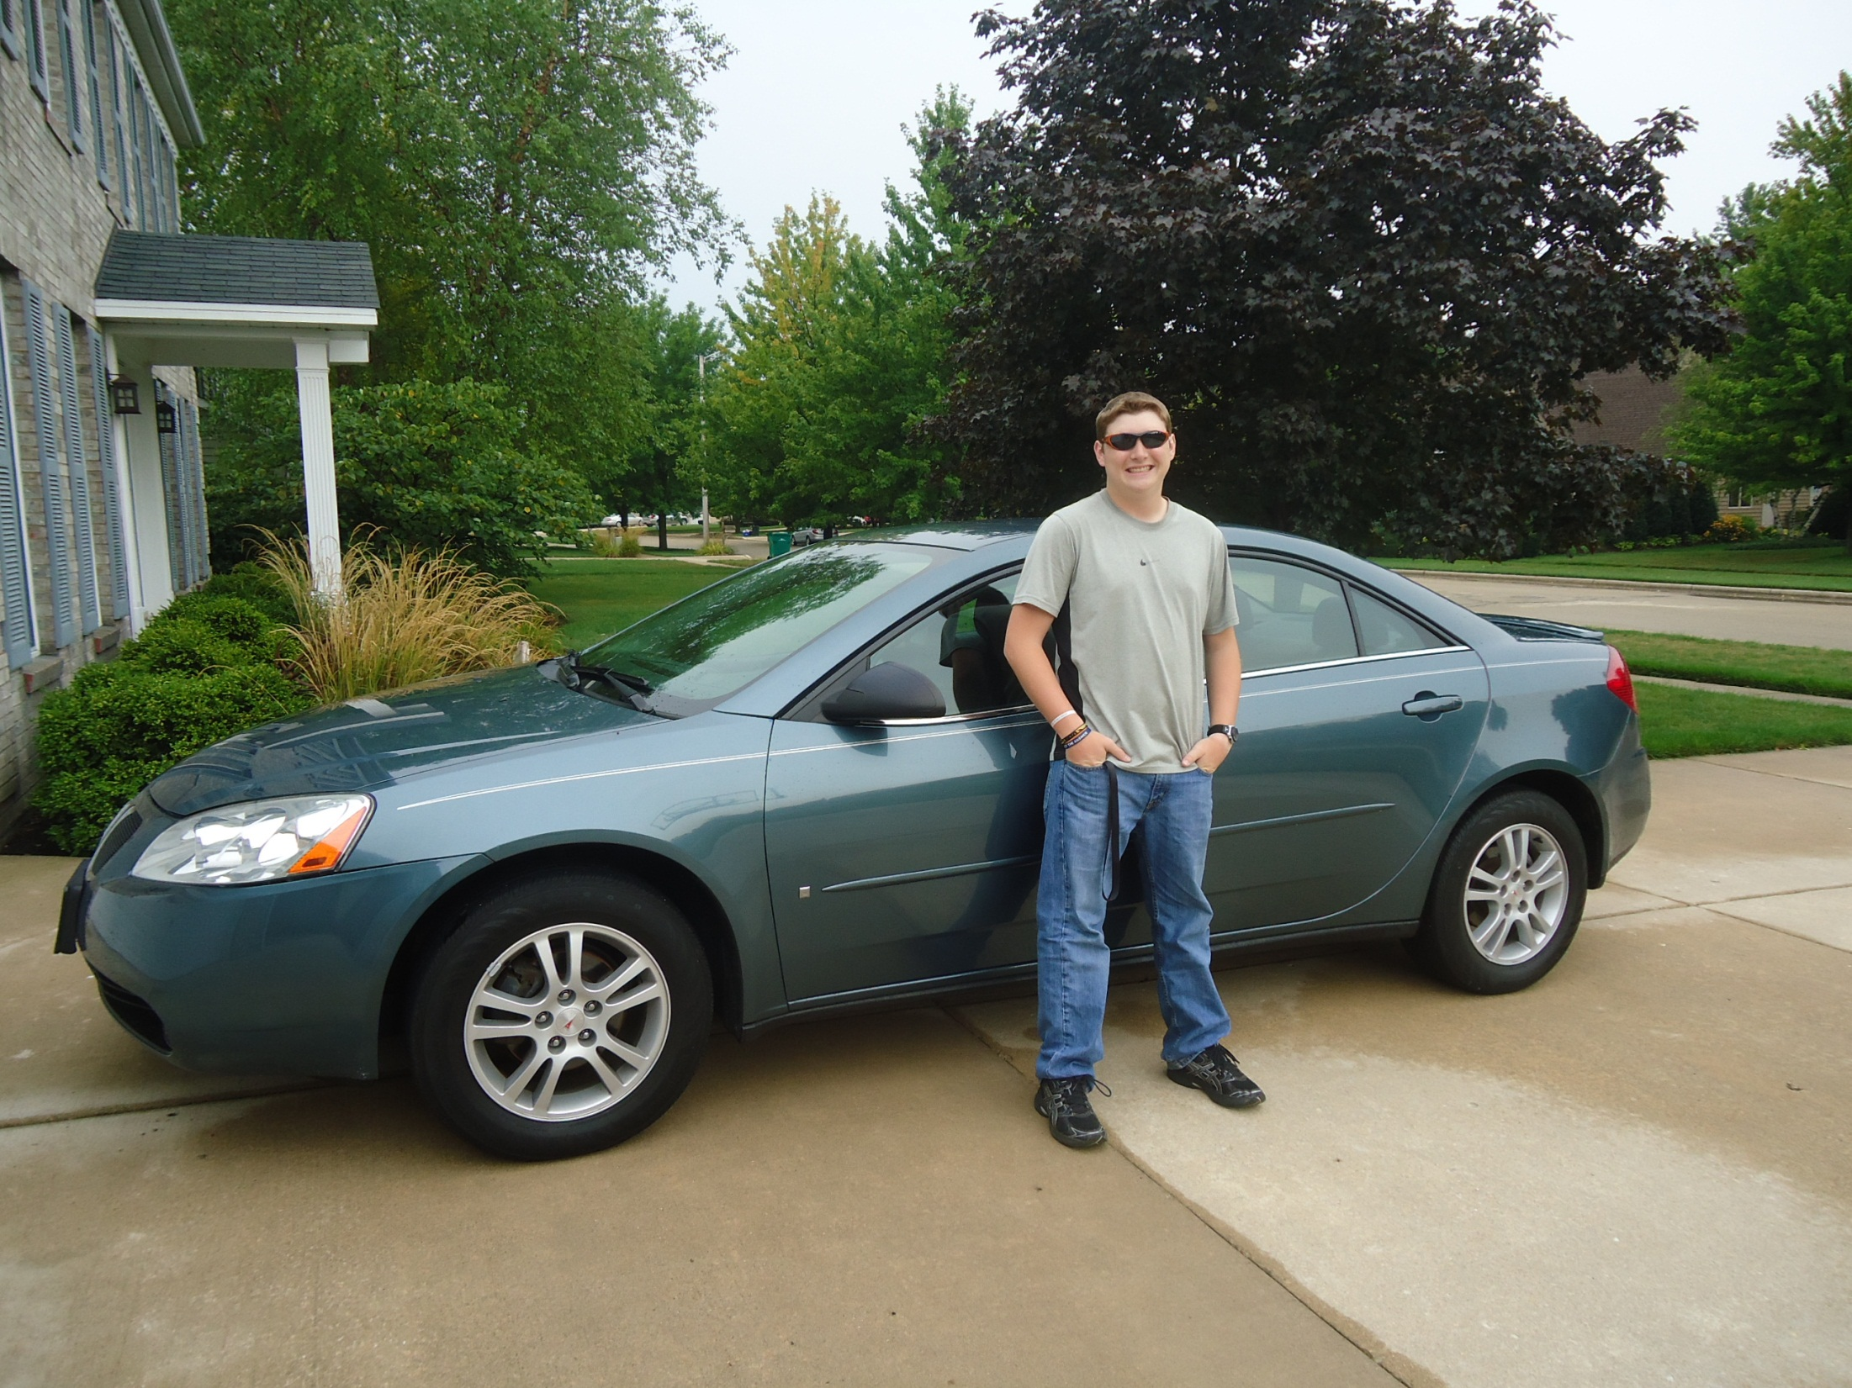
Evan’s Passion

Slide 18
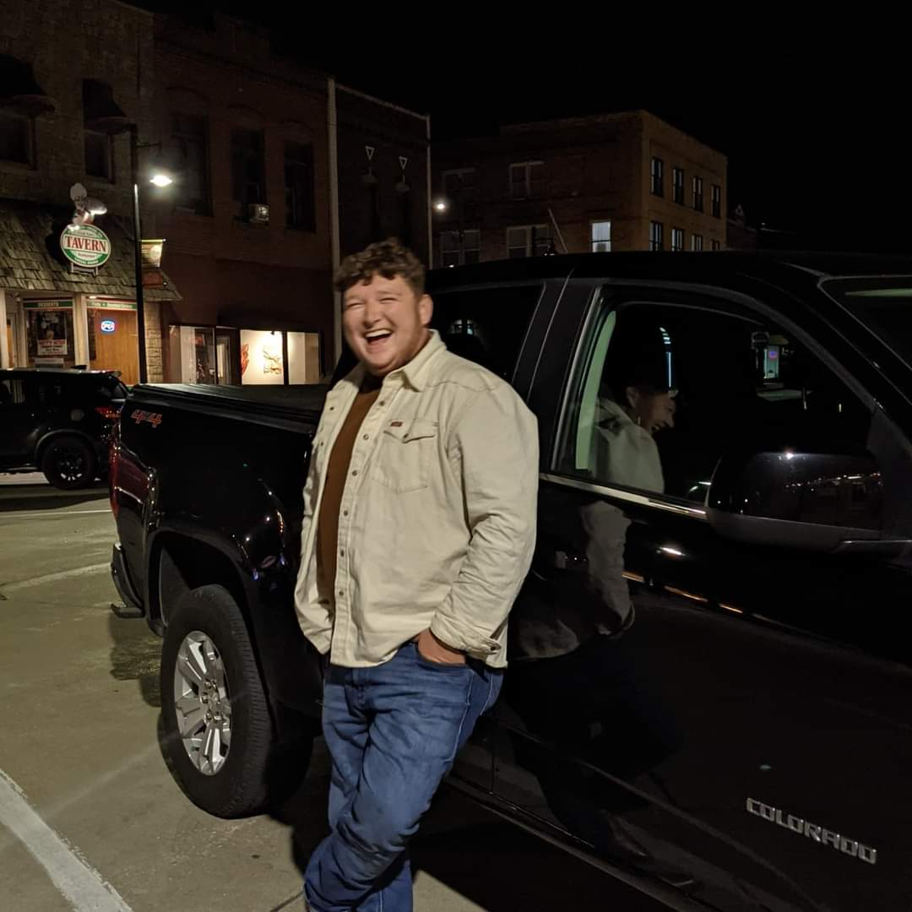
Evan Grown Up

Slide 19
Reset your L.O.S.
Life Operating System

Slide 20

Retreat

Slide 21

What does happy look like?

Slide 22

As a thank you from ATAP…

Slide 23
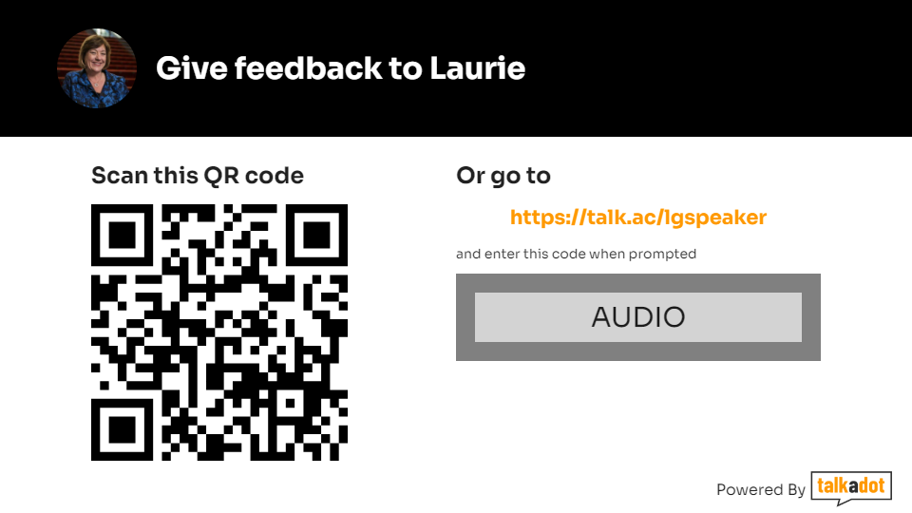
Give Feedback

Slide 24
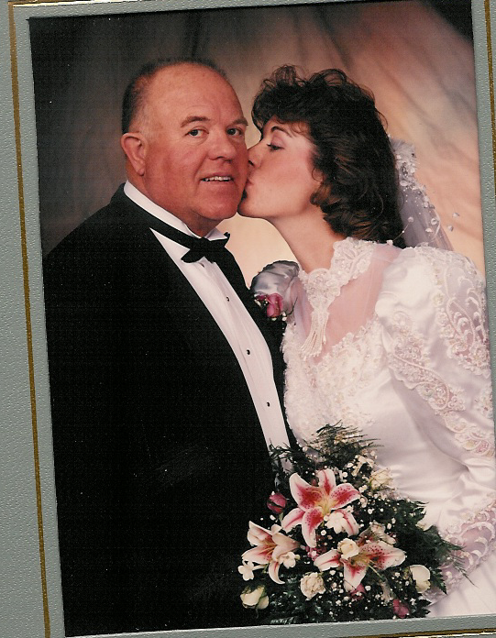
Ask For What You Want

Slide 25

Beauty in Simple

Slide 26
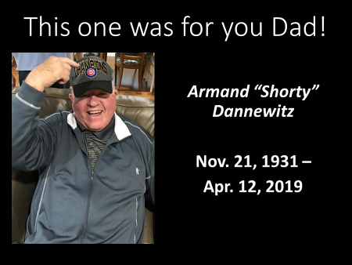
This one was for you Dad!

Slide 27
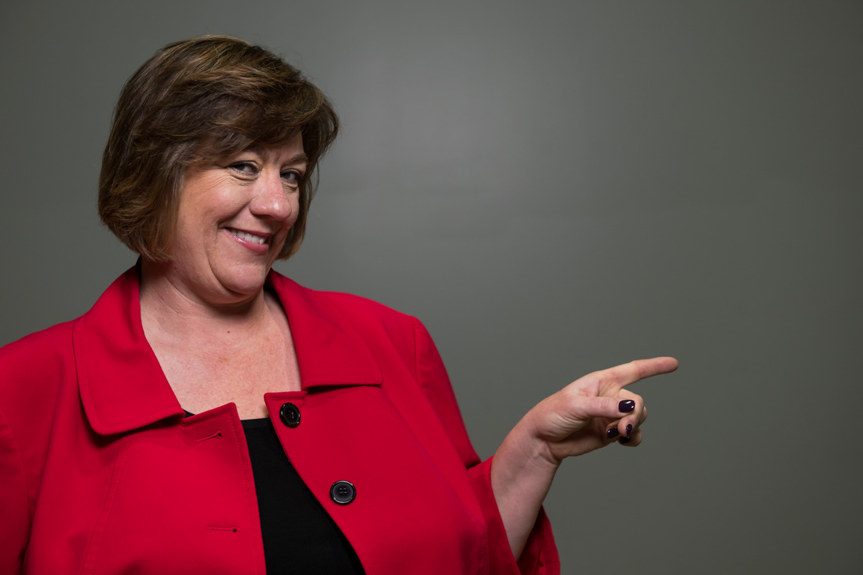

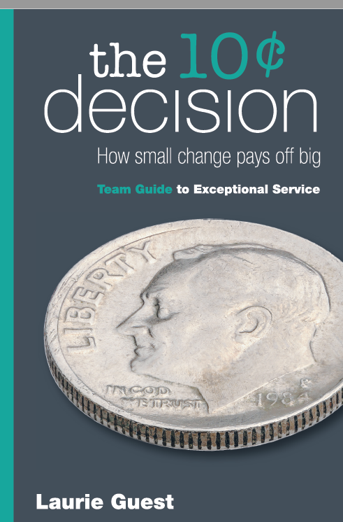


Available today at the book table

Slide 28

A gift for you…Audio book too!
Unlockthegoodies.com
Vault called:
Wrapped in Stillness Audio Book
Password: GIFT4you!

