Slide 1
Understanding Key Laws that Govern the Provision of A.T. Devices and Services in Birth-3 and K-12 Settings
Angela Standridge, M.A., CCC-SLP, ATP, Director
Texas Technology Access Program astandridge@austin.utexas.edu
Shannon Paige, M.A., CCC-SLP, Education Project Manager
Texas Technology Access Program, shannon.paige@austin.utexas.edu

Slide 2
Reminders
To see captions, click on the CC button on the control panel.
This webinar will be recorded and can be accessed moving forward.
Please enter comments or questions in the chat. We will answer them as time permits.

Slide 3
Association of Assistive Technology Act Programs (ATAP)
ATAP facilitates the coordination of state and territory assistive technology (A.T.) programs nationally to maintain and enhance a strong, effective, and efficient national network of state and territory wide A.T. programs. As part of this mission and effort, ATAP also provides technical assistance and support to its members through the Assistive Technology and Training and Technical Assistance (AT3) Center.
The AT3 Center provides technical assistance and training for all A.T. Act section 4 state and territory A.T. programs to support quality implementation of state-level and state-leadership activities.
ATAP and AT3 both support national assistive technology internet sites that make general A.T. information available to the public and other stakeholders.
To learn more visit us at: Home - ATAP (ataporg.org)
and at: Accessibility Training, Technical Assistance, A.T. Programs - AT3 Center

Slide 4
Webinar Evaluation and Pre-Test:
You will receive a short evaluation survey for this webinar. It will be posted as a link to the chat just prior to the end of this webinar. When you receive it, please take a moment to respond.
Complete a pre-test for the series– Helps us capture baseline information for those participating in the cohort.

Slide 5
Objectives
Identify key federal legislation, regulations, and policies that govern the provision of A.T. in Birth-3 and K-12.
Define A.T. devices and services required to ensure a Free and Appropriate Education (FAPE).
Develop a plan to identify state level legislation, regulations, and policies/procedures that govern the provision A.T. in Birth-3 and K-12.
Identify one area of need or growth for the State A.T. program to connect with and support the provision of A.T. devices and services, in the Birth-3 and K-12 settings.

Slide 6

It's Your Turn
If you could create one law to support students in your school, what would it be and why?
In one phrase or sentence, write your law in the chat.

Slide 7

Assumptions
Laws are broad by design, and over time they are fine-tuned by case law
The ultimate test for success: In the actual classroom, does the student have the appropriate tools (A.T.?) and know how to use them, are they engaged and accessing the curriculum with measurable, ambitious and challenging IEP objectives, and is the student is LEARNING?
A.T. is provided to support access to a Free and Appropriate Education (FAPE) to create citizens that participate and contribute to society in a way that is meaningful
The presenters are not lawyers. This a broad overview. Specific legal questions should be addressed by the SEA/LEA legal teams.

Slide 8
Statues and Regulations govern the provision of A.T. (1)
The Elementary and Secondary Education Acts of 1965
The Education for All Handicapped Children Act (EHA)/ Public Law 94-142 (1975)
Rehabilition Act of 1973: 504, 508 (amended 1998)
Americans with Disabilities Act (ADA; technology added in1990)
Individuals with Disabilities Education Act (IDEA, last reauthorized 2004)
21st Century Communications and Video Accessibility Act (CVAA, 2010)

Slide 9
Statues and Regulations govern the provision of A.T. (2)
Every Student Succeeds Act (ESSA, 2015)
21st Century Assistive Technology Act (A.T. Act, original 1998, reauthorized: 2004, 2022)
Other federal guidance, policy, and resources
  Recent US Department of Education Guidance Letter on A.T. to SEAs and the National Educational Technology Plan
State constitution, education laws, statutes, regulations, policies, and guidelines

Slide 10

The Elementary and Secondary Education Acts of 1965
Strengthened the program for the educationally deprived children in low-income areas
Provided additional school library resources, textbooks and other instructional materials
Financed supplementary educational centers and service
Broadened areas of cooperative research
Strengthened State Departments of Education

Slide 11

The Education of All Handicapped Children Act, Public Law 94-142 (1975)
All handicapped children within specified age ranges are guaranteed a Free and Appropriate Public Education (FAPE)
Educational agencies are required to identify and evaluate handicapped children and offer special education services at no cost to the parents

Slide 12

Rehabilitation Act: 504 and 508, Americans with Disabilities Act

Slide 13

Rehabilitation Act: Section 504 (Civil Rights law)
Prohibits discrimination against any qualified individual with a disability in a program receiving federal financial assistance
Title II prohibits discrimination on the basis of disability by state and local governments
Refers to "special education and related aids and services" and "supplementary aids and services"
Technical assistance and enforcement of Section 504 is provided through the Office for Civil Rights (OCR)
OCR guidance also addresses transition and post-secondary setting expectations
Affects students, employees, and the public

Slide 14
Rehabilitation Act: Section 508
(1998 amendment, rules constantly updated, 1)
Requires any entity that receives federal funding to ensure electronic and information technology is accessible to employees and members of the public
Does not pose an "undue burden" on the agency/entity
Includes employees, students, parents, caregivers, advocates, the public

Slide 15
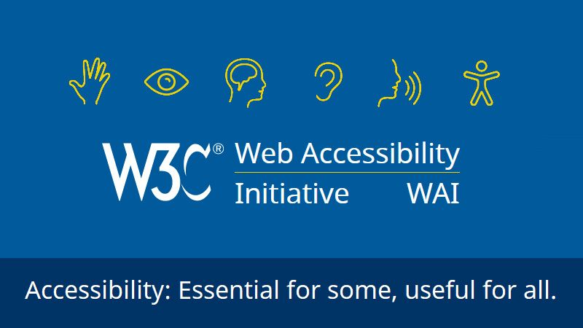
Rehabilitation Act: Section 508 (1998 amendment, rules constantly updated, 2)
Does not apply to private industry (currently)
More information:
  Federal Communicaitons Commission (FCC)- governance
  General Services Administration (GSA)- implementation, procurement, how to
  Access Board- technical assistance, training, develop standards, garner public comment

Slide 16

Americans with Disabilities Act (ADA 1)
Protects all individuals with disabilities from discrimination by public entities and guarantees equal opportunity for those individuals to access public programs and facilities
Defines and addresses the provision of "auxiliary aids and services" to ensure effective communication

Slide 17
Americans with Disabilities Act (ADA 2)
Children with disabilities who attend public schools, a public program, are protected by the ADA
Employers, state and local governments, businesses that are open to the public, commercial facilities, transportation providers, and telecommunication companies all have to follow the requirements of the ADA

Slide 18
It's Your Turn
In the chat, share an example of how the Rehabilition Act 504/508, or the ADA that either worked well, or did not work well?

Slide 19


Individuals with Disabilities Education Act '04

Slide 20
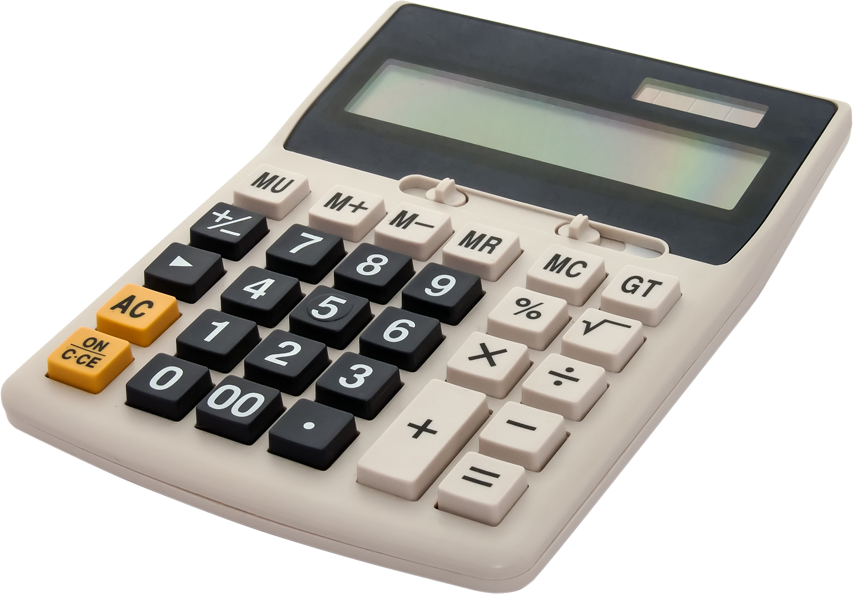

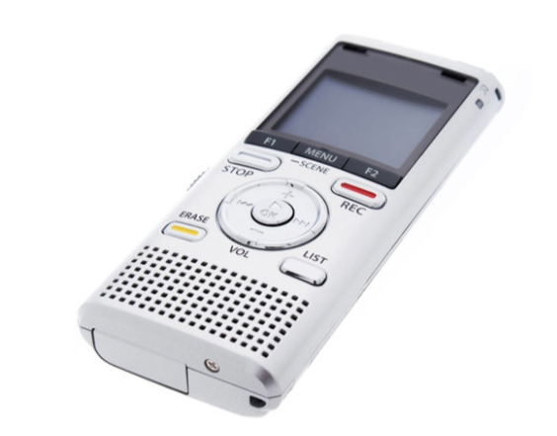

IDEA '04
Defines assistive technology
Defines services related to assistive technology
Mandates consideration of assistive technology
Requires the school district to provide the eligible student with free and appropriate public education (FAPE)
A.T.- Part A General Provisions, Part B school age Special Education for ages 3-22, Part C Infants and Toddlers to age 2, Part D National Activities

Slide 21



IDEA '04: Definitions of A.T. Devices and Services
Device - "any item, piece of equipment or product system, whether acquired commercially off the shelf, modified or customized, that is used to increase, maintain, or improve the functional capabilities of children with disabilities."
"any Service that directly assists a child with a disability in the selection, acquisition, or use of an assistive technology device."

Slide 22

IDEA '04 and A.T.
A.T. must be considered at EVERY IEP meeting
A.T. evaluations must be provided if required
A.T. devices and services must be provided if required in the IEP as determined by the IEP committee

Slide 23

IDEA '04: The A.T. Consideration Process
Part of the big umbrella of Special Education/504 provision
  Referral
  Evaluation (or data collection/review)
  Implementation and Evalution of Effectiveness

Slide 24

IDEA '04: FAPE
Free Appropriate Public Education (FAPE) special education and related services that-
  Have been provided at public expense, under public supervision and direction, and without charge;
  Meet the standards of the State Educational Agency;
  Include an appropriate preschool, elementary school, or secondary school education in the State involved; and
  Are provided in conformity with the individualized education program (IEP) required

Slide 25

IDEA Case Law
Board of Education of the Hendrick Hudson Center School District v. Rowley (1982)
  Has the school district complied with procedures
  Is Individual Education Plan (IEP) reasonably calculated to benefit the student
Endrew F. v. Douglas County School District (2017)
  IEP must be "reasonably calculated to enable the child to make progress appropriate in light of the child's circumstances"

Slide 26

IDEA Case Law: Four Factor Test (2018)
The IEP is individualized on the basis of the student’s current assessment and information from teachers and parents
It is carried out in the least restrictive environment
It is implemented in a coordinated and collaborative manner by key stakeholders
It results in positive academic and nonacademic benefits

Slide 27

IDEA '04: Documenting A.T. in the IEP
A.T. is needed
A.T. is not needed
More information is needed (i.e. additional evaluation, diagnostic evaluation, data collection/review, extended trials, etc.)

Slide 28

Individuals with Disabilities Education Act (IDEA) '04
Provision of A.T. - one of 3 options
  As a related service,
  As supplemental aids and services,
  As part of special ed
Acquistion of A.T. - must be "timely"

Slide 29
IDEA '04: Where do you put A.T. in the IEP?
LEA Discretion (unless SEA dictates)
At least one place in the IEP, however redundancy can be good practice
  A.T. "Section" of the IEP (thoughts on IEP software)
  Modifications page
  Minutes/Notes
  Present Levels of Academic Achievement and Functional Performance (PLAAFP) statements
Can the people that need the information on A.T. devices and services find it, and apply it?

Slide 30
Every Student Succeeds Act (ESSA)
High Quality Preschool
High Academic Standards
Path to College and Careers
2015 Update of No Child Left Behind

Slide 31
Every Student Succeeds Act (ESSA)
Outlines the federal government’s role in public education and emphasizes the inclusion of technology in the states’ educational planning and investments
Technology is recognized as a key element to personalize learning and support students with disabilities during daily instruction and on assessments
Improve the academic achievement and digital literacy of all students
The statute does not alter the requirements of IDEA that the IEP Committee make an individualized determination of a student’s need for A.T.

Slide 32
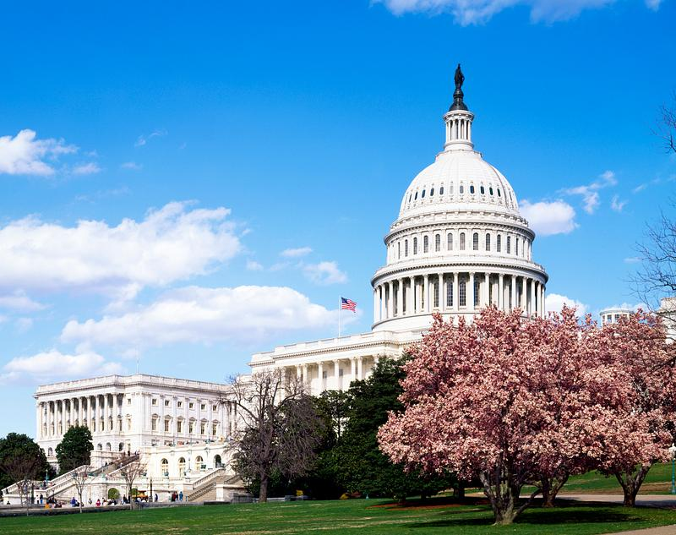
The 21st Century A.T. Act
Reauthorized December 2022!

Slide 33
The A.T. Act Overview-1988, 2004, 2022
State Level Activities
  Device Demonstration, Device Lending, State Financing, Device Reuse
State Leadership Activities
  Education (Training), Technical Assistance, Public Awareness, Information and Assistance
Section 4 Funding- 50 states, 4 territories, DC and Puerto Rico via the formula grant, plus possible other leveraged funding
Serve all individuals of any age and with any type of disability, functional limitation, or chronic health condition

Slide 34
21st Century A.T. Act Highlights (1)
Updated definitions, language/terminology, and references
Grant administration moved from DoE to HHS/ACL
Added and expanded existing language concerning housing and transportation for people with disabilities
More inclusive and diverse definition of underserved populations
Expanded expectations of Advisory Council participation (includes an SEA representative)

Slide 35
21st Century A.T. Act Highlights (2)
Further defined development and implementation of the State A.T. Plan
Identified collaboration expectations with STATE AGENCIES including SEAs, Vocational Rehabilition, and Medicaid
Clarified equipment disposition to support Reuse
Changed aspects of A.T. Program data collection and reporting
Added collaboration with Projects of National Significance
Added administrative updates

Slide 36
New DoE Guidance Letter for SEAs
Dear Colleague Letter on the Provision of Assistive Technology Devices and Services for Children with Disabilities under the Individuals with Disabilities Education Act (January 2024)
Myths and Facts Surrounding Assistive Technology Devices and Services accompanies the Guidance Letter
The guidance links to the 2024 National Education Technology Plan which now specifically includes A.T. terminology and accessibility language

Slide 37
Dear Colleague Letter-Guidance
A coordinated effort between the The Office of Educational Technology and the Office of Special Education Programs (OSEP) to provide clarification in support of children with disabilities who need assistive technology (A.T.) devices and services
Includes infants, toddlers, children, and youth with disabilities as required in both IDEA Parts B and C

Slide 38
A.T. Myths and Facts-Guidance
Increases understanding of the provision of A.T. devices and services under IDEA ‘04
Dispels common misconceptions regarding A.T.
Provides examples of the use of A.T. devices and services for children with disabilties
Highlights different requirements under Parts B and C of IDEA ‘04

Slide 39
National Education Technology Plan
(Guidance 1)
Improve how students use technology
Expand educator professional learning
Gain equitable access to educational technology (connectivity, devices, digital content, accessibility, digital health/safety/citizenship)

Slide 40
National Education Technology Plan
(Guidance 2)
2024 NAEP- MUCH deeper dive into Accessibility/A.T.
  Highlights OK ABLE Tech as a partnership example!
  Preschool supports
  Procurement (SEA, LEA, building level)
  IEP Team responsibilities
  Definitions, examples, detailed role expectations (EdTech Directors for example)
  Physical learning spaces (at school and home)
  UDL/CITES/Statewide support for accessing AEM
  "Partner with State A.T. Act Programs, which provide free A.T. loans for learners with disabilities before purchasing. For more on A.T., see the A.T. section below."

Slide 41



Moving forward...

Slide 42
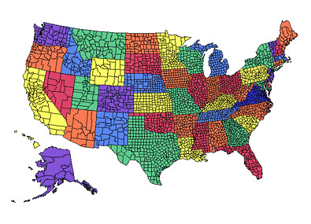
Your State, Counties, and Municipalities
State constitution and statues, education laws, rules, education and administrative codes
  Policies, procedures, and updates
  Guidance documents
  "To Whom It May Concern" or "To the Administrator Addressed" memoranda
  Subscribe to SEA SPED listserv
Texas Example
This Photo by Unknown author is licensed under CC BY.

Slide 43
Now What?
Does the SEA have A.T. Guidelines and Procedures?
Do LEAs have A.T. Guidelines and Procedures?
Do SEAs and LEAS have audit processes in place to periodically review A.T. Guidelines and Procedures?
Do SEAs have A.T. knowledgeable staff?
Are LEA staff, caregivers, and students trained on how to use the required A.T. to support FAPE?
Is A.T. provided in a timely manner and it is in the hands of students in all relevant settings (including non-academic and the home)

Slide 44

Research, policy, and practice don't always play nice in the sandbox
Research tells us what it should look like
Policy/law tells us how to make that happen
Practice is what actually happens

Slide 45
It's Your Turn
For the Coaching Session...
Email Shannon and Angela at least 1 idea, thought, or concern about:
Legal issues in your state to support the provision of A.T. devices and services in the Birth-3 and K-12 settings; and
How your A.T. Program and SEA might address that idea, thought, or concern

Slide 46
Resources in Formbee
PowerPoint Slidedeck
Annotated list of AT case law pertaining to education
Guidance Letter on Myths and Facts Surrounding Assistive Technology Devices
Myths and Facts Surrounding Assistive Technology Devices
National Education Technology Plan

Slide 47

Conclusion
Contact Information:
  Angela Standridge, astandridge@austin.utexas.edu, 512-232-0752
  Shannon Paige, shannon.paige@austin.utexas.edu, 512-232-9387
Questions?

